Slide 1
Fractions
ID1050– Quantitative & Qualitative Reasoning

Slide 2
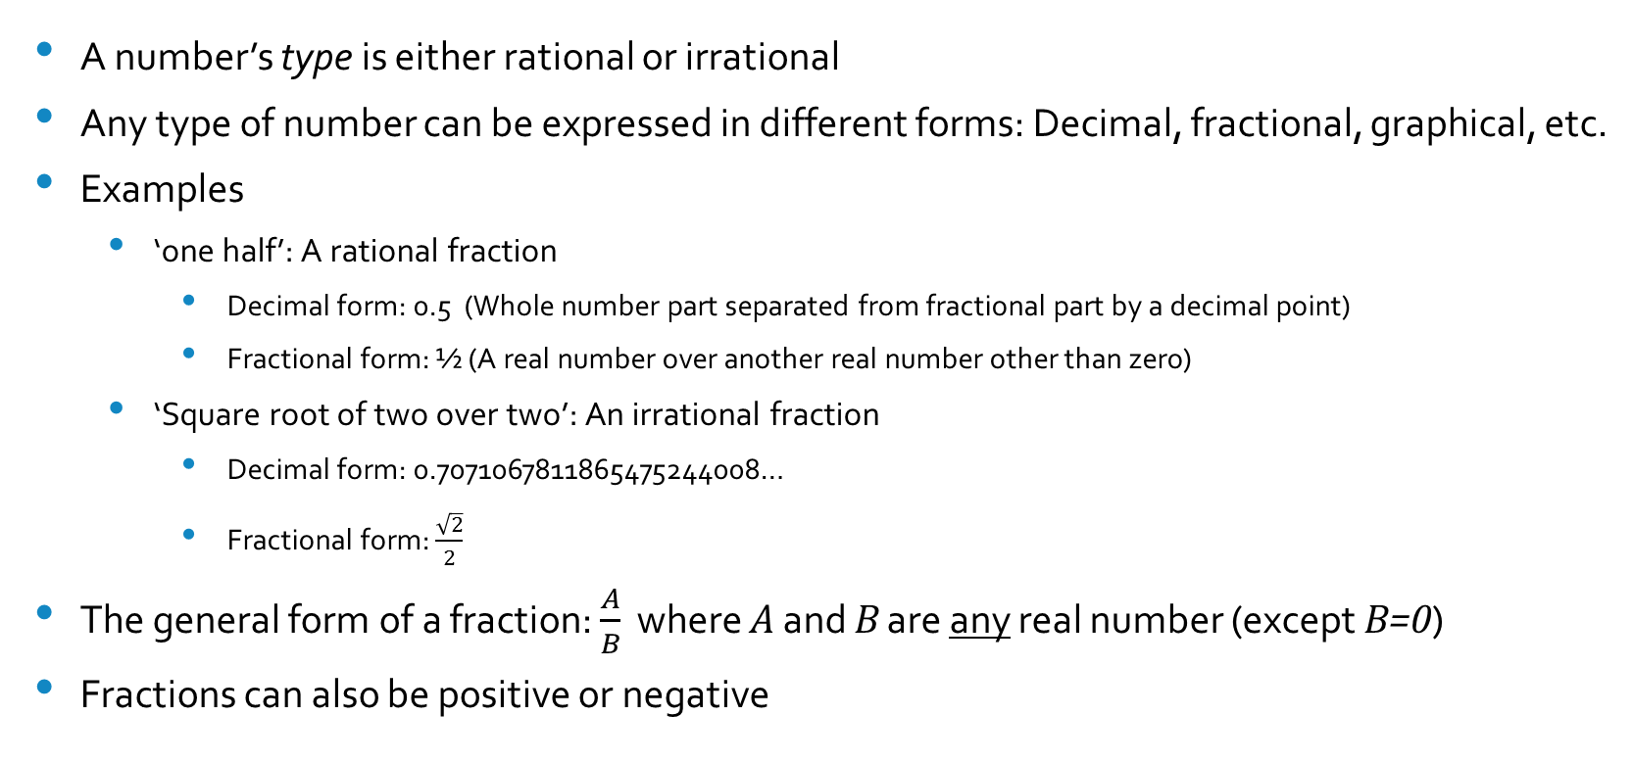
Fractional Form vs. Rational/Irrational Types
A number’s type is either rational or irrational
Any type of number can be expressed in different forms: Decimal, fractional, graphical, etc.
Examples
  ‘one half’: A rational fraction
    Decimal form: 0.5 (Whole number part separated from fractional part by a decimal point)
    Fractional form: ½ (A real number over another real number other than zero)
  ‘Square root of two over two’: An irrational fraction
    Decimal form: 0.7071067811865475244008…
    Fractional form: $\frac{\sqrt{2}}{2}$
The general form of a fraction: $\frac{A}{B}$ where A and B are any real number (except B=0)
Fractions can also be positive or negative

Slide 3
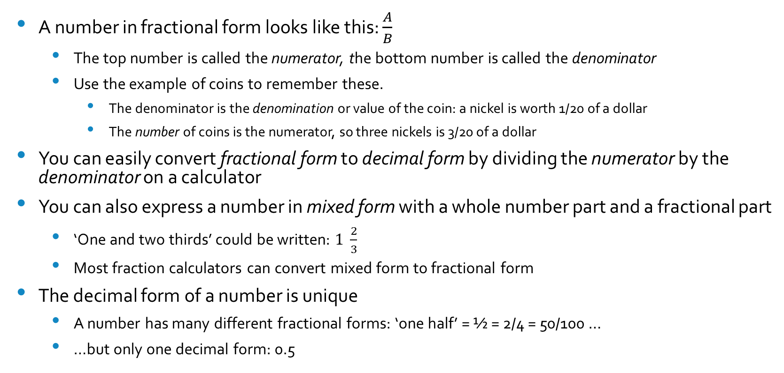
Fractional Form
A number in fractional form looks like this: $\frac{A}{B}$
  The top number is called the numerator, the bottom number is called the denominator
  Use the example of coins to remember these.
    The denominator is the denomination or value of the coin: a nickel is worth 1/20 of a dollar
    The number of coins is the numerator, so three nickels is 3/20 of a dollar
You can easily convert fractional form to decimal form by dividing the numerator by the denominator on a calculator
You can also express a number in mixed form with a whole number part and a fractional part
  ‘One and two thirds’ could be written: $1 \frac{2}{3}$
  Most fraction calculators can convert mixed form to fractional form
The decimal form of a number is unique
  A number has many different fractional forms: ‘one half’ = ½ = 2/4 = 50/100 …
  …but only one decimal form: 0.5

Slide 4
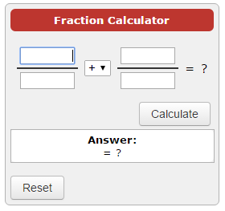
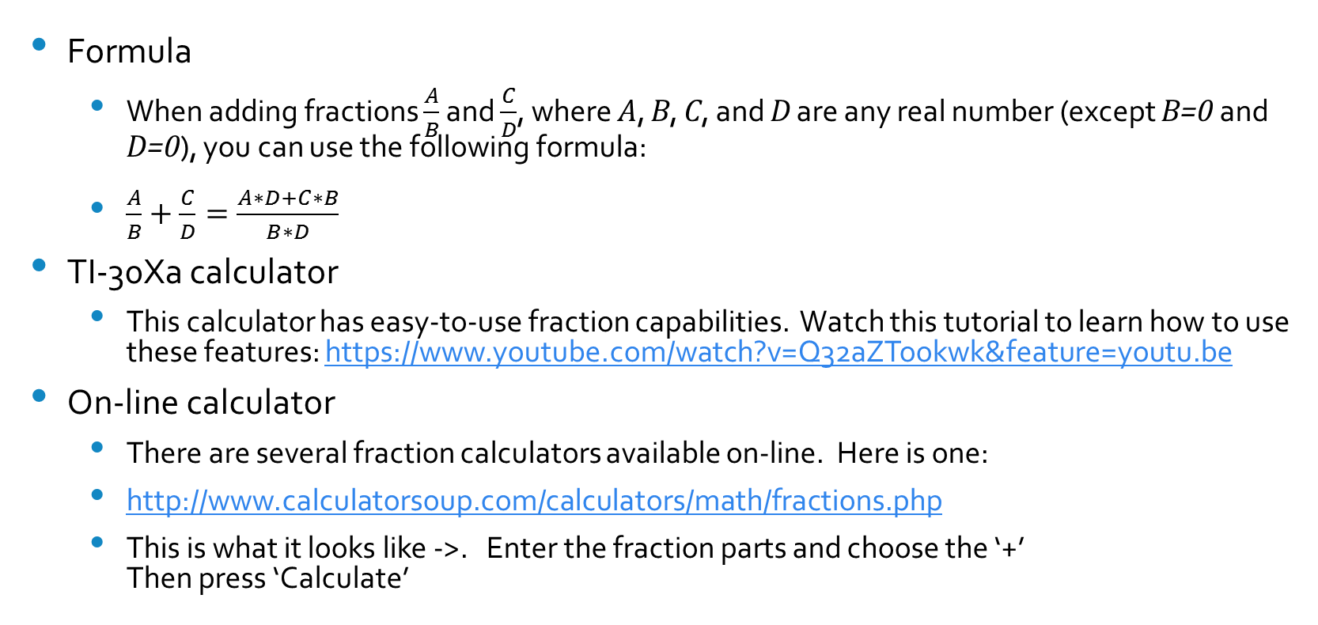
Operations with Fractions: Addition
Formula
  When adding fractions $\frac{A}{B}$ and $\frac{C}{D}$, where A, B, C, and D are any real number (except B=0 and D=0), you can use the following formula:
  $\frac{A}{B}+\frac{C}{D}=\frac{A∗D+C∗B}{B∗D}$
TI-30Xa calculator
  This calculator has easy-to-use fraction capabilities. Watch this tutorial to learn how to use these features: https://www.youtube.com/watch?v=Q32aZTookwk&feature=youtu.be
On-line calculator
  There are several fraction calculators available on-line. Here is one:
  http://www.calculatorsoup.com/calculators/math/fractions.php
  This is what it looks like ->. Enter the fraction parts and choose the ‘+’
  Then press ‘Calculate’

Slide 5
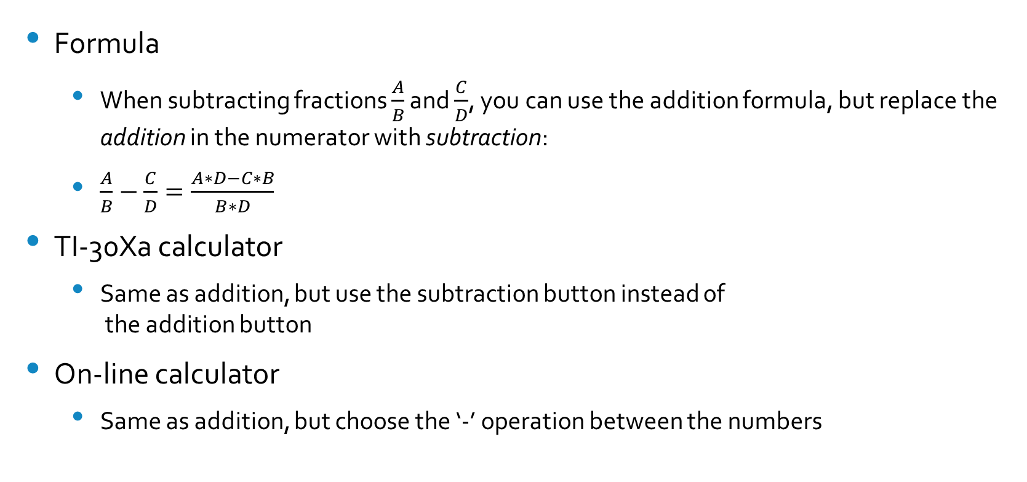
Operations with Fractions: Subtraction
Formula
  When subtracting fractions $\frac{A}{B}$ and $\frac{C}{D}$, you can use the addition formula, but replace the addition in the numerator with subtraction:
  $\frac{A}{B}−\frac{C}{D}=\frac{A∗D−C∗B}{B∗D}$
TI-30Xa calculator
  Same as addition, but use the subtraction button instead of
  the addition button
On-line calculator
  Same as addition, but choose the ‘-’ operation between the numbers

Slide 6
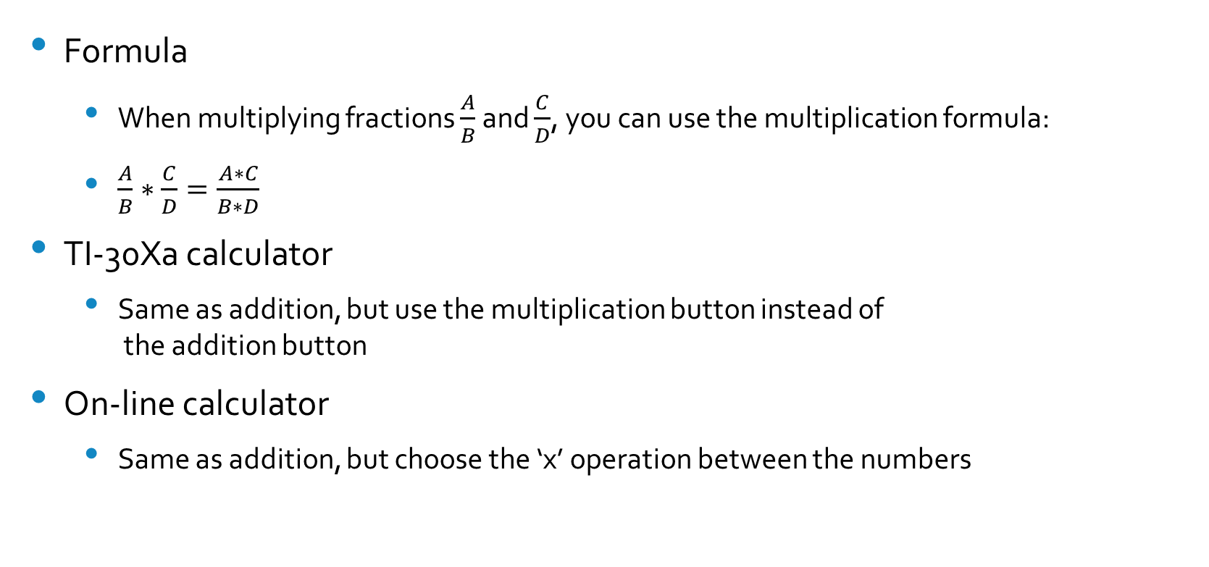
Operations with Fractions: Multiplication
Formula
  When multiplying fractions $\frac{A}{B}$ and $\frac{C}{D}$, you can use the multiplication formula:
  $\frac{A}{B}∗\frac{C}{D}=\frac{A∗C}{B∗D}$
TI-30Xa calculator
  Same as addition, but use the multiplication button instead of
  the addition button
On-line calculator
  Same as addition, but choose the ‘x’ operation between the numbers

Slide 7
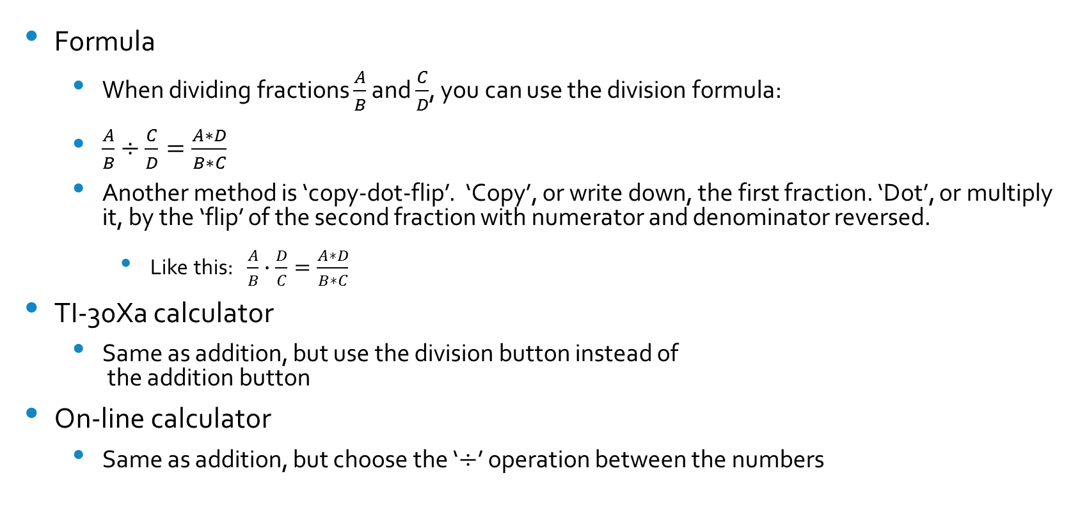
Operations with Fractions: Division
Formula
  When dividing fractions $\frac{A}{B}$ and $\frac{C}{D}$, you can use the division formula:
  $\frac{A}{B}÷\frac{C}{D}=\frac{A∗D}{B∗C}$
  Another method is ‘copy-dot-flip’. ‘Copy’, or write down, the first fraction. ‘Dot’, or multiply it, by the ‘flip’ of the second fraction with numerator and denominator reversed.
    Like this: $\frac{A}{B}∙\frac{D}{C}=\frac{A∗D}{B∗C}$
TI-30Xa calculator
  Same as addition, but use the division button instead of
  the addition button
On-line calculator
  Same as addition, but choose the ‘$÷$’ operation between the numbers

Slide 8
Conclusion
Fractions are just a form of expressing any real number
Fractions can be either rational or irrational, positive or negative
There are many tools to find the result of mathematical operations with fractions
There are many fractional forms of a number but only one decimal form

