Slide 1
Integers and Operations
ID1050– Quantitative & Qualitative Reasoning

Slide 2
Mathematical Operations
The mathematical operations addition (+), subtraction (-), multiplication (*) and division (÷) are examples of binary operations.
  They act (operate) on two (binary) numbers and result in another number
  On a calculator, you have to press the ‘equals’ key to obtain the result
The negation operation (-) is an example of a unary operator, which acts on a single number to result in another number
  Negation makes positive numbers negative and vice versa
  On a calculator, you get the result immediately after pressing the operator’s key

Slide 3
Operations with Integers: Addition & Subtraction
Addition and the positive sign use the same symbol: +
  The positive sign is usually not written explicitly for positive numbers: ⁺3 = 3
Subtraction and the negative sign use the same symbol: -
  This is intentional. One reason:
    Subtraction of a positive number is equivalent to addition of negative number
    Example: 3 + ⁻2 = 3 - ⁺2
    You can effectively swap the operation and the sign in this case
Subtraction of a negative number is equivalent to addition of a positive number
  Example: 1 - ⁻4 = 1 + ⁺4
  If you remove negativity, you are left with a positive. The ‘negatives’ ‘cancel’ each other.

Slide 4
Operations with Integers : Multiplication
Multiplication (*) is a short-hand notation for a series of additions
  Example: four instances of adding three
    (3+3+3+3) is replaced with 4*3= 12
  Example: four instances of adding negative three
    (⁻3+⁻3+⁻3+⁻3) is replaced with 4*(⁻3)= ⁻12
There are other notations for multiplication
  4a – Putting a number next to a variable (which represents any number) implies multiplication
  4●3 – Separates 4 and 3 so as to remove confusion with the number 43
  4x3 – the symbol ‘x’ may be used unless it is also being used as a variable

Slide 5
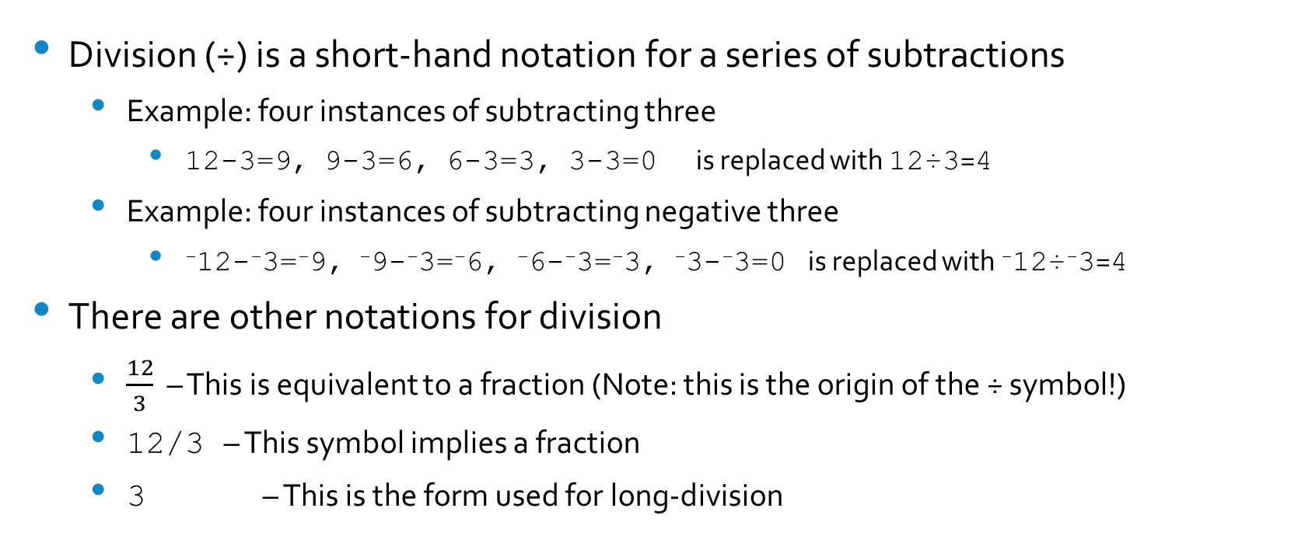
Operations with Integers : Division
Division (÷) is a short-hand notation for a series of subtractions
  Example: four instances of subtracting three
    12-3=9, 9-3=6, 6-3=3, 3-3=0 is replaced with 12÷3=4
  Example: four instances of subtracting negative three
    ⁻12-⁻3=⁻9, ⁻9-⁻3=⁻6, ⁻6-⁻3=⁻3, ⁻3-⁻3=0 is replaced with ⁻12÷⁻3=4
There are other notations for division
  $\frac{12}{3}$ – This is equivalent to a fraction (Note: this is the origin of the ÷ symbol!)
  12/3 – This symbol implies a fraction
  3 – This is the form used for long-division
12
12

Slide 6
Sign Rules for Multiplication and Division
Looking at the pattern, we notice the following rule:
  Multiplying/dividing like signs gives a positive result
  Multiplying/dividing unlike signs gives a negative result
For the product of many numbers multiplied or divided:
  Negative signs ‘cancel’ in pairs
    If there are an even number of negative numbers, the final result will be positive
    If there are an odd number of negative numbers, the final result will be negative
    Example: (-1)*(-2)*(-3)*(-4)*(-5) = -(1*2*3*4*5)= -120

Slide 7
A Little Farther: Positive Integer Exponents
Just like multiplication is a short-hand notation for many addition, exponents are a short-hand notation for many multiplications
2*2*2 is replaced with 2³ (=8)
3*3 is replaced with 3² (=9) (Note: order is important)
If a number raised to an exponent is multiplied by the same number to another exponent, the result is the number raised to the sum of the exponents
  10² * 10³ = (10*10)*(10*10*10) = 10⁵ = 10²⁺³
If a number raised to an exponent is itself raised to another exponent, the result is the number raised to the product of the exponents
  (10²)³=10²*10²*10²=10⁶=10^{2*3}

Slide 8
Conclusion
Our mathematical system has practical notations that make using it easier
  Imagine having to describe a complicated math problem using only words!
There are important patterns to remember as we begin working with our number system
It is worthwhile to examine the mathematics with which we are so familiar in order to see the elegance and utility of its structure

