Slide 1
Reading an Abacus
ID1050– Quantitative & Qualitative Reasoning

Slide 2
Positional Notation on an Abacus
An abacus is a physical representation of positional notation using beads on separate wires.
The wires correspond to the columns in our positional notation, and each represents a power of ten. Each wire has nine beads that can slide along it.
The number of beads to one side of the wire is read as the digit for that power of ten.
Generally, one of the wires is designated as the ‘ones’ wire, or ‘10⁰’ wire
This wire and the ones above it contain the integer part of the number
The wires below the ‘ones’ wire contain the fractional part of the number

Slide 3
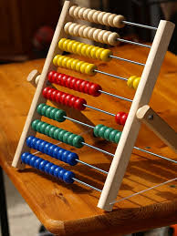
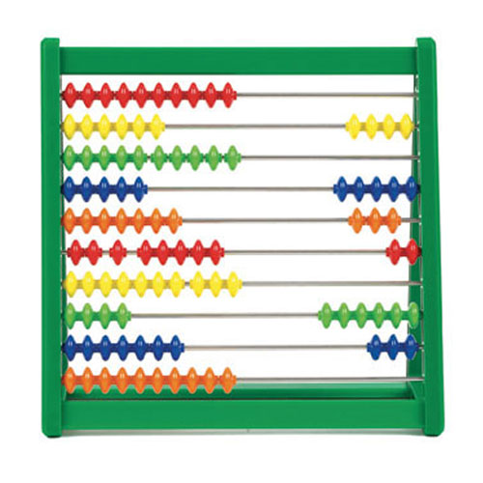
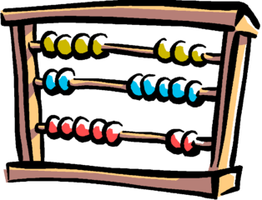
Examples of Reading an Abacus
The abacus can be used by an expert to do practically any numerical operation a standard calculator can do (including square and cube roots!), and at roughly the same speed.
We will only be concerned with reading a number from an abacus.
Examples: (I’ll arbitrarily indicate a wire as the ‘ones’ wire)
ones
ones
ones
351.
202.5
40532.063

Slide 4
Conclusion
An abacus can be used to represent numbers
Reading an abacus requires specification of a ‘ones’ wire
The integer part is this wire and the ones above it
The fractional part, if any, is expressed on the wires below it

