Slide 1
Positional Notation
ID1050– Quantitative & Qualitative Reasoning

Slide 2
Powers of 10
Recall the
powers of ten:
  10 is the ‘base’
  The exponent is
  the ‘power’
Note how the power is related to the number of zeros
  For positive powers, there are that many zeros right of the 1
  For negative powers, there are that many zeros left of the 1
Power of ten | Numerical value
…
10² | 100
10¹ | 10
10⁰ | 1
10⁻¹ | 0.1
10⁻² | 0.01
…

Slide 3

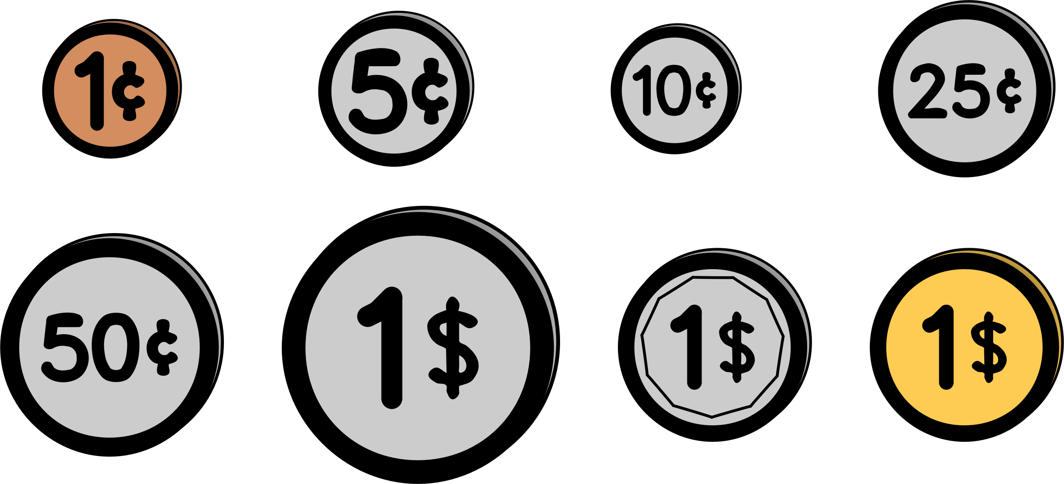
Definitions
Number – A value or quantity that is the same regardless of how it is expressed
  Example: the quantity of ten sheep
Digit – A basic number from which other numbers are formed
  Example: one and zero, when placed together like ’10’, means ten
Numeral – A symbol that represents a digit
  Example: the symbol ‘1’ and the symbol ‘0’
    Arabic numerals: ‘0, 1, 2, 3, 4, 5, 6, 7, 8, 9’
    Roman numerals: I, V, X, L, C, D, M
    Monetary numerals: penny, nickel, dime, quarter, half-dollar

Slide 4
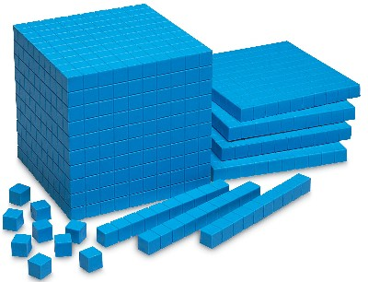
Positional Notation vs. Ordinal Notation
We won’t be using this system in any way in this class
Ordinal Notation
  This is the system used by the ancient Roman civilization
  In this system, the order that digits appear determines their value
    If a digit appears before a lower-value digit, you add their values
    If a digit appears before a higher-value digit, you subtract the lower digit from the higher one
    For instance, MCMLXIV means “1000 add (100 from 1000) add 50 add 10 add (1 from 5)”, or 1964
    No digit for ‘zero’ is needed
Positional Notation
  This is the system modern civilizations use
  In this system, the column position or place that each digit
  occupies determines its value
    A digit for ‘zero’ is critical in this system.

Slide 5
Positional Notation Chart for Base-10
10³ = 1000
=‘thousands’
10² = 100
=‘hundreds’
10¹ = 10
=‘tens’
10⁰ = 1
=‘ones’
10⁻¹ = 1/10
=‘tenths’
10⁻² = 1/100
=‘hundredths’
Base-10 Digits:
0,1,2,3,4,5,6,7,8,9
Go here
Use this area for calculations

Slide 6
Representing Numbers in Base-10
10³ = 1000 =‘thousands’ | 10² = 100 =‘hundreds’ | 10¹ = 10 =‘tens’ | 10⁰ = 1 = ‘ones’ | 10⁻¹ = 1/10 =‘tenths’ | 10⁻² = 1/100 =‘hundredths’
____________ | ____________ | ____________ | ____________ | ____________ | ____________
2305.46

Slide 7
Positional Notation Chart for a Different Base
We use a decimal or base-ten system (because ten fingers?)
  Columns have value based on powers of ten
There is no mathematical reason to choose ten. Any other number, like five or two or twenty can be used as the base and the system works the same
The Mayan civilization used a positional notation system with a base of 20
  http://www.storyofmathematics.com/mayan.html
The Babylonians used a positional notation system with a base of 60
  Our time-keeping system is a remnant of this mathematical legacy

Slide 8
Positional Notation Chart for Base-5
5³ = 125
5² = 25
5¹ = 5
5⁰ = 1
5⁻¹ = 1/5
5⁻² = 1/25
Only Base-5 Digits
0,1,2,3,4
Go here
Use this area for regular Base-10 calculations

Slide 9
Conclusion
Our system of representing numbers, while familiar to us, was invented and has lasted because of its ease of use.
  When adding numbers, line up their columns, add within each column, carry into the next column if necessary
We have a base-10 system, but other bases are possible and have existed
  Computers use a base-2, or binary, system
We will learn to convert to and from other bases
Motivation
  Understand how our number system works
  Empathize with children first learning the base-10 system
  Explore an unfamiliar area of mathematics

