Slide 1
Factoring
ID1050– Quantitative & Qualitative Reasoning

Slide 2
Distributive Property and Factoring
Factoring is a method of manipulating an equation.
The factor is a common number or variable that appears in two terms that are being added together.
  Example: A is a common factor in A*B + A*C
When we factor out the common factor, we move that factor out in front of the two terms and group what’s left of the terms between parentheses.
  Example:
Factoring is really just an application of the distributive property.
Following are some techniques to help perform this operation correctly:
(
A
*
B
+
A
)
*
C

Slide 3
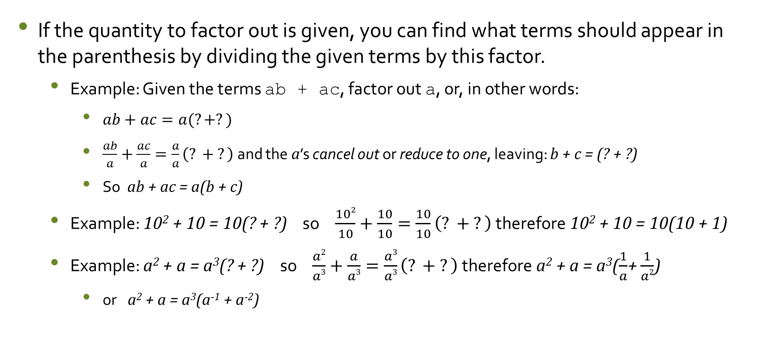
Technique 1: Dividing by the factor
If the quantity to factor out is given, you can find what terms should appear in the parenthesis by dividing the given terms by this factor.
  Example: Given the terms ab + ac, factor out a, or, in other words:
    $ab+ac=a(?+?)$
    $\frac{ab}{a}+\frac{ac}{a}=\frac{a}{a}\left(? + ?\right)$ and the a’s cancel out or reduce to one, leaving: b + c = (? + ?)
    So ab + ac = a(b + c)
  Example: 10² + 10 = 10(? + ?) so $\frac{102}{10}+\frac{10}{10}=\frac{10}{10}\left(? + ?\right)$ therefore 10² + 10 = 10(10 + 1)
  Example: a² + a = a³(? + ?) so $\frac{a2}{a3}+\frac{a}{a3}=\frac{a3}{a3}\left(? + ?\right)$ therefore a² + a = a³($\frac{1}{a}$+ $\frac{1}{a2}$)
    or a² + a = a³(a⁻¹ + a⁻²)

Slide 4
Technique 2: Comparing Exponents
In this technique, we recall that when you multiply numbers with the same base, you add their exponents: 10² * 10³ = 10⁽²⁺³⁾ = 10⁵
In our problem: 10² + 10 = 10(? + ?) we know that the ?’s must be 10 to some exponent, so we need to find that exponent. Writing everything as 10 to some exponent:
  10² + 10¹ = 10¹(10▲ + 10■) = 10 ^{1+▲} + 10 ^{1+■}
The first terms must be equal, so 10² = 10^{1+▲} so 2=1+▲ therefore ▲=1
The second terms must be equal, so 10¹ = 10^{1+■} so 1=1+■ therefore ■ =0
  So 10² + 10 = 10(10¹ + 10⁰) = 10(10 + 1)

Slide 5
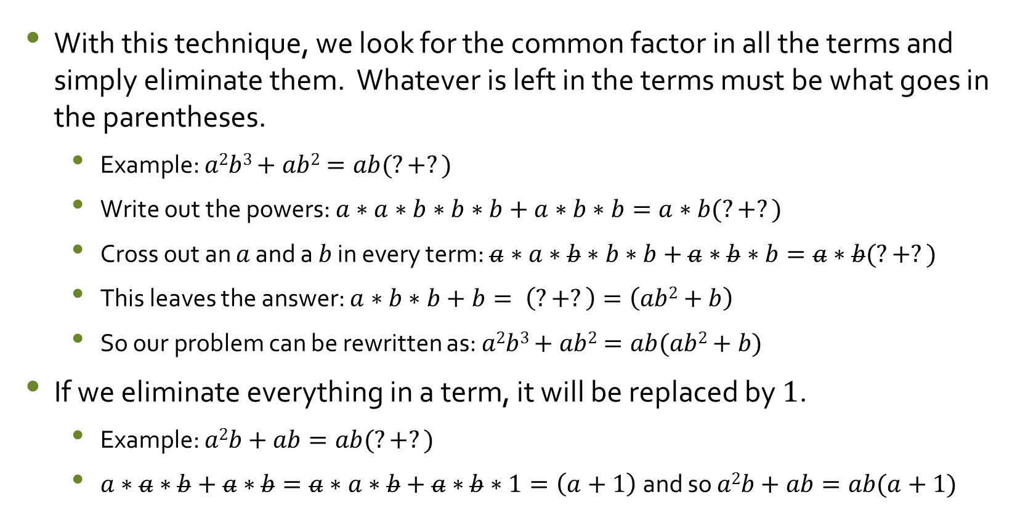
Technique 3: Eliminating Common Factors
With this technique, we look for the common factor in all the terms and simply eliminate them. Whatever is left in the terms must be what goes in the parentheses.
  Example: $a2b3+ab2=ab(?+?)$
  Write out the powers: $a∗a∗b∗b∗b+a∗b∗b=a∗b(?+?)$
  Cross out an $a$ and a $b$ in every term: $a∗a∗b∗b∗b+a∗b∗b=a∗b(?+?)$
  This leaves the answer: $a∗b∗b+b= \left(?+?\right)=\left(ab2+b\right)$
  So our problem can be rewritten as: $a2b3+ab2=ab(ab2+b)$
If we eliminate everything in a term, it will be replaced by 1.
  Example: $a2b+ab=ab(?+?)$
  $a∗a∗b+a∗b=a∗a∗b+a∗b∗1=\left(a+1\right) \text{and} \text{so} a2b+ab=ab(a+1)$

Slide 6
Conclusion
Factoring involves factoring out a common value from some given terms and finding what is left.
If the quantity to factor out is given, you can use one of several techniques to find what is left after factoring it out.
Some techniques will work better for different problems; if one doesn’t work out, try a different one.

