Slide 1
Properties of Operations for Real Numbers
ID1050– Quantitative & Qualitative Reasoning

Slide 2
What Are Properties?
These are rules that are always true…
  … for the set we are working with (the set of real numbers)
  … for the operations we are working with (addition and multiplication)
They may seem ‘obvious’ because we are so familiar with them
  The are not always true for other sets of things
They form an important foundation for higher mathematics

Slide 3
Associative Property
Associative property of addition of real numbers (associate)
  This answers the question “When we add numbers together, does grouping matter?”
  No, it does not. In general, (A + B) + C = A + (B + C) and A, B, and C are any real number
    Example: (⁻1 + 2) + 3 = ⁻1 + (2 + 3) = 4
  Does this work for subtraction?
    Counter-example: (⁻1 - 2) - 3 ≠ ⁻1 - (2 - 3)
    But you can convert subtraction problems into addition problems, and it will work.
Associative property of multiplication of real numbers
  Since multiplication is a series of additions, multiplication is also associative.
  In general, (A*B)*C = A*(B*C)
    Example: (⁻1 * 2) * 3 = ⁻1 * (2 * 3) = ⁻6

Slide 4
Commutative Property
Commutative property of addition of real numbers (commute or travel)
  This answers the question “When we add numbers together, does order matter?”
  No, it does not. In general, A + B = B + A and A and B are any real number
    Example: ⁻2 + 3 = 3 + ⁻2 = 1
  Does this work for subtraction?
    Counter-example: ⁻2 - 3 ≠ 3 - ⁻2
    But you can convert subtraction problems into addition problems, and it will work.
Commutative property of multiplication of real numbers
  Since multiplication is a series of additions, multiplication is also commutative.
  In general, A*B = B*A
    Example: ⁻3 * 4 = 4 * ⁻3 = ⁻12

Slide 5
Does the Order of Operations Ever Matter?
We are so used to order not making a difference for addition of real numbers that we may wonder if it’s true for addition of anything.
Here’s a counter-example: Rotations of an object
  Hold an object (like a can) orientated like this:
  First, rotate it forward, then to your left. Note the final orientation.
  Now start over with your original orientation.
  Now, rotate it to your left first, then forward.
    The orientation is different than the first time
  The order of adding rotations matters, so rotations don’t commute.

Slide 6
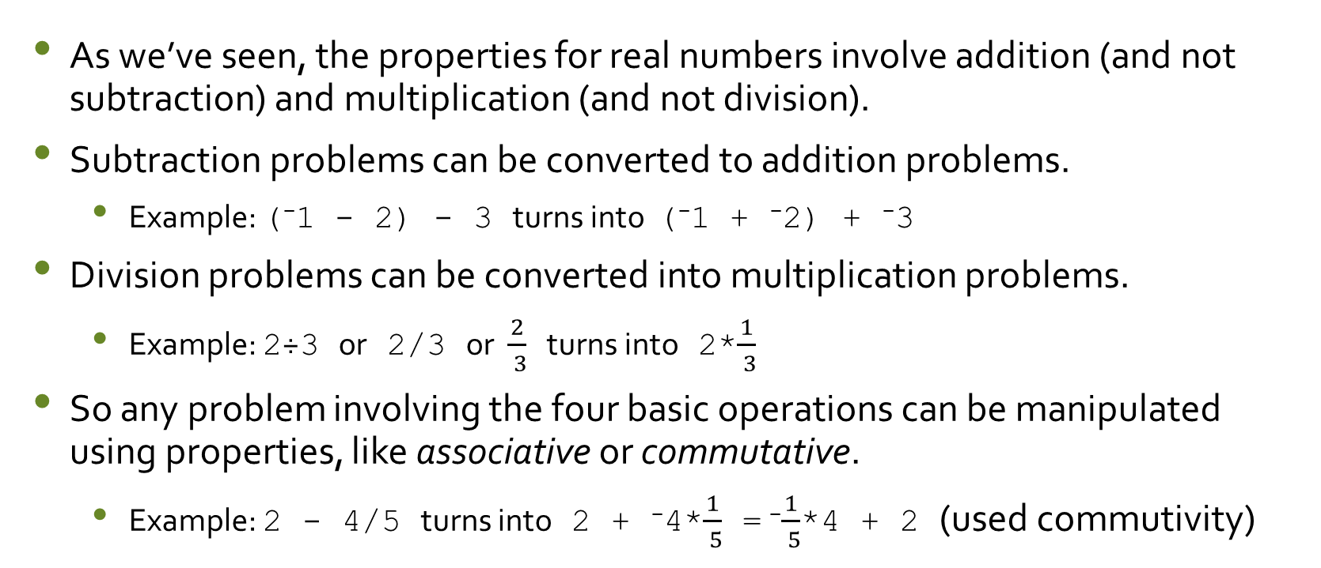
Converting Subtraction & Division
As we’ve seen, the properties for real numbers involve addition (and not subtraction) and multiplication (and not division).
Subtraction problems can be converted to addition problems.
  Example: (⁻1 - 2) - 3 turns into (⁻1 + ⁻2) + ⁻3
Division problems can be converted into multiplication problems.
  Example: 2÷3 or 2/3 or $\frac{2}{ 3}$ turns into 2*$\frac{1}{ 3}$
So any problem involving the four basic operations can be manipulated using properties, like associative or commutative.
  Example: 2 - 4/5 turns into 2 + ⁻4*$\frac{1}{ 5}$ = ⁻$\frac{1}{ 5}$*4 + 2 (used commutivity)

Slide 7
Distributive Property
This property combines both multiplication and addition
  This changes the addition of two terms into the multiplication of two factors
  We say ‘multiplication distributes over addition’ for real numbers
  In general, A*(B + C) = A*B + A*C and A, B, and C are any real number
    Example: 2*(3 + 4) = 2*3 + 2*4 = 14
  Does multiplication distribute over subtraction?
    Actually, yes, but it is because you can convert subtraction of a number into addition of its negative.
    Example: 2*(3 - 4) = 2*(3 + ⁻4) = 2*3 + 2*⁻4 = ⁻2
Careful! Don’t distribute multiplication over multiplication
  This is wrong: 2*(3 * 4) ≠ 2*3 * 2*4

Slide 8
Conclusion
Operations on real numbers have some rules that are always true:
  Associativity of addition (and multiplication): grouping doesn’t matter
  Commutativity of addition (and multiplication): order doesn’t matter
  Distributive property: Governs how addition and multiplication interact
Knowing the properties of real numbers lets us manipulate equations to get them into a more useful form without ‘breaking’ the equality.

