Slide 1
Graphing Lines and Quadratics
ID1050– Quantitative & Qualitative Reasoning

Slide 2



Lines
$$\text{y} \text{=} \text{x} \text{+} \text{1}$$
$$\text{y} \text{=}\text{ 1∗}\text{x} \text{+} \text{1}$$
y
$$\text{y} \text{=} \frac{\text{1}}{\text{1}}\text{x} \text{+} \text{1}$$
Functions that have the form y=ax+b appear as lines when graphed.
  They can be graphed in the normal way, plotting each point (x,y).
  But we know they are lines, so we can graph them in a smarter way.
The number in front of x, labeled a here, is called the ‘slope’.
  Slope is defined as ‘rise over run’
    ‘run’ is a unit step to the right along the x-axis
    ‘rise’ is the amount the line increases (or decreases) in the y-direction.
    A slope that is upward (from left to right) is a positive slope.
    A slope that is downward is a negative slope.
    A steep slope has a large value for a
    A shallow slope has a small value for a.
    A slope of 0 is a horizontal line.
The term with no x in it, labeled b here, is called the ‘y-intercept’.
  It is the location where the line crosses the y-axis.
5
4
3
2
1
rise
x
run
-2 -1 0 1 2
y
x

Slide 3

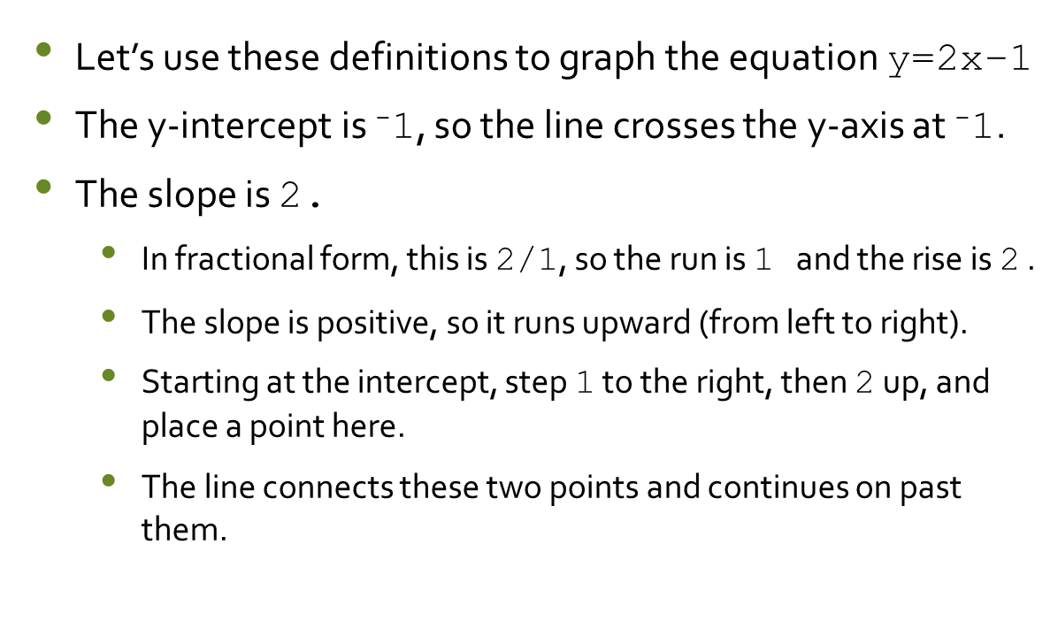
A Line Example
$$\text{y} \text{=}\text{ 2}\text{x}\text{ − }\text{1}$$
y
Let’s use these definitions to graph the equation $\text{y}\text{=2}\text{x}\text{−}\text{1}$
The y-intercept is ⁻1, so the line crosses the y-axis at ⁻1.
The slope is 2.
  In fractional form, this is 2/1, so the run is 1 and the rise is 2 .
  The slope is positive, so it runs upward (from left to right).
  Starting at the intercept, step 1 to the right, then 2 up, and place a point here.
  The line connects these two points and continues on past them.
2
1
-1
-2
rise
x
-2 -1 1 2
run

Slide 4

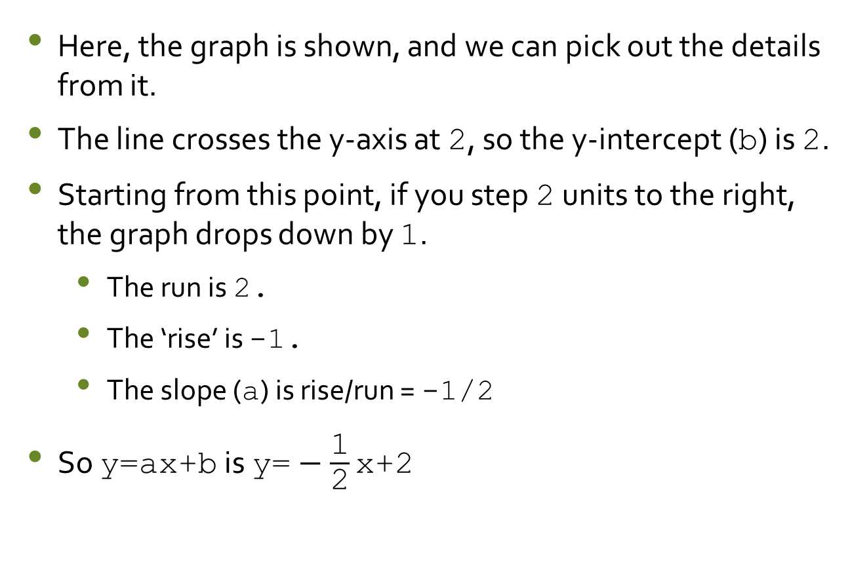
Another Line Example
$$\text{y} \text{=} −\frac{\text{1}}{\text{2}}\text{x} \text{+} \text{2}$$
Here, the graph is shown, and we can pick out the details from it.
The line crosses the y-axis at 2, so the y-intercept (b) is 2.
Starting from this point, if you step 2 units to the right, the graph drops down by 1.
  The run is 2.
  The ‘rise’ is -1.
  The slope ($\text{a}$) is rise/run = -1/2
So $\text{y}\text{=}\text{a}\text{x}\text{+}\text{b}$ is $\text{y}\text{=}−\frac{\text{1}}{\text{2}}\text{x}\text{+2}$
y
run
2
1
-1
-2
rise
x
-2 -1 1 2

Slide 5


Quadratics
$$\text{y} \text{=} \text{x}\text{2} \text{+} \text{1}$$
y
$$\text{y} \text{=}\text{ 1∗}\text{x}\text{2} \text{+} \text{1}$$
5
4
3
2
1
Functions that have the form y=ax²+bx+c appear as parabolas or quadratics when graphed. (b or c could be zero.)
  They can be graphed in the normal way, plotting each point (x,y).
  Knowing they are parabolas, we can look at certain features.
The number in front of x, labeled a here, is called the ‘curvature’.
  A parabola that opens upward has a positive curvature.
  A parabola that opens downward has a negative curvature.
  A narrow curvature has a large value for a.
  A shallow curvature has a small value for a.
The term with no x in it, labeled c here, is called the ‘y-intercept’.
  It is the location where the line crosses the y-axis.
x
-2 -1 0 1 2
y
x

Slide 6

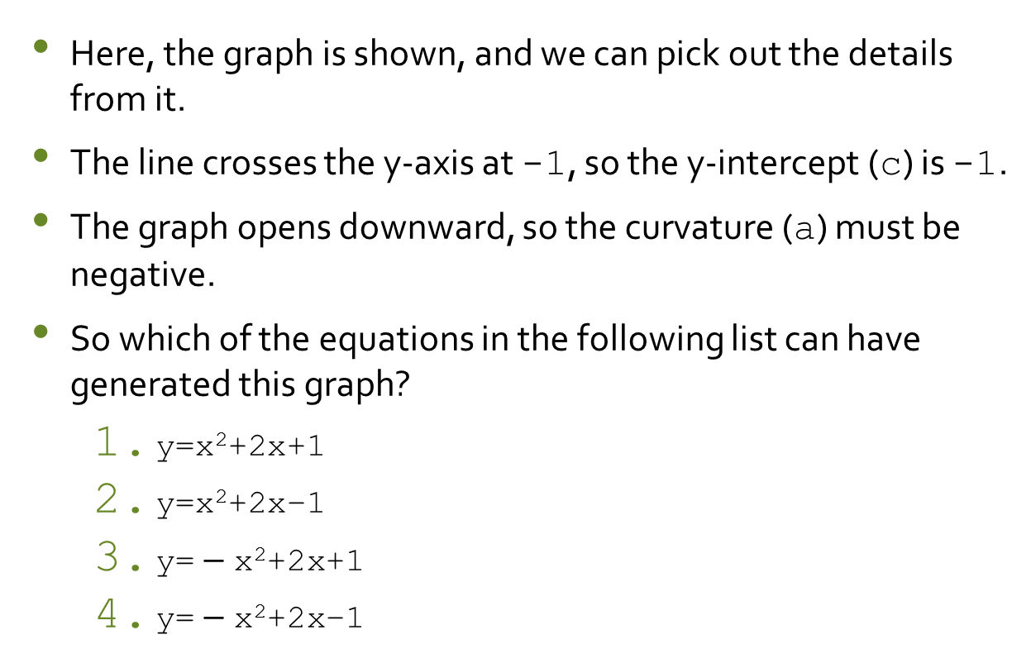
A Quadratic Example
$$\text{y} \text{=}\text{ −}\text{x}\text{2}\text{ +2}\text{x}\text{ − 1}$$
Here, the graph is shown, and we can pick out the details from it.
The line crosses the y-axis at -1, so the y-intercept (c) is -1.
The graph opens downward, so the curvature (a) must be negative.
So which of the equations in the following list can have generated this graph?
  $\text{y}\text{=}\text{x}\text{2}\text{+}\text{2}\text{x}\text{+1}$
  $\text{y}\text{=}\text{x}\text{2}\text{+}\text{2}\text{x}\text{−1}$
  $\text{y}\text{=}−\text{x}\text{2}\text{+}\text{2}\text{x}\text{+}\text{1}$
  $\text{y}\text{=}−\text{x}\text{2}\text{+}\text{2}\text{x}\text{−1}$
y
2
1
-1
-2
x
-2 -1 1 2

Slide 7
Conclusion
Line graphs are generated from equations of the form y=ax+b.
  They have a slope (a) and a y-intercept (b).
  We can construct or identify the graph from these two values.
Quadratic graphs (parabolas) are generated from equations of the form y=ax²+bx+c.
  The have a curvature (a) and a y-intercept (c).
  We can identify the graph from these two values.

