Slide 1
Graphing Logarithm and Trigonometry Functions
ID1050– Quantitative & Qualitative Reasoning

Slide 2
A Trigonometry Graphing Example
In a previous tutorial, we graphed point-by-point some simple functions involving the basic operations of addition, subtraction, multiplication, and division.
What about a function with which we may not be familiar?
Graph y=sin(x) for -360º ≤ x ≤ 360º
What should our step size be?
  If we choose 1 degree steps, we’ll need 360-(-360)=720 points. Too many!
  If we want about 15 points, divide 720º by 15. That gives us a step size of 48º. Let’s round that to an even 45º, which will give us 720º / 45º = 16 points.
  The interval size doesn’t matter; in the end, the graph will look the same. Choose the step size for convenience and to give you enough points to plot.

Slide 3
A Trigonometry Graphing Example (continued)
x (degrees) | y
-360
-315
-270
-225
-180
-135
-90
-45
0
45
90
135
180
225
279
315
360
x (degrees) | y
-360 | 0
-315 | 0.71
-270 | 1
-225 | 0.71
-180 | 0
-135 | -0.71
-90 | -1
-45 | -0.71
0 | 0
45 | 0.71
90 | 1
135 | 0.71
180 | 0
225 | -0.71
279 | -1
315 | -0.71
360 | 0
Our table will be a bit bigger than usual.
First, fill out the x values, starting at -360º and stepping up by 45º each time.
Enter each x value in the calculator and compute the sine function of it.
Round your answers to a reasonable amount. Since we’re graphing, let’s keep only one or two digits of accuracy.
We note that the y-value only goes between -1 and +1, so we scale our axes to match the table values.

Slide 4
A Trigonometry Graphing Example (continued)
Here are the axes. Plot the points, and connect the dots.
We see a wave shape emerge, and it looks like it continues on left and right.
y
1
0.5
x
-360 -315 -270 -225 -180 -135 -90 -45 0 45 90 135 180 225 270 315 360
-0.5
-1

Slide 5
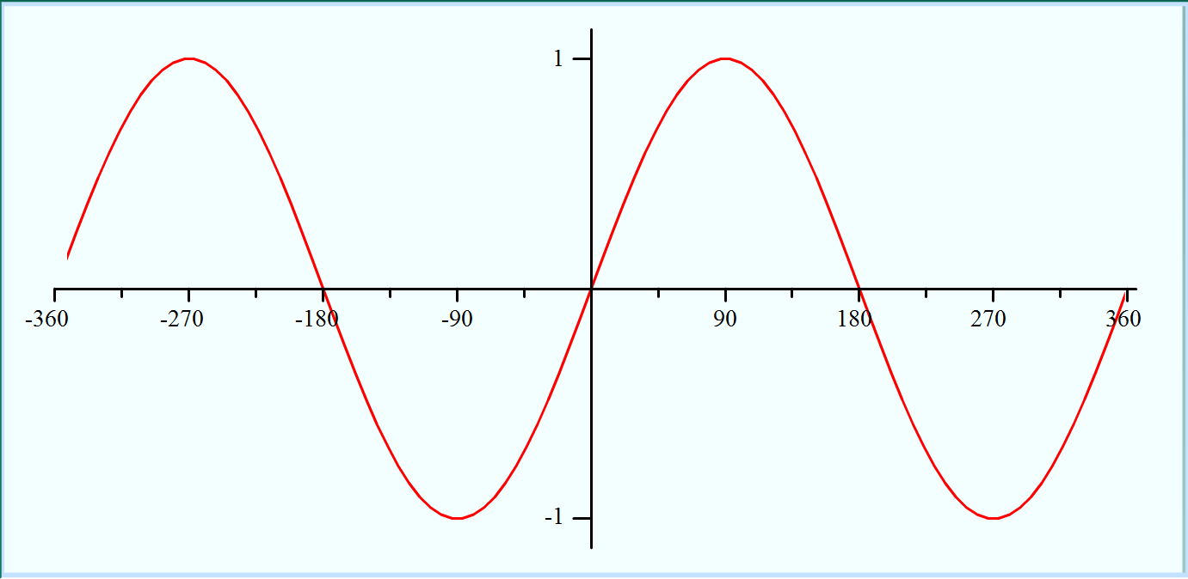
Trigonometry: Sine
Computers can patiently plot many more points than we can
Many calculators can plot functions, and there are many applications on the internet that can do the same. Here is one: http://go.hrw.com/math/midma/gradecontent/manipulatives/GraphCalc/graphCalc.html
Let’s use this application to plot the sine function. We’ll talk about the details of how to do this in a later tutorial, but here is the result:
Observations
  The sine crosses through the origin

Slide 6
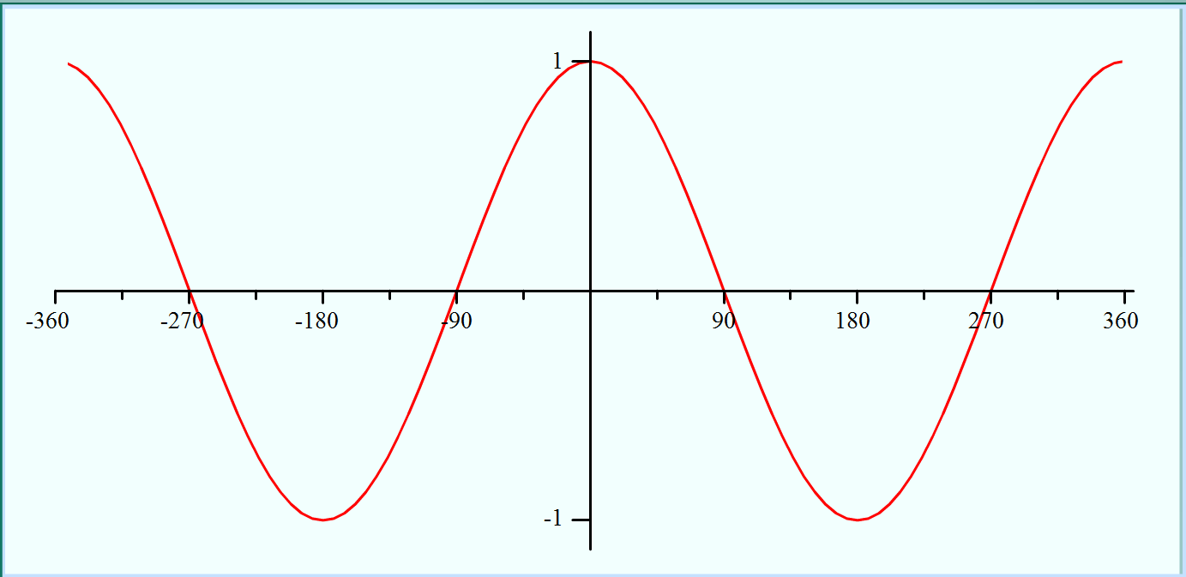
Trigonometry: Cosine
Graph y=cos(x) for -360º ≤ x ≤ 360º
Observations:
  This graph looks very similar to the sine function
  It is different because it does not pass through the origin
  This is also a wave function

Slide 7
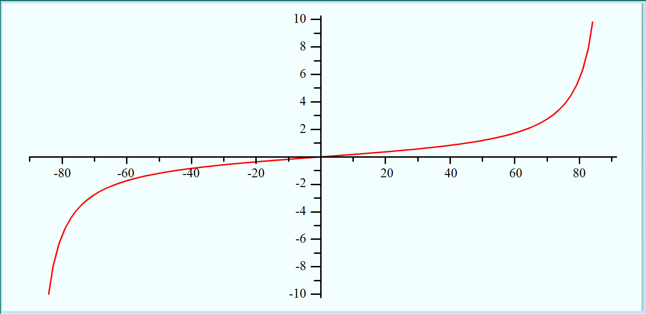
Trigonometry: Tangent
Graph y=tan(x) for -90º < x < 90º
Observations:
  We can’t compute the tangent function at x=-90⁰ or at x=90⁰
  It looks like the function becomes infinite at these two values
  Tangent is negative for negative angles and positive for positive angles

Slide 8
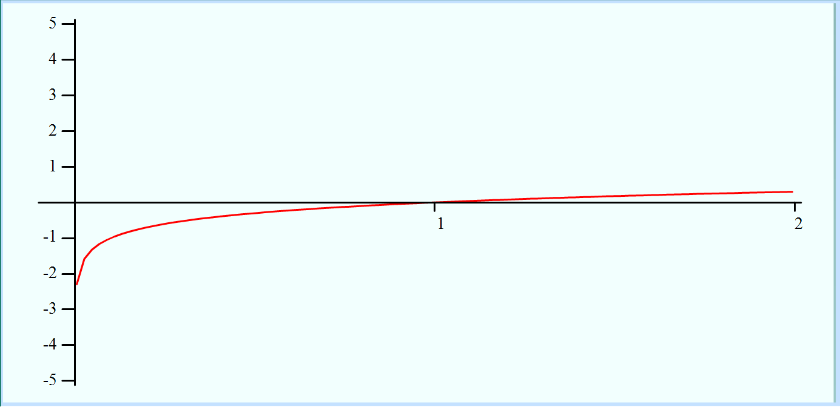
Logarithms: Common Log
Graph y=log(x) for 0 < x ≤ 2
Observations:
  We can’t compute the logarithm for x=0
  The function goes to negative infinity at x=0
  The function crosses the x-axis at x=1 and gradually keeps rising
  There is no graph for negative x-values (log is not defined here)

Slide 9
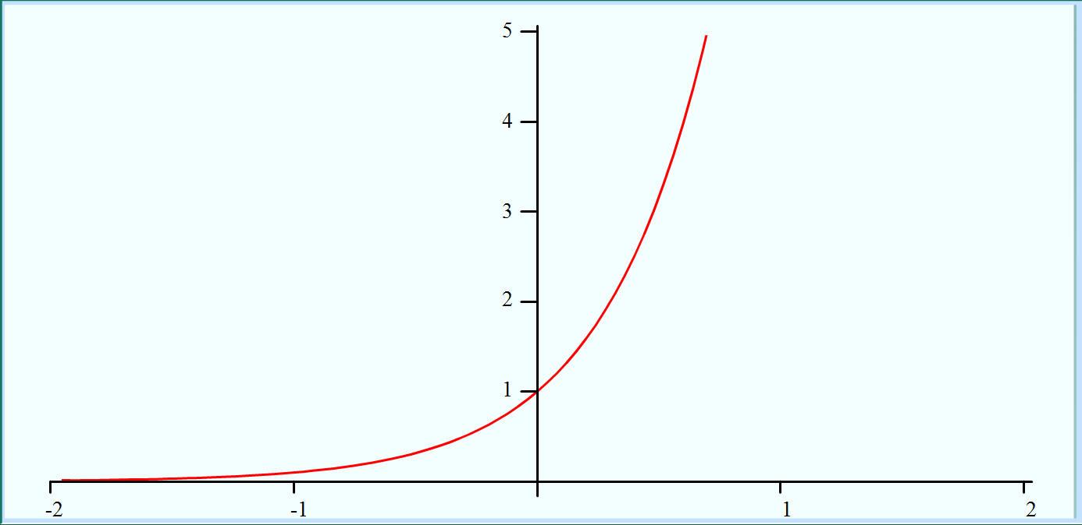
Logarithms: Common Anti-log
Graph y=log⁻¹(x) (or y=10^{x}) for -2 ≤ x ≤ 2
Observations:
  The function is always a positive number
  It is very small for large negative numbers
  It is very large for large positive numbers
  It crosses the y-axis at y=1

Slide 10
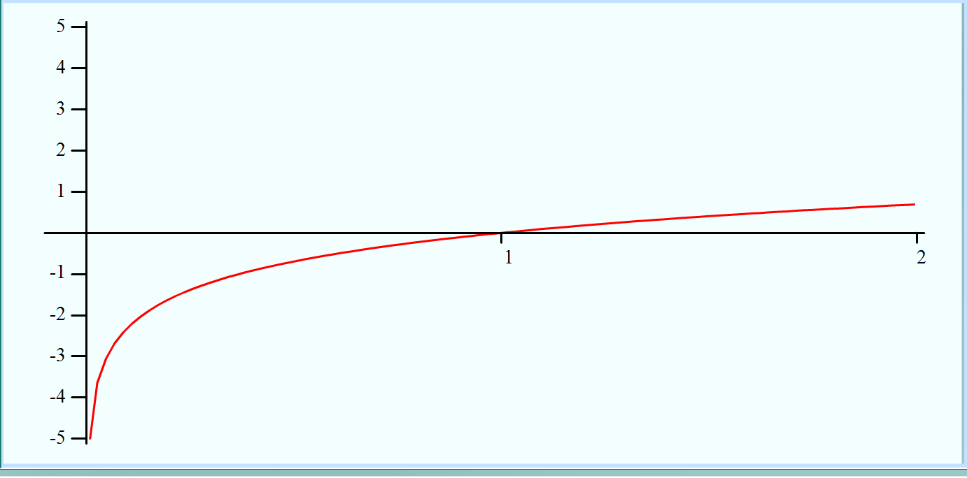
Logarithms: Natural Log
Graph y=ln(x) for 0 < x ≤ 2
Observations:
  This looks almost identical to the graph for log(x). They are similar, but the curving is slightly different
  This function goes to infinity for x=0, and crosses the x-axis at x=1

Slide 11
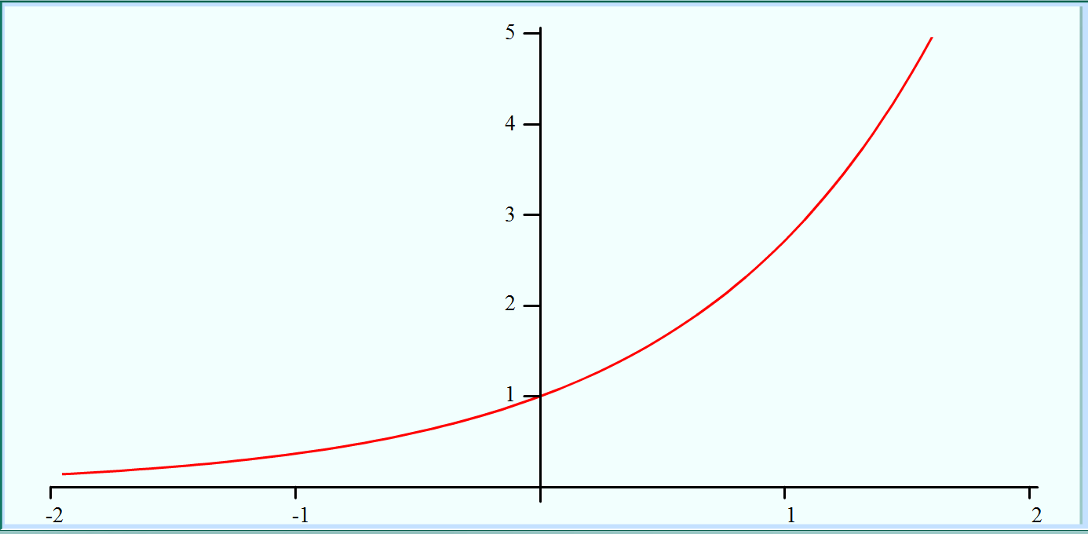
Logarithms: Natural Anti-log
Graph y=ln⁻¹(x) (or y=e^{x}) for -2 ≤ x ≤ 2
Observations:
  This graph looks very similar to the common anti-log graph
  The differ in the amount of curvature they have, but are otherwise quite similar

Slide 12
Conclusion
These are the graphs of some important functions used in mathematics
Without knowing what the functions do, we can get a sense of how they behave by looking at their graphs
  When the cross axes
  When they aren’t defined
  Where they are positive or negative
  Etc.

