Slide 1
Functions and Inverses
ID1050– Quantitative & Qualitative Reasoning

Slide 2



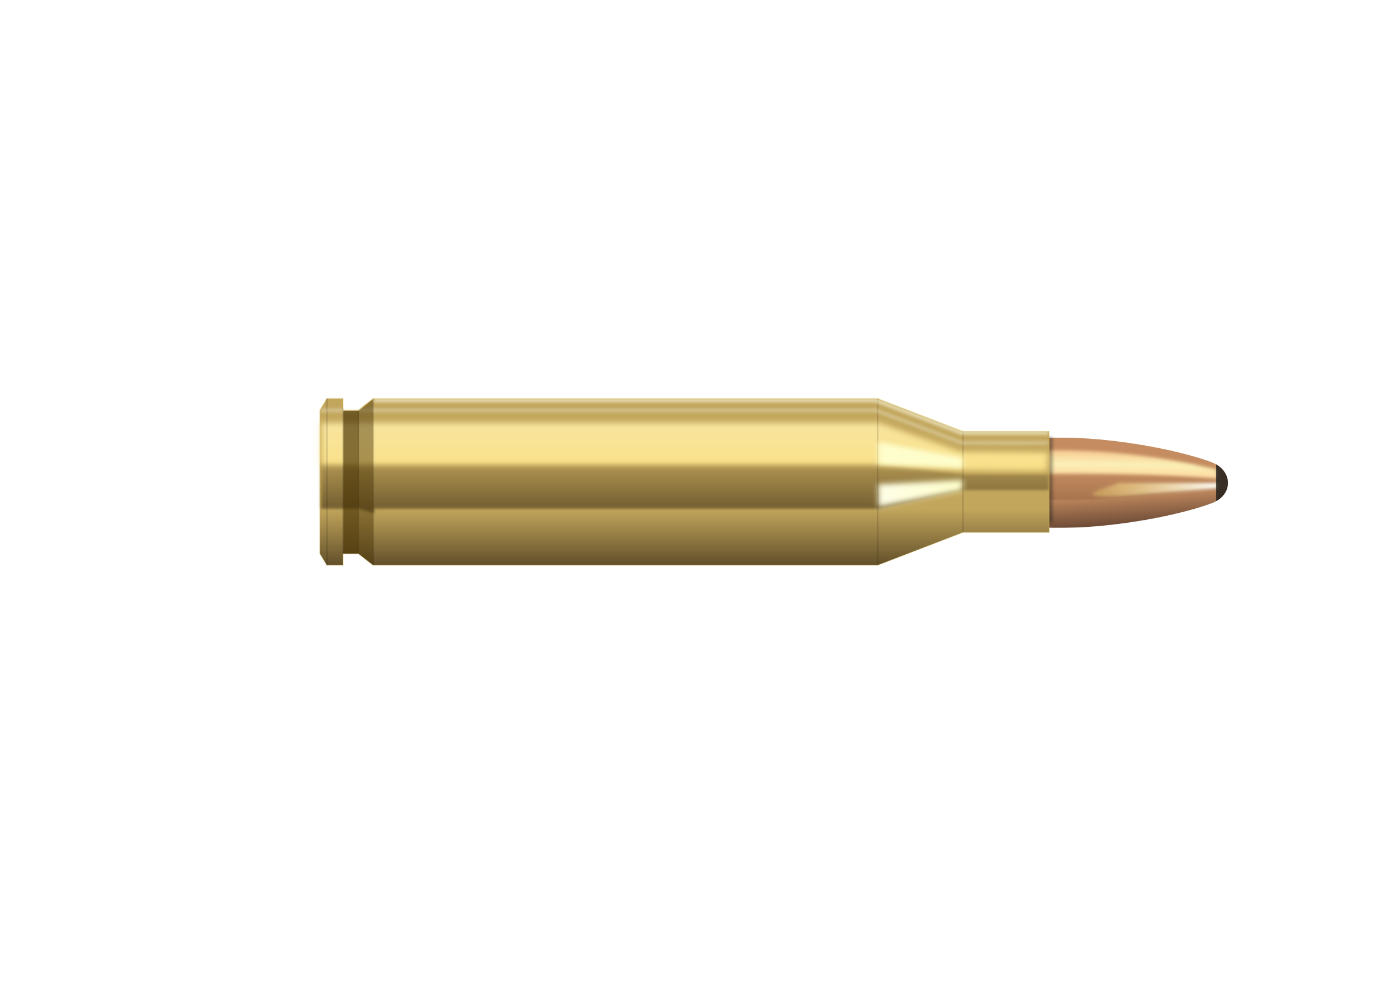
Function and Inverse Function Gun Analogy
Functions take a number, perform an operation on it, and return another number.
The inverse of that function takes that result and returns the original number.
In our function gun analogy,
  For each type of bullet, the function gun always hits the same point on the target.
  The bullet is the x-value, and the hole in the target is the y-value
The inverse function runs this scenario in reverse:
  Observing the hole in the target, one can deduce the bullet that made it.
  Analogously, if we know the y-value, we can use the inverse function to solve for the x-value

Slide 3
Basic Operations and Their Inverses
You already know the inverse functions of the basic operations:
  Subtraction is the inverse of addition
  Addition is the inverse of subtraction
  Division is the inverse of multiplication
  Multiplication is the inverse of division
Example: x*2=4
  x is multiplied by 2, so invert with division by 2 on both sides
  x*2÷2 = 4÷2
  So x=2
+ -
x ÷

Slide 4
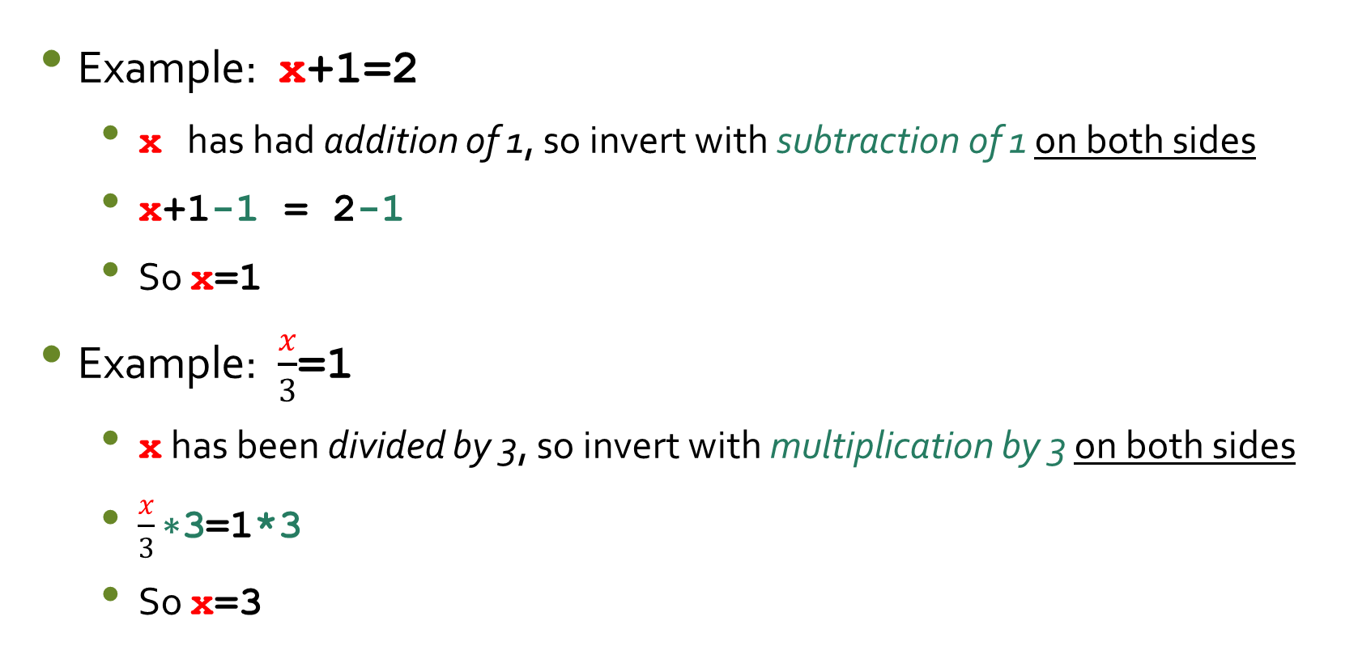
More Examples
Example: x+1=2
  x has had addition of 1, so invert with subtraction of 1 on both sides
  x+1-1 = 2-1
  So x=1
Example: $\frac{x}{3}$=1
  x has been divided by 3, so invert with multiplication by 3 on both sides
  $\frac{x}{3}\text{∗3}$=1*3
  So x=3

Slide 5
Trigonometry Functions and Their Inverses
The trigonometry functions sin(x), cos(x), and tan(x) each have their own inverses
  Sin(x) is inverted with the inverse sine function [also called arc-sine] and written sin⁻¹(x) [also written arcsin(x) or asin(x) ]
  Cos(x) is inverted with the inverse cosine function [also called arc-cosine] and written cos⁻¹(x) [also written arccos(x) or acos(x) ]
  Tan(x) is inverted with the inverse tangent function [also called arc-tangent] and written tan⁻¹(x) [also written arctan(x) or atan(x) ]
The inverse of the inverse function is the original function itself
sin(x) asin(x)
cos(x) acos(x)
tan(x) atan(x)

Slide 6
Examples
Example: sin(x)=0.5
  x has had the sine function applied to it, so invert by applying the arc-sine function to both sides
  asin[ sin(x) ] = asin[ 0.5 ]
  So x=30º
Example: atan(x)=45º
  x has had the arc-tangent function applied to it, so invert by applying the tangent function to both sides
  tan[ atan(x) ] = tan[ 45º ]
  So x=1

Slide 7
Logarithm Function and Its Inverses
The logarithm function log(x) has an inverse
  log(x) is inverted with the inverse log function [also called anti-log] and written log⁻¹(x) [also written alog(x) or 10^{x} ]
The inverse of the anti-logarithm is the logarithm function
log(x) alog(x)

Slide 8
Examples
Example: log(x)=2
  x has had the logarithm function applied to it, so invert by applying the anti-logarithm function to both sides
  alog[ log(x) ] = alog[ 2 ]
  So x=100
Example: alog(x)=1000
  x has had the anti-logarithm function applied to it, so invert by applying the logarithm function to both sides
  log[ alog(x) ] = log[ 1000 ]
  So x=3

Slide 9
Powers and Roots
The x^{th} power function, y^{x}, has an inverse called the x^{th} root, ^{x}√y
The x^{th} root function is inverted with the x^{th} power
Examples:
  x squared (x²) is inverted by the square root, and vice versa
  x cubed (x³) is inverted by the cube root, and vice versa
  x to the fourth power is inverted by the fourth root, and vice versa
  Etc.
y^{x} ^{x}√y
x² √x
x³ ³√x

Slide 10
Examples
Example: x²=25
  x has had the square function applied to it, so invert by applying the square-root function to both sides
  √(x²) = √(25)
  So x=5
Example: ³√x=2
  x has had the cube-root function applied to it, so invert by applying the cube function to both sides
  (³√x)³ = (2)³
  So x=8

Slide 11
Order of Operations and Inversions
When evaluating an expression, we adhere to a specified order when we apply operations like addition, squaring, etc. This is called the order of operations.
  The order is listed to the right. Expressions in parentheses should be evaluated first. Exponent operations should be evaluated next, followed by multiplication, etc.
  One mnemonic for PEMDAS is “please excuse my dear Aunt Sally”.
When inverting an equation, we must go backwards through PEMDAS.
  We invert the operations on the unknown x in reverse order of how the operations would have been applied if we had known x from the start.
(evaluating)→
PEMDAS
←(inverting)
Parentheses
Exponents
Multiplication
Division
Addition
Subtraction

Slide 12
Basic Operations
We have seen examples of inverting single operations like addition or division. We don’t need PEMDAS for this.
When we have two or more operations, we need PEMDAS to determine the correct order. If the two operations are the same (addition and addition), the order doesn’t matter.
  2-step inversion example: 4x-1=3
  We ask “what operations are acting on x?” They are multiplication by 4 and subtraction of 1.
  PEMDAS says we invert Subtraction first (by addition of 1), then invert Multiplication next (by division by 4.)
  Remember to apply the inversion operation to both sides.
    Invert subtraction: 4x-1+1 = 3+1 or 4x=4
    Invert multiplication: 4x/4 = 4/4 or x=1
(evaluating)→
PEMDAS
←(inverting)
Parentheses
Exponents
Multiplication
Division
Addition
Subtraction
Function/Inverse Pairs
Multiply and divide
Addition and subtract

Slide 13
Conclusion
All functions have an inverse function that reverses their effect
  Applying a function on a number results in another number.
  Applying the inverse function to that number results in the original number.
Applying the inverse function to a function acting on the variable x results in the two ‘cancelling’ each other, leaving just the variable x.
Applying a function or its inverse to a number can be done on a calculator.
  See the tutorials for the TI-30Xa, if you have that calculator.
  Consult your user’s manual if you have a different calculator.
  Often, a function and its inverse share the same button on a calculator, and you can use ‘2nd function’ or ‘3rd function’ keys to access them.

