Slide 1
Powers and Roots
ID1050– Quantitative & Qualitative Reasoning

Slide 2
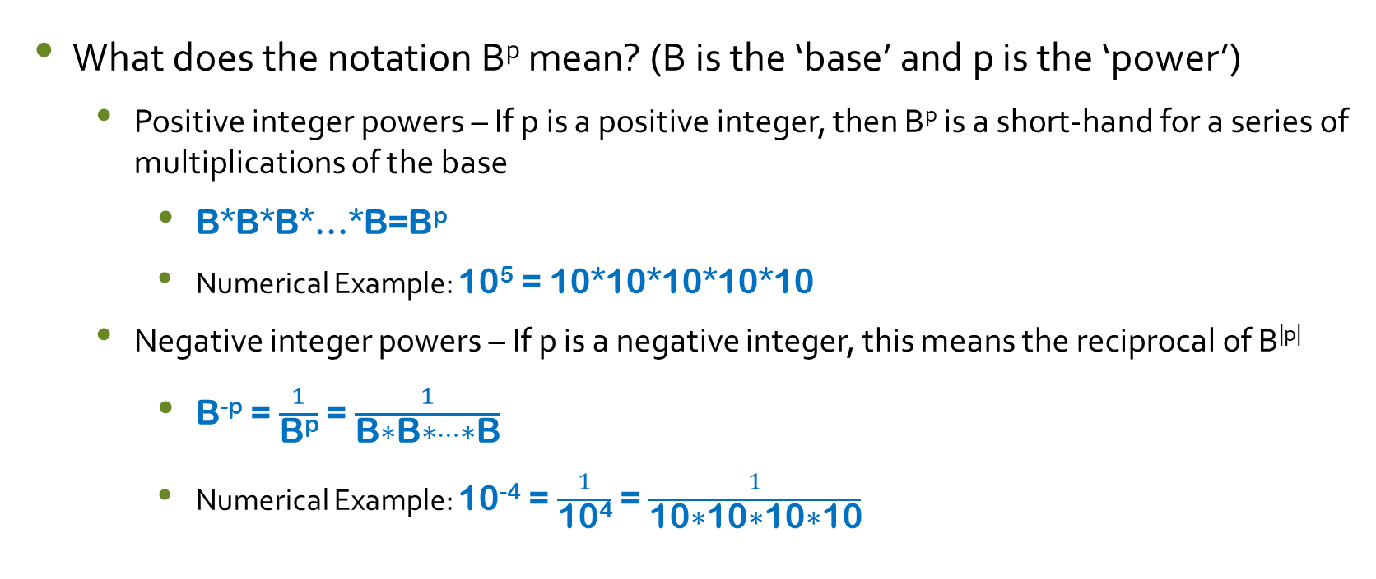
Powers
What does the notation B^{p} mean? (B is the ‘base’ and p is the ‘power’)
  Positive integer powers – If p is a positive integer, then B^{p} is a short-hand for a series of multiplications of the base
    B*B*B*…*B=B^{p}
    Numerical Example: 10⁵ = 10*10*10*10*10
  Negative integer powers – If p is a negative integer, this means the reciprocal of B^{|p|}
    B^{-p} = $\frac{1}{\text{B}\text{p}}$ = $\frac{1}{\text{B}\text{∗}\text{B}\text{∗}…\text{∗}\text{B}}$
    Numerical Example: 10⁻⁴ = $\frac{1}{\text{10}\text{4}}$ = $\frac{1}{\text{10}\text{∗10∗10∗10}}$

Slide 3
Roots
What does the notation B^{1/r} mean? (B is the ‘base’ and r is the ‘root’)
  The number (B^{1/r}) times itself r times is B
  (B^{1/r}) * (B^{1/r}) * … * (B^{1/r}) = B
Numerical example
  Cube root of 2 = 1.26…
  So (1.26…)*(1.26…)*(1.26…) = 2
Radical Notation
  Cube root of 2 = ³√2
  Square root of five = ²√5 = √5
Fractional Notation
  Cube root of 2 = 2^{1/3}

Slide 4

Rules for Combining Powers
B^{p}*B^{q} = B^{p+q}
  2³*2⁴ =(2*2*2)*(2*2*2*2) = 2⁷ = 2³⁺⁴
$\frac{\text{B}\text{p}}{\text{B}\text{q}}$ = B^{p-q}
  $\frac{\text{5}\text{3}}{\text{5}\text{2}}$= $\frac{\text{5∗5∗5}}{\text{5∗5}}$ = 5¹ = 5³⁻²
(B^{p})^{q} = B^{p*q}
  (4³)² =(4*4*4)*(4*4*4) = 4⁶ = 4^{3*2}
(B^{p})^{1/q} = B$\text{p}\text{/}\text{q}$ = (B$\text{1/}\text{q}$)^{p}
  (3²)$\text{1/}\text{3}$= 3$\text{2/3}$= (3$\text{1/}\text{3}$)² = 2.08008…

Slide 5

Powers and Roots Are Inverses of Each Other
(B^{p})$\text{1/}\text{p}$=B$\text{p}\text{/}\text{p}$= B¹= B
(B$\text{p}\text{/}\text{r}$)$\text{r}\text{/}\text{p}$=B$\text{p}\text{r}\text{/}\text{pr}$= B¹= B
Numerical examples
  Radical notation example
    (³√2)³ = ³√(2³) = 2
  Fractional power notation examples
    (10$\text{3}\text{/}\text{2}$)$\text{2}\text{/}\text{3}$= 10¹ = 10

Slide 6
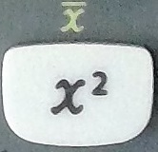
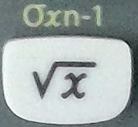
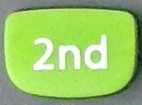
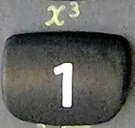
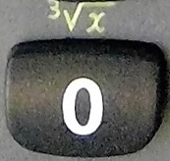
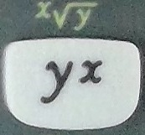
Examples: Evaluation
The integer powers and roots are unary functions.
  They take a single argument (number) and return the result.
See the TI-30Xa calculator tutorial, or the manual for your calculator, to determine exactly how to enter these functions.
Alternative notation:
  10^{2/3} = 10^(2/3) = 4.641589…
---------→
PEMDAS
Parentheses
Exponents
Multiplication
Division
Addition
Subtraction

Slide 7
Solving Equations: Single Function
To solve an equation for an unknown variable that is affected by only one power or root operation, you must apply the inverse of that operation to both sides of the equation.
The operation and its inverse ‘cancel each other’, leaving just the unknown on one side, and its value on the other.
  Example: x³ = 55
    The operation affecting ‘x’ is ‘cube’ or ‘3rd power’.
    Its inverse is ‘cube root’ or ‘3rd root’. Taking the cube root of both sides yields:
    ³√( x³ ) = ³√( 55 )
    x = 3.80
  Example: √x = 15
    The operation affecting ‘x’ is ‘square root’ or ‘2nd root’.
    Its inverse is ‘square’ or ‘2nd power’. Taking the square of both sides yields:
    ( √x )² = ( 15 )²
    x = 225

Slide 8
Solving Equations: Single Function
To solve an equation for an unknown variable that is affected by only one fractional power operation, you must apply the inverse of that operation to both sides of the equation.
The inverse of a fraction is its reciprocal (e.g 3/2 is the reciprocal of 2/3)
A fractional power is inverted by raising it to the reciprocal of that fractional power.
The operation and its inverse ‘cancel each other’, leaving just the unknown on one side, and its value on the other.
  Example: x ^{2/3} = 10
    The operation affecting ‘x’ is ‘2/3 power’ or ‘2nd power, 3rd root’.
    Its inverse is ‘2/3 root’ or ‘2nd root, 3rd power’. Taking the 3/2 power of both sides yields:
    ( x ^{2/3} )^{3/2} = ( 10 )^{3/2}
    x = 31.62

Slide 9
Conclusion
The functions we call ‘powers’ and ‘roots’ are inverse functions of each other
We can express roots in either radical notation or fractional power notation
To invert a function that is a fractional power, raise the function to the reciprocal of that fraction

