Slide 1
Trigonometry
ID1050– Quantitative & Qualitative Reasoning

Slide 2
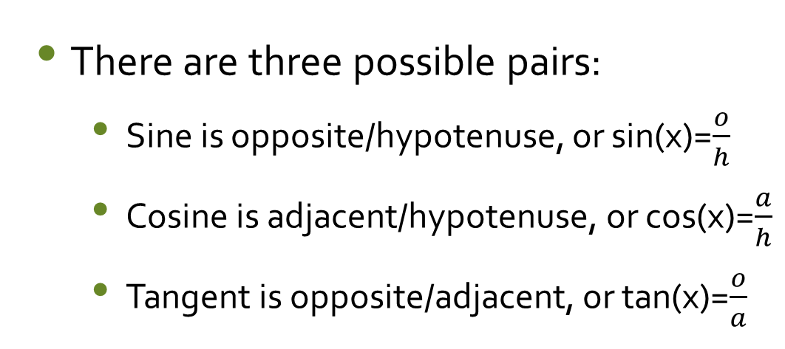
Triangle and Definitions
ypotenuse
Trigonometry is the study of the ratios of the sides of a right triangle.
One of the angles that isn’t the 90⁰ angle is labeled x.
The sides of the triangle are labeled relative to x:
  Adjacent (a)
  Opposite (o)
  Hypotenuse (h)
h
o
pposite
x
a
djacent
There are three possible pairs:
  Sine is opposite/hypotenuse, or sin(x)=$\frac{o}{h}$
  Cosine is adjacent/hypotenuse, or cos(x)=$\frac{a}{h}$
  Tangent is opposite/adjacent, or tan(x)=$\frac{o}{a}$

Slide 3
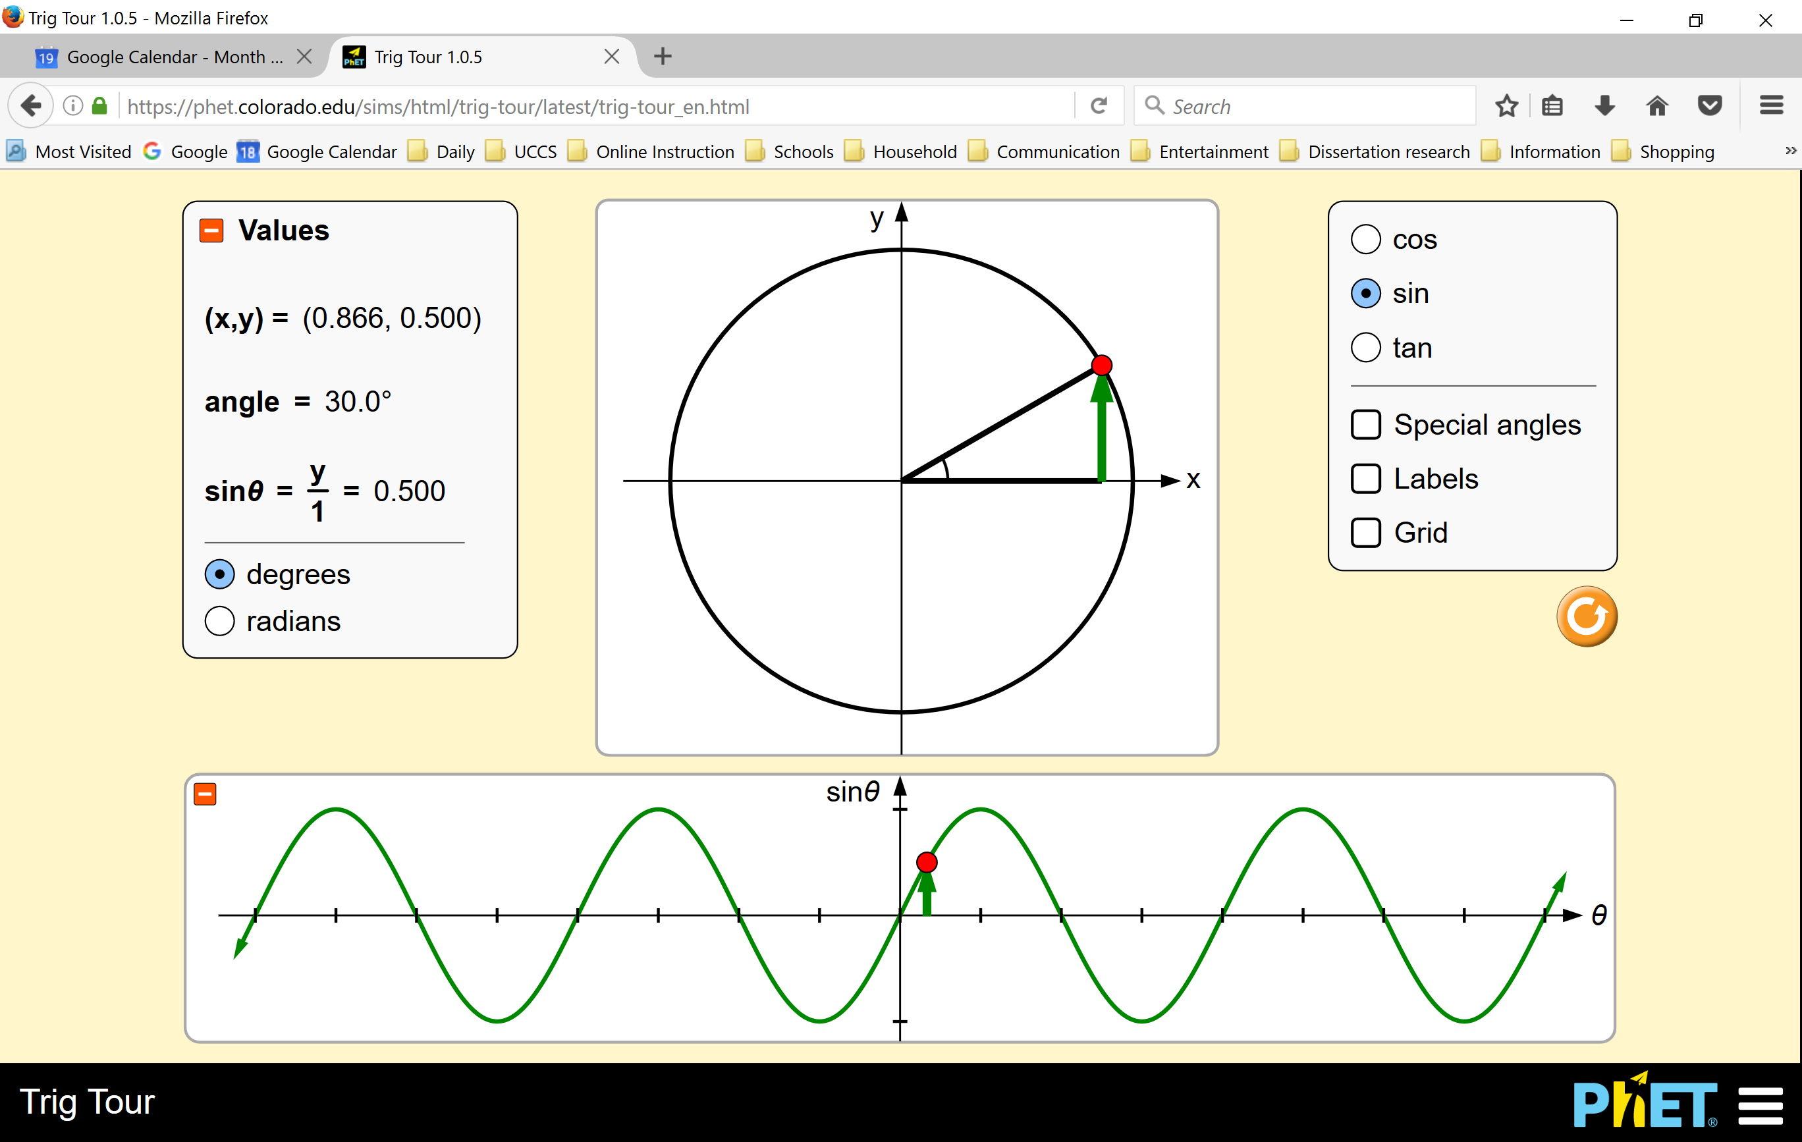
Interactive Simulation
This simulation illustrates the geometric relationship between the trigonometry functions and the right triangle. Some things to note:
  You can select sin, cos, and tan
  You can choose degrees or radians
  The angle and the function value are shown to the left.
  You can display the graph of the function versus angle (at the bottom). The connection between the triangle and the graph is shown by the red dot
https://phet.colorado.edu/en/simulation/trig-tour

Slide 4
Examples: Evaluation
The trigonometry functions are unary functions.
  They take a single argument (number), which is an angle, usually specified in either degrees or radians.
Examples:
  Sin(30º)=0.5
  Cos(30º)=0.866…
  Tan(45º)=1
In the order of operations, the trigonometry functions fall between Parentheses and Exponents
See the TI-30Xa calculator tutorial, or the manual for your calculator, to determine exactly how to enter these functions and to choose the
angle mode.
---------→
PEMDAS
Parentheses
Exponents
Multiplication
Division
Addition
Subtraction

Slide 5
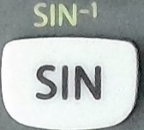
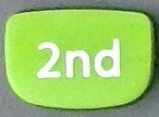
Inverse Trigonometric Functions
Each trigonometry functions has its own inverse
  Sine is inverted by the inverse sine, sin⁻¹ (also called arc-sine, anti-sine, or asin)
  Cosine is inverted by the inverse cosine, cos⁻¹ (also called arc-cosine, anti-cosine, or acos)
  Tangent is inverted by the inverse tangent, tan⁻¹ (also called arc-tangent, anti-tangent, or atan)
  The inverse functions are also unary functions. They take a single argument (number), and return an angle.
Calculators often use the same button for both a function and its inverse. The inverse function is usually accessed by first hitting the ‘2nd’ button, then the function button.
Inverse Sine
Sine

Slide 6
Inverse Trigonometric Functions
---------→
PEMDAS
Parentheses
Exponents
Multiplication
Division
Addition
Subtraction
In the order of operations, the inverse trigonometry functions also fall between Parentheses and Exponents
Evaluation examples:
  Sin⁻¹(0.5)=30º [ because Sin(30º)=0.5 ]
  Cos⁻¹ (0.866)= 30º [ because Cos(30º)=0.866 ]
  Tan⁻¹ (1)= 45º [ because Tan(45º)=1 ]

Slide 7
Solving Equations: Single Function
To solve an equation for an unknown variable that is affected by only one trigonometry operation, you must apply the inverse of that operation to both sides of the equation.
The operation and its inverse ‘cancel each other’, leaving just the unknown on one side, and its value on the other.
  Example: sin(x)=0.5
    The operation affecting ‘x’ is ‘sine’ or sin().
    Its inverse is ‘inverse sine’ or sin⁻¹(). Taking the inverse sine of both sides yields:
    sin⁻¹( sin(x) ) = sin⁻¹( 0.5 )
    x = 30º
  Example: tan⁻¹(x) = 16
    The operation affecting ‘x’ is ‘inverse tangent’ or tan⁻¹().
    Its inverse is ‘tangent’ or tan(). Taking the tangent of both sides yields:
    tan( tan⁻¹(x) ) = tan( 16 )
    x = 0.287

Slide 8
Conclusion
Trigonometry is the study of the relationship between angles and sides of a right triangle.
There are three important functions: sine, cosine, and tangent.
Each function has an inverse.

