Slide 1
Solving for the Unknown: Logarithms and Quadratics
ID1050– Quantitative & Qualitative Reasoning

Slide 2
Logarithms
Logarithm functions (common log, natural log, and their inverses) represent exponents, so they are the ‘E’ in PEMDAS.
Recall that the common log has a base of 10
  Log(x) = y means 10^{y}=x (10^{y} is also known as the common anti-log)
Recall that the natural log has a base of e
  Ln(x) = y means e^{y}=x (e^{y} is also know as the natural anti-log)
(evaluating)→
PEMDAS
←(inverting)
Parentheses
Exponents
Multiplication
Division
Addition
Subtraction
Function/Inverse Pairs
Log() and 10^{x}
LN() and e^{x}

Slide 3
Common Logarithm and Basic Operations
2-step inversion example: 2*log(x)=8
  Operations on x: Common log and multiplication by 2
  Divide both sides by 2: 2*log(x)/2 = 8/2 or log(x) = 4
  Take common anti-log of both sides: 10^{log(x)} = 10⁴ or x=10000
3-step inversion example: 2·log(x)-5=-4
  Operations on x: multiplication, common log, and subtraction
  Add 5 to both sides: 2·log(x)-5+5=-4+5 or 2·log(x)=1
  Divide both sides by 2: 2·log(x)/2=1/2 or log(x)=0.5
  Take common anti-log of both sides: 10^{log(x)} = 10^{0.5} or x=3.16
(evaluating)→
PEMDAS
←(inverting)
Parentheses
Exponents
Multiplication
Division
Addition
Subtraction
Function/Inverse Pairs
Log() and 10^{x}
LN() and e^{x}

Slide 4
Common Anti-Logarithm and Basic Operations
2-step inversion example: 5*10^{x}=6
  Operations on x: 10^{x} and multiplication
  Divide both sides by 5: 5*10^{x}/5 = 6/5 or 10^{x}=1.2
  Take common log of both sides: log(10^{x})=log(1.2) or x=0.0792
3-step inversion example: 10^{x}/2-5=0
  Operations on x: division, 10^{x}, and subtraction
  Add 5 to both sides: 10^{x}/2-5+5=0+5 or 10^{x}/2=5
  Multiply both sides by 2: 10^{x}/2*2=5*2 or 10^{x}=10
  Take common log of both sides: log(10^{x})=log(10) or x=1
(evaluating)→
PEMDAS
←(inverting)
Parentheses
Exponents
Multiplication
Division
Addition
Subtraction
Function/Inverse Pairs
Log() and 10^{x}
LN() and e^{x}

Slide 5
Natural Logarithm and Basic Operations
2-step inversion example: 2*LN(x)=4
  Operations on x: Natural log and multiplication by 2
  Divide both sides by 2: 2*LN(x)/2 = 4/2 or LN(x) = 2
  Take natural anti-log of both sides: e^{LN(x)} = e² or x=7.39
3-step inversion example: 3LN(x)+5=8
  Operations on x: multiplication, natural log, and addition
  Subtract 5 from both sides: 3LN(x)-5+5=8-5 or 3LN(x)=3
  Divide both sides by 3: 3LN(x)/3=3/3 or LN(x)=1
  Take natural anti-log of both sides: e^{LN(x)} = e¹ or x=2.72
(evaluating)→
PEMDAS
←(inverting)
Parentheses
Exponents
Multiplication
Division
Addition
Subtraction
Function/Inverse Pairs
Log() and 10^{x}
LN() and e^{x}

Slide 6
Natural Anti-Logarithm and Basic Operations
2-step inversion example: e^{x}/3=1
  Operations on x: e^{x} and division
  Multiply both sides by 3: e^{x}/3*3 = 1*3 or e^{x}=3
  Take natural log of both sides: LN(e^{x})=LN(3) or x=1.10
3-step inversion example: 2*e^{x}-1=2
  Operations on x: multiplication, e^{x}, and subtraction
  Add 1 to both sides: 2*e^{x}-1+1=2+1 or 2*e^{x}=3
  Divide both sides by 2: 2*e^{x}/2=3/2 or e^{x}=1.5
  Take natural log of both sides: LN(e^{x})=LN(1.5) or x=0.405
(evaluating)→
PEMDAS
←(inverting)
Parentheses
Exponents
Multiplication
Division
Addition
Subtraction
Function/Inverse Pairs
Log() and 10^{x}
LN() and e^{x}

Slide 7
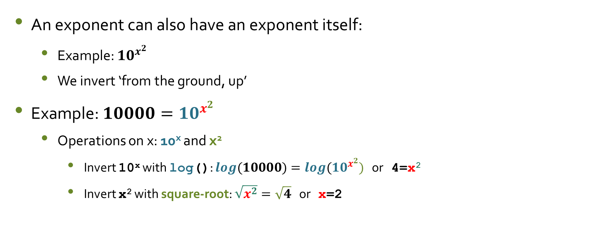
Double Exponents
An exponent can also have an exponent itself:
  Example: ${10}^{x^{2}}$
  We invert ‘from the ground, up’
Example: ${10000=10}^{x^{2}}$
  Operations on x: 10^{x} and x²
    Invert 10^{x} with log(): ${log(10000)=log(10}^{x^{2}})$ or 4=x²
    Invert x² with square-root: $\sqrt{x^{2}}=\sqrt{4}$ or x=2

Slide 8
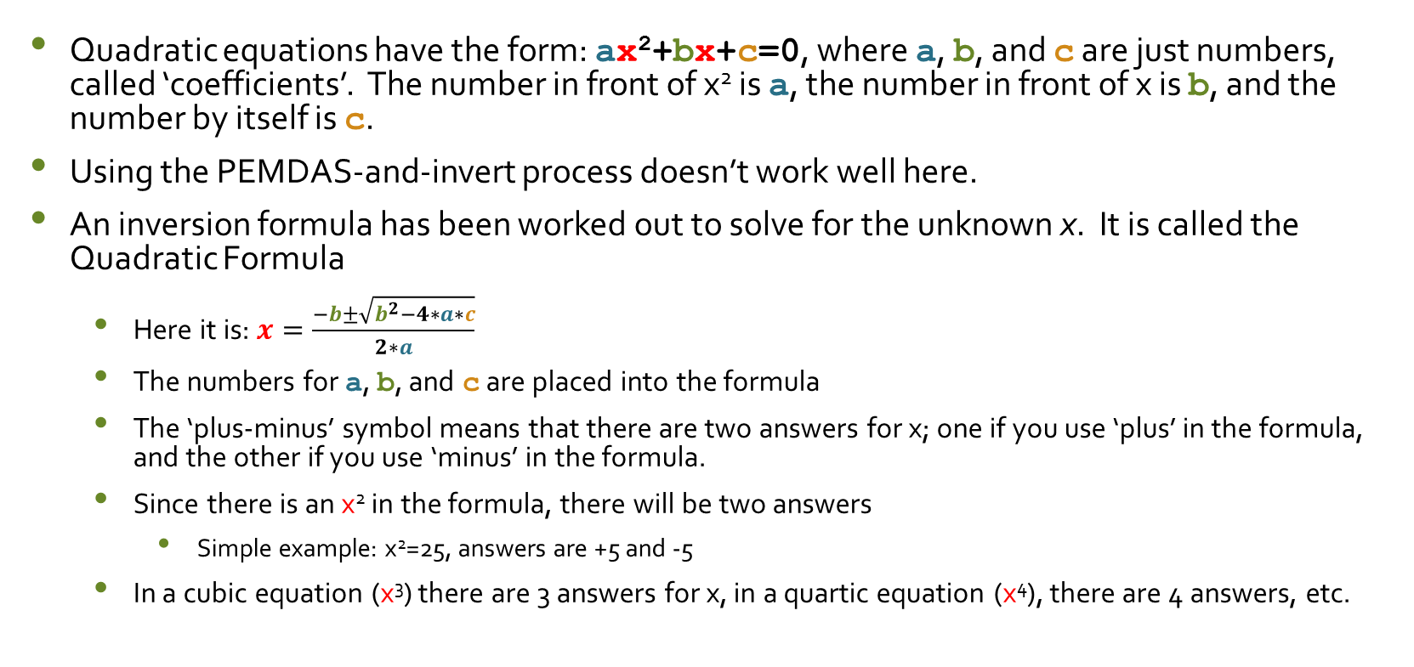
Quadratic Equations
Quadratic equations have the form: ax²+bx+c=0, where a, b, and c are just numbers, called ‘coefficients’. The number in front of x² is a, the number in front of x is b, and the number by itself is c.
Using the PEMDAS-and-invert process doesn’t work well here.
An inversion formula has been worked out to solve for the unknown x. It is called the Quadratic Formula
  Here it is: $x=\frac{−b±\sqrt{b^{2}−4∗a∗c}}{2∗a}$
  The numbers for a, b, and c are placed into the formula
  The ‘plus-minus’ symbol means that there are two answers for x; one if you use ‘plus’ in the formula, and the other if you use ‘minus’ in the formula.
  Since there is an x² in the formula, there will be two answers
    Simple example: x²=25, answers are +5 and -5
  In a cubic equation (x³) there are 3 answers for x, in a quartic equation (x⁴), there are 4 answers, etc.

Slide 9
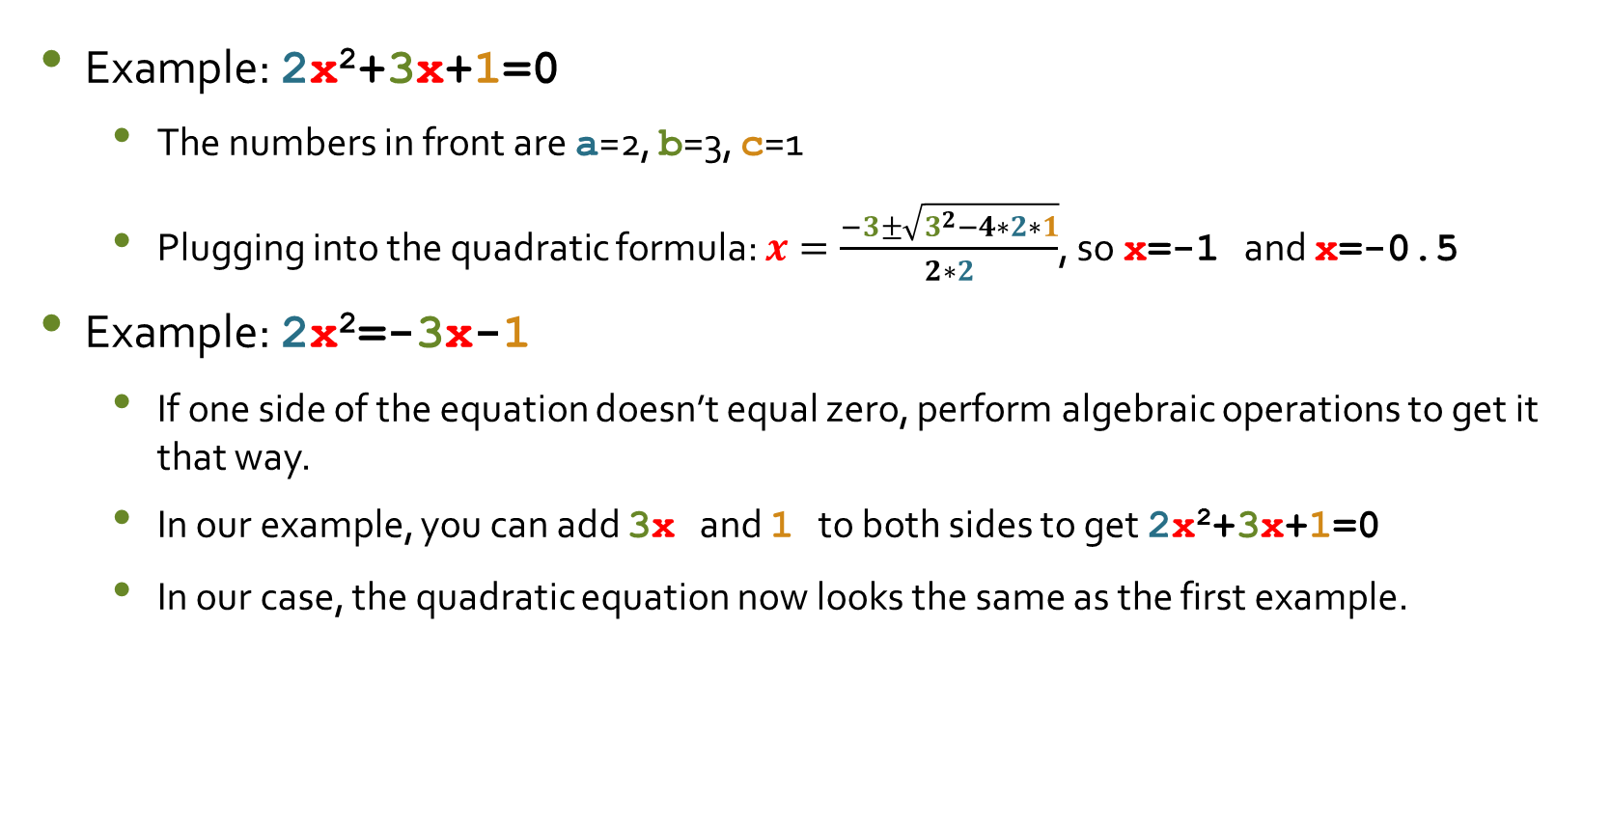
Examples: Quadratic Formula
Example: 2x²+3x+1=0
  The numbers in front are a=2, b=3, c=1
  Plugging into the quadratic formula: $x=\frac{−3±\sqrt{3^{2}−4∗2∗1}}{2∗2}$, so x=-1 and x=-0.5
Example: 2x²=-3x-1
  If one side of the equation doesn’t equal zero, perform algebraic operations to get it that way.
  In our example, you can add 3x and 1 to both sides to get 2x²+3x+1=0
  In our case, the quadratic equation now looks the same as the first example.

Slide 10
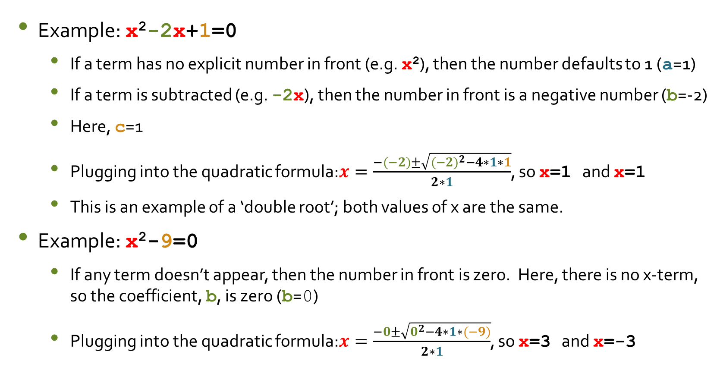
Examples: Quadratic Formula
Example: x²-2x+1=0
  If a term has no explicit number in front (e.g. x²), then the number defaults to 1 (a=1)
  If a term is subtracted (e.g. -2x), then the number in front is a negative number (b=-2)
  Here, c=1
  Plugging into the quadratic formula:$x=\frac{−(−2)±\sqrt{{(−2)}^{2}−4∗1∗1}}{2∗1}$, so x=1 and x=1
  This is an example of a ‘double root’; both values of x are the same.
Example: x²-9=0
  If any term doesn’t appear, then the number in front is zero. Here, there is no x-term, so the coefficient, b, is zero (b=0)
  Plugging into the quadratic formula:$x=\frac{−0±\sqrt{0^{2}−4∗1∗(−9)}}{2∗1}$, so x=3 and x=-3

Slide 11
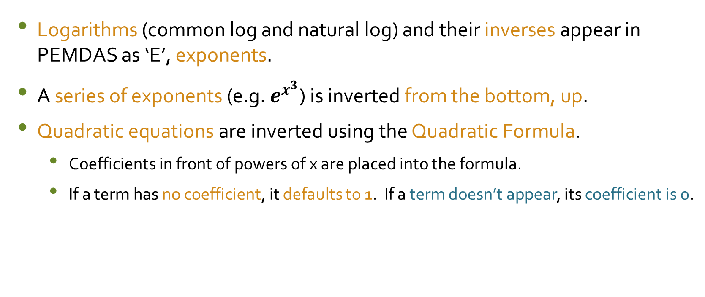
Conclusion
Logarithms (common log and natural log) and their inverses appear in PEMDAS as ‘E’, exponents.
A series of exponents (e.g. $e^{x^{3}}$) is inverted from the bottom, up.
Quadratic equations are inverted using the Quadratic Formula.
  Coefficients in front of powers of x are placed into the formula.
  If a term has no coefficient, it defaults to 1. If a term doesn’t appear, its coefficient is 0.

