Slide 1
Graphing Statistical Data
ID1050– Quantitative & Qualitative Reasoning

Slide 2
Definitions
Classes
  This is another word for the groups to which the data can belong.
  Classes can be:
    Nominal (or ‘name-based’, like US state of birth or hair color)
    Ordinal (or ‘order-based’, like high/medium/low or all/some/none)
    Numerical (integers, like 1, 2, 3, …, or ranges, like 1-2, 2-3, 3-4, etc.)
Frequency
  This is another word for the number or the count of members in each class.

Slide 3
Bar Graph
Bar graphs are used for discrete data, which includes data grouped by name (nominal), order (ordinal), or integers.
It is assumed that grouping rules have been established that enable individual data to be unambiguously placed into a group. (For hair color, where do we place an individual with greying black hair?)
Since the data itself is discrete the bars that represent each group are separated from each other with gaps.

Slide 4
Bar Graph: Example
Data: 1, 1, 2, 3, 4, 4, 5, 5, 5
Center each bar over its class label.
Here the classes are numbers, but they could also be names or ranking words.
Class | Frequency
1 | 2
2 | 1
3 | 1
4 | 2
5 | 3

Slide 5
Histogram
Histograms look very similar to bar graphs.
Histograms are used for continuous numerical data.
A class (group) for a histogram is a range of numbers.
It is assumed that rules have been established that determine which class a number on the border between two classes should be placed.
  Example: If the classes are 1-2 and 2-3, where should 2.0 be placed?
  Usually, the rule is to promote the ‘fence-sitter’ to the higher class.
Since the data itself is continuous the bars that represent each group are touching each other, with no gaps between.

Slide 6
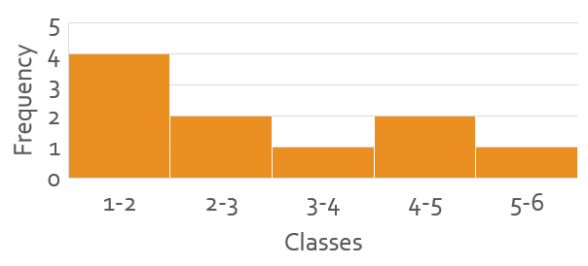
Histogram: Example
Data: 1.1, 1.2, 1.3, 1.8, 2.0, 2.6, 3.1, 4.6, 4.8, 5.1
We have chosen the ranges shown so that each class has a reasonable number of members. Choice of class ranges can have profound effects on how the histogram appears.
Here, we will use the ‘promote the fence-sitter’, so that 2.0 will belong to the class with range 2-3.
Class | Frequency
1-2 | 4
2-3 | 2
3-4 | 1
4-5 | 2
5-6 | 1

Slide 7
Conclusion
Graphing statistical data is a good deal less complicated than graphing of functions.
Bar graphs and histograms are the two main types of graphing, and they are very similar:
  The x-axis has the classes (groupings) of the data.
  A vertical bar is placed over each class, with a height that is the frequency.
Bar graphs and histograms are different:
  Bar graphs are used for discrete data, while histograms are used for continuous data.
  Each column of a bar graph has a gap between its neighbors, reflecting the discrete nature of the data.
  Each column of a histogram touches its neighbors, reflecting the continuous nature of the data.

