Slide 1
Inductive Arguments: Fallacies
ID1050– Quantitative & Qualitative Reasoning

Slide 2
Analyzing an Inductive Argument
In an inductive argument, the conclusion follows from its premises with some likelihood.
Inductive arguments can be strong, weak, or somewhere between.
Ways to attack an inductive argument:
  Introduce additional (contradictory) premises that weaken the argument.
  Question the accuracy of the supporting premises.
  Identify one (or more) logical fallacies in the argument.

Slide 3
What is a Fallacy?
A logical fallacy is an error in reasoning in an argument.
Formal fallacy
  A ‘formal fallacy’ is an error in the structure of an argument.
  Formal fallacies are used to analyze deductive arguments for validity by means of symbolic logic.
Informal fallacy
  An ‘informal fallacy’ is an error in the content of an argument.
  This is the type of fallacy that will be discussed in this presentation.
An argument with a fallacy is said to be ‘fallacious’.

Slide 4
Formal and Informal Fallacies
Formal fallacy example:
  All humans are mammals.
  All dogs are mammals.
  So, all humans are dogs.
  This argument has a structural flaw. The premises are true, but they do not logically lead to the conclusion. This would be uncovered by the use of symbolic logic.
Informal fallacy example:
  All feathers are light.
  Light is not dark.
  So, all feathers are not dark.
  The structure of this argument is actually correct. The error is in the content (different meanings of the word ‘light’.) It uses a fallacy called ‘Equivocation’.

Slide 5
Lists of Fallacies
There are a great number of identified fallacies of the informal type. Following are some good websites that list them and provide definitions and examples. Keep in mind that some fallacies have other names.
  The Fallacy Files: http://fallacyfiles.org
  Stephen’s Guide: https://www.fallacies.ca/toc.htm
  Internet Encyclopedia of Philosophy: http://www.iep.utm.edu/fallacy
We will focus on only ten fallacies for this course.
  Against the Person, Appeal to Force, Appeal to Pity, Argument from Ignorance, Argument to the People, Appeal to Authority, Accident, Hasty Generalization, Begging the Question, and False Cause
The best way to learn fallacies is to look at examples of them.
  To get a better understanding of each fallacy, explore these websites and do internet searches to observe more examples of each fallacy.

Slide 6
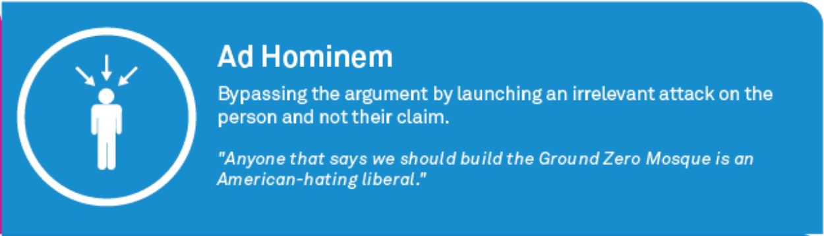
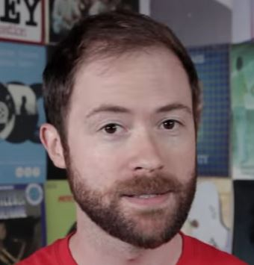
Against the Person
This fallacy is committed when an argument attacks the person instead of the person’s argument.
Other names: Ad hominem, personal attack
Example: Maxine should not get that job at the bank. She has no taste in boyfriends and her apartment is a mess.
  Corrected: Maxine should not get that job at the bank. She has no sense for money and her finances are a mess.
Links
Stephen’s Guide
Fallacy Files
IEP

Slide 7
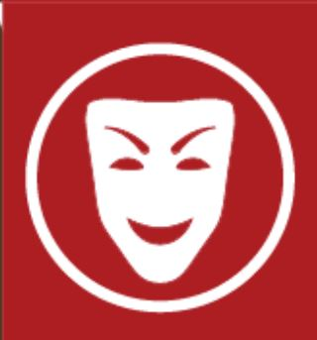

Appeal to Force
This fallacy is committed when one of the premises has a threat or implication of danger.
Other names: Scare tactics, argumentum ad baculum
Example: You are not to drive the family car any more this week. If you do, you will find yourself living in the dog house for a month.
  Corrected: You are not to drive the car this week, because you bring it back without gas and you got a ticket last week.
Links
Stephen’s Guide
Fallacy Files
IEP
Supporting your argument not by facts but by an implied threat.
“You’d better raise my grade because my father knows the principal.”

Slide 8
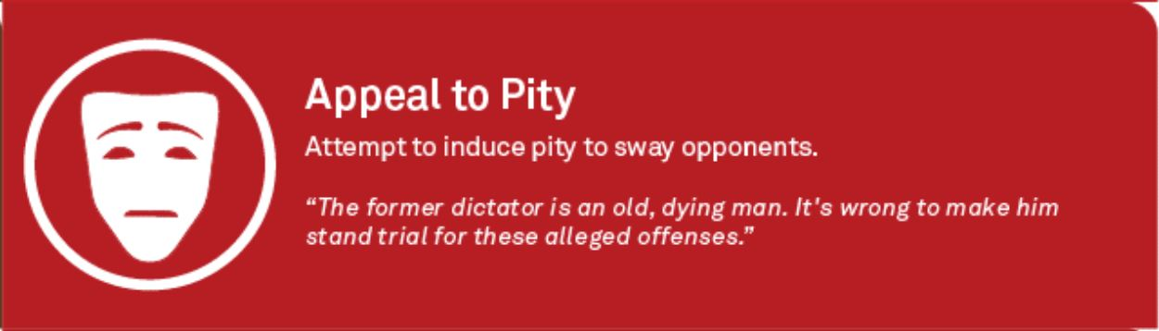
Appeal to Pity
This fallacy can be recognized by one or more premises intended to appeal to your emotion rather than your reason.
Other names: Argumentum ad misericortium
Example: Dr. Smith, I know I missed the last test but I would really like you to throw it out because my life has been a mess. My girlfriend broke up with me, and my grandmother is ill.
  Corrected: Dr. Smith, may I be given a chance to make up the exam? My ex-girlfriend, who gives me rides to campus, broke up with me right before the exam yesterday.
Links
Stephen’s Guide
Fallacy Files
IEP

Slide 9
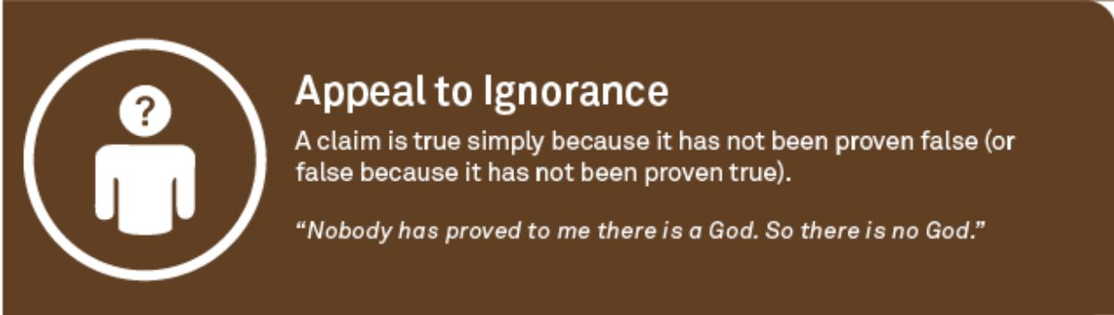
Argument from Ignorance
This fallacy is committed when the proposition relies only on the fact that it has never been proven false. It is an argument based on lack of proof.
Other names: Argumentium ad Ignoratium
Examples:
  There must be aliens at Area 51 because no one has ever proven there aren’t.
  There must not be any aliens in Area 51. If there were, someone would have proven it by now.
    Corrected: There must be aliens at Area 51 because the government just released their bodies to be studied by medical universities around the world.
Links
Stephen’s Guide
Fallacy Files
IEP

Slide 10
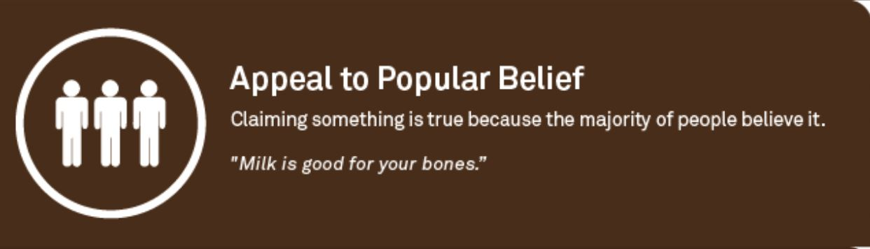

Argument to the People
This fallacy is committed when the only premise is that other people accept it to be true. It is very common in advertising.
Other names: Bandwagon, appeal/argument to the people/popularity
Example: If you want to be as cool as the people in this commercial, then you have to drink the same beer that they do.
  Corrected: Drink this beer because it has a great taste and is an excellent bargain, as well.
Links
Stephen’s Guide
Fallacy Files
IEP

Slide 11
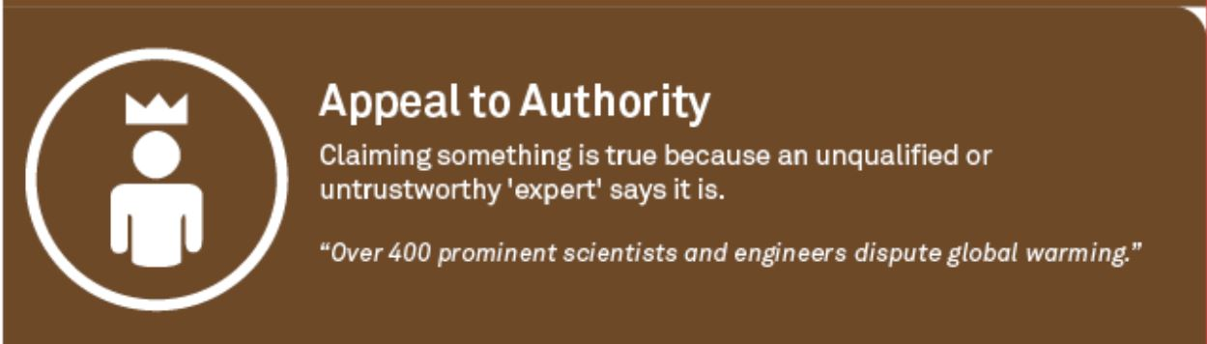
Appeal to Authority
Arguments may be strengthened by the support of a legitimate expert, but not by a person who is not a recognized authority on the subject.
Other names: Appeal to False Authority/Celebrity, name-dropping
Example: Quantum mechanics proves that the mind is independent of the brain, a question philosophers have had for years. I just learned this from my orthopedic surgeon.
  Corrected: Quantum mechanics proves that the mind is independent of the brain, a question philosophers have had for years. I just learned this from my philosophy teacher.
Links
Stephen’s Guide
Fallacy Files
IEP

Slide 12
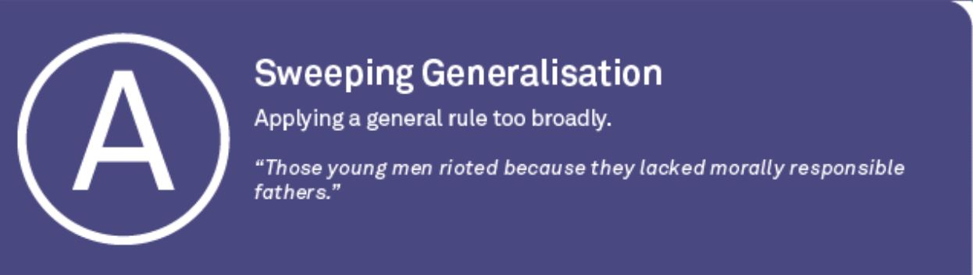
Accident
This fallacy is committed when one takes a rule which is widely accepted as good or true and misapplies it to a circumstance it was never intended to cover. (Accident is the converse of Hasty Generalization)
Other names: Sweeping generalization
Example: The constitution allows all Americans to bear arms. I don’t see how we can prevent someone from carrying a gun into a bank if they want to.
  Corrected: The constitution allows all Americans to bear arms. I don’t see why we should prevent someone from storing a gun in their home if it was legally purchased.
Links
Stephen’s Guide
Fallacy Files
IEP

Slide 13
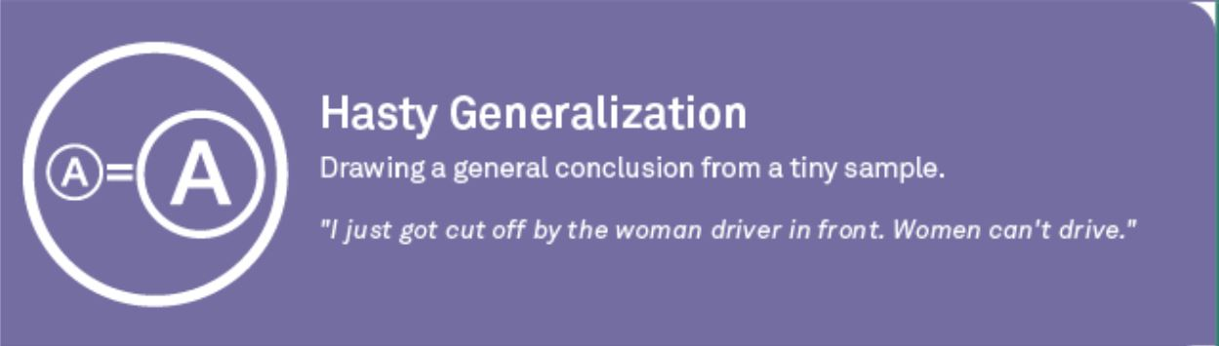
Hasty Generalization
This fallacy is committed when one takes a very specific circumstance or a small set of data and tries to misapply it to a broad category or make a general rule from it. (Hasty Generalization is the converse of Accident.)
Other names: Jumping to conclusions, stereotyping
Example: Some friends from California are staying with us. They drive like maniacs, speeding, passing on the right, running red lights. I guess people from California are really irresponsible drivers.
  Corrected: Our friends from California speed, pass on the right, and run red lights. I guess my friends are really irresponsible drivers.
Links
Stephen’s Guide
Fallacy Files
IEP

Slide 14
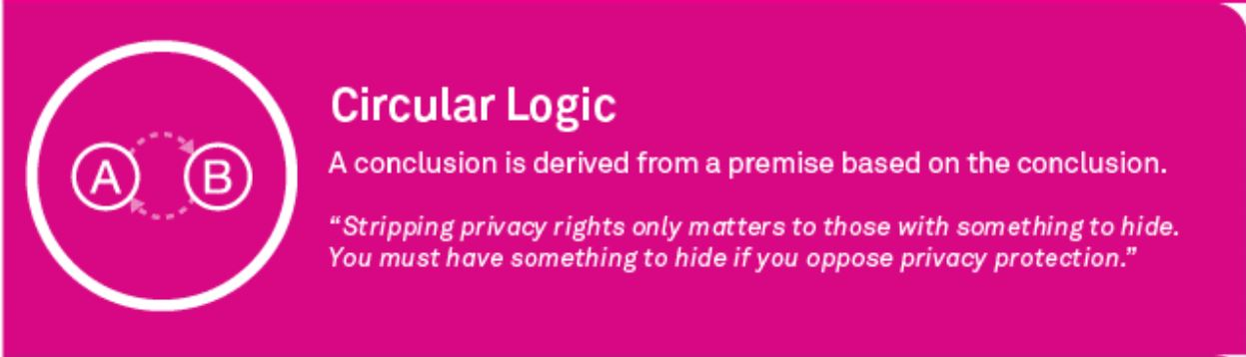

Begging the Question
This fallacy occurs when the conclusion is used as one of the premises. Often the offending premise has been restated in a way to obscure the fact it is being used as the conclusion.
Other names: Circular reasoning, vicious circle
Example: Tom Clancy is a better writer than Stephen King because people with discerning taste prefer Clancy over King. You can always identify people with discerning taste by the fact that they like Clancy much more than King.
  Corrected: Tom Clancy is a better writer than Stephen King because Clancy’s novels use more intricate plots, his characters are fully developed, and his stories are plausible.
Links
Stephen’s Guide
Fallacy Files
IEP

Slide 15
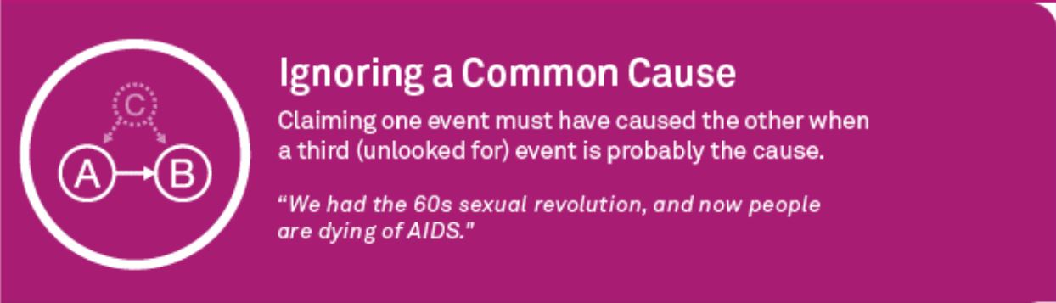
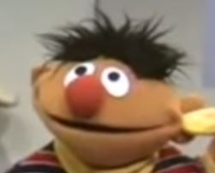
False Cause
Just because two events are occur at the same time, it doesn’t mean that they are related. Also, because one event preceded another event, it doesn’t mean that it caused the second event.
Other names: Superstition; post hoc ergo propter hoc, cum hoc ergo proper hoc
Example: Every time I wash my car, it rains. I guess washing my car today would be a bad idea, if we want to have fun in the sun.
  Corrected: Every time I wash my car, it gets clean. On a different topic, I hope it doesn’t rain today.
Links
Stephen’s Guide
Fallacy Files
IEP

Slide 16
A List of Fallacies: Reasoning Errors in Content
Fallacy | Other Names | Stephen’s Guide | Fallacy Files | IEP
Against the Person | Ad hominem | Link | Link | Link
Appeal to Force | Scare tactic | Link | Link | Link
Appeal to Pity |  | Link | Link | Link
Argument from Ignorance | Appeal to ignorance | Link | Link | Link
Argument to the People | Appeal to the people/popularity; Bandwagon | Link | Link | Link
Appeal to Authority | False authority; name dropping | Link | Link | Link
Accident | Sweeping generalization | Link | Link | Link
Hasty Generalization | Jumping to conclusions | Link | Link | Link
Begging the Question | Circular reasoning | Link | Link | Link
False Cause | Superstition; Post hoc; Cum hoc | Link | Link | Link

Slide 17
Image Attributions
Rhetological Arguments – Information is Beautiful – David McCandless http://www.informationisbeautiful.net/visualizations/rhetological-fallacies/
Additional Links
Illustrated Book of Bad Arguments
Flag on the Play! Logic Memes

