Slide 1
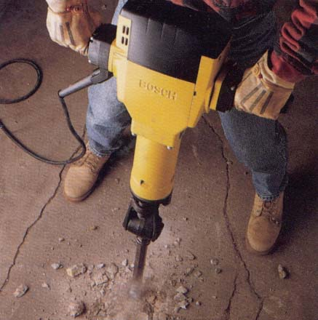
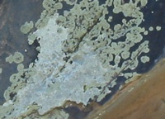
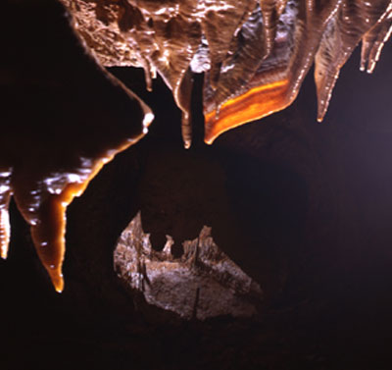
From 9/18: WEATHERING PROCESS REVIEW
Physical weathering
frost wedging (36)
salt wedging (14)
temperature change (31)
unloading (3)
spheroidal (5)
hydration (8)
Biological weathering
root pry (32)
lithobionts (34)
burrowing animals (14)
Chemical weathering
dissolution (19)
caveofthewinds.com

Slide 2
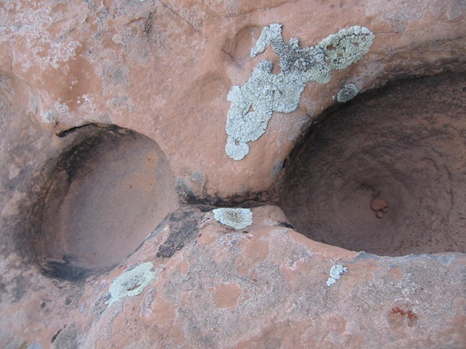
From 9/18: WEATHERING FORM REVIEW
Weathering forms
gnamma pits (7)
tafoni (21)
honeycombs (30)
cavities (20)
theater-headed valleys (11)
arches (25)
caveofthewinds.com

Slide 3
1. (5) What is the difference between weathering and erosion?
2. What is a “gnamma pit”? How do they form?
3. (35) How do plants help resist erosion? (give TWO examples)
Example 1:
Example 2:
4. (4) How do plants help accelerate weathering? (give TWO examples)
Example 1:
Example 2:
5. (5) What is physical weathering?
6. (7) What is chemical weathering?
7. (32) How does physical weathering help (accelerate) chemical weathering?
8. What role does an impermeable rock layer play in groundwater sapping?

Slide 4
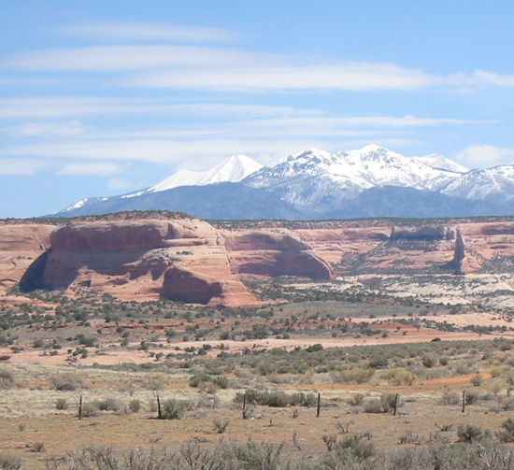
(11)
6a - Based on the fact that, generally, mountainous areas receive more precipitation than their surrounding lowlands, do you think there is more or less weathering taking place in the mountains or in the foreground and why?

Slide 5
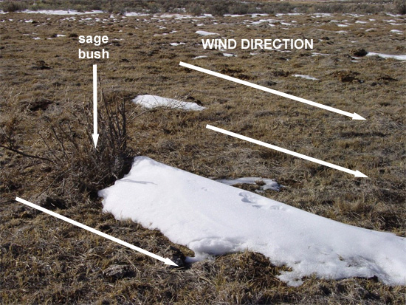
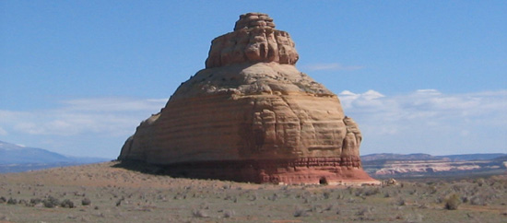
(23)
6b - Based on what you know about wind and sand, what would you say the prevailing wind direction is in this place, and why?

Slide 6
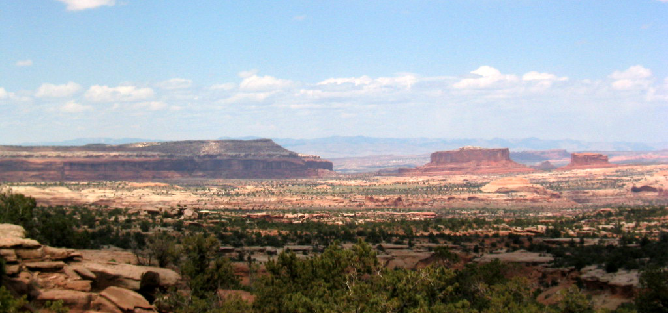
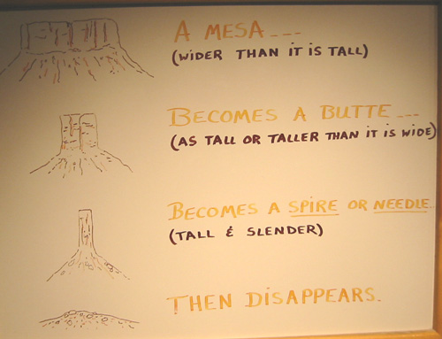
(4)
6e - If I suggested to you that, one day, one of the above mesas or buttes would someday be the same size and shape of Beehive Rock, would you say I was totally nuts, and why?

Slide 7
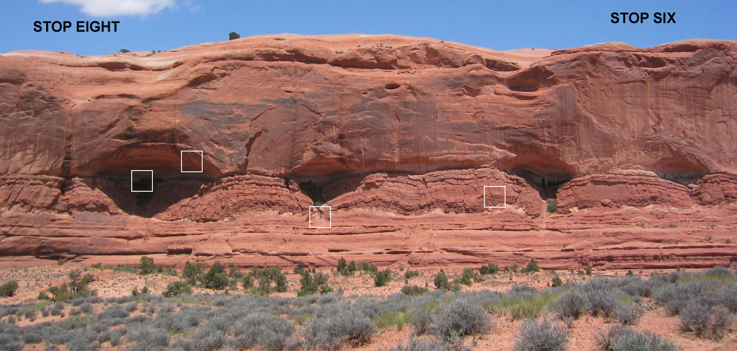
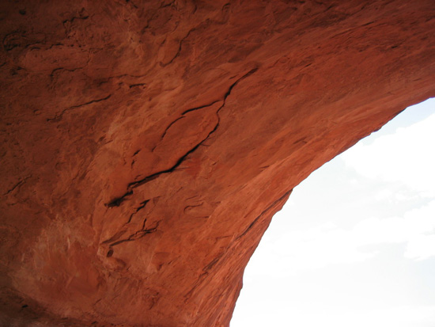
(19)
7a - Notice how the sandstone is "flaking" off in sheets... Knowing that solids expand when heated, and knowing that that these flakes of sandstone probably weigh literally thousands of pounds, do you think it would be safe to have a hot campfire inside of this alcove, and why?

Slide 8
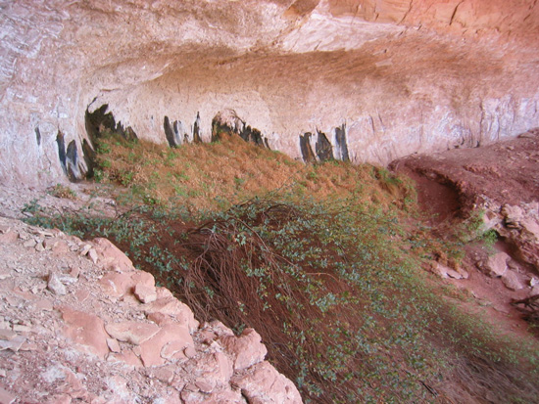
(33)
7b - What processes other than freeze thaw and salt crystal growth can you think of that might help to enlarge (weather) these forms?

Slide 9
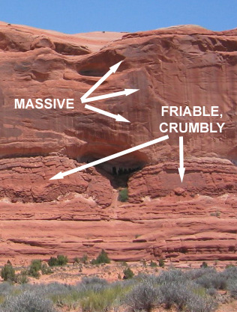
(10)
7c - Where in this series of strata do you think the "barrier" (impermeable) layer is that is channeling the water to the seepage, and what can you say about the permeability of the layer of sandstone above the impermeable layer?

Slide 10
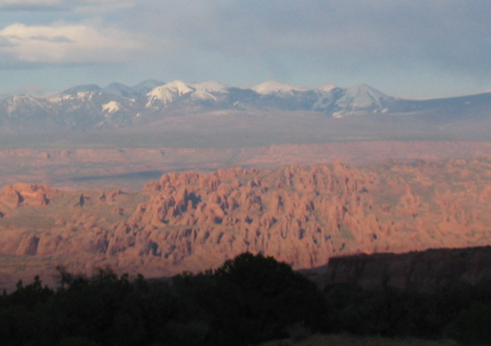
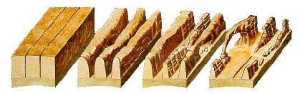
(20)
8b - Using the Helper image below, what stage in the landform evolution process (from fractured bedrock to natural arch) do you think the fins are above (use image below to select a stage), and why?
Stage 1
Stage 2
Stage 3
Stage 4

Slide 11
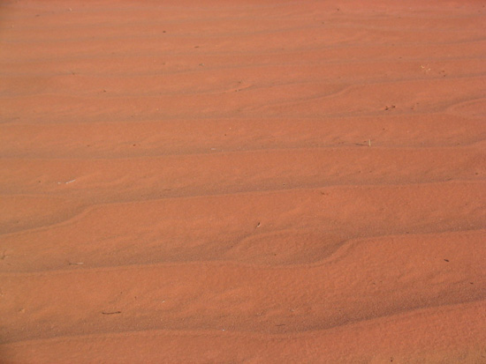
(12)
8c - Here's an image of sand.. a very common site on the Colorado Plateau. Notice the little ripples on the sand surface. What are possible sources for this sand?

Slide 12
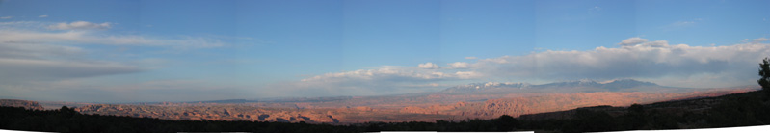
(27)
8d - The time is evening... We are in Utah (38 degrees north latitude); and we are in the shadow of a hill (mountain) behind us. In which direction (N, S, E, W) was the image taken (which direction was the camera pointing)?

Slide 13
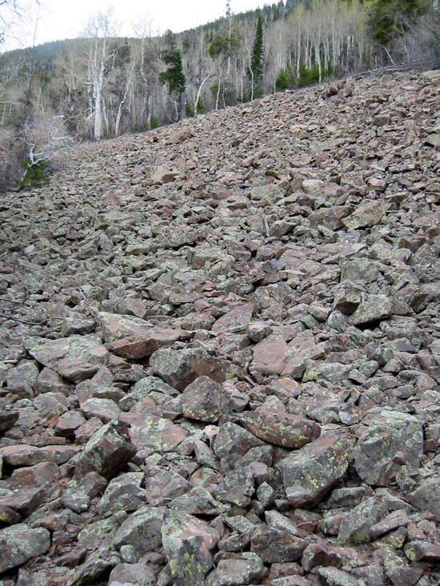
(26)
9b - What is the predominate weathering process that is breaking up these rocks?

Slide 14
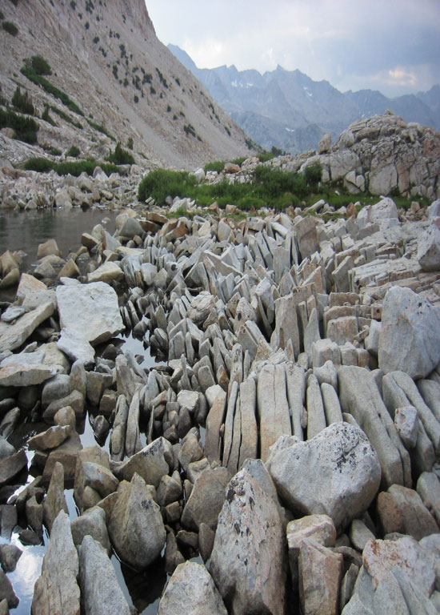
(14)
9c - What is the predominate weathering process that is breaking up the rocks AND why do they become more and more weathered (broken up) from right to left?

Slide 15
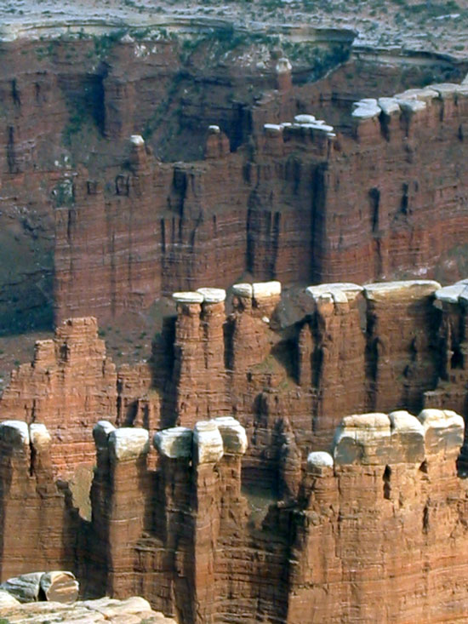
(30)
13a - What can you say about the "white" sandstone and about the reddish sandstone below in terms of their resistances to weathering?

Slide 16
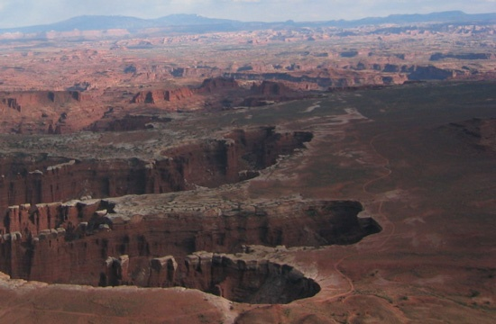
(3)
13b - What process is undermining the headwall of these canyons?

Slide 17
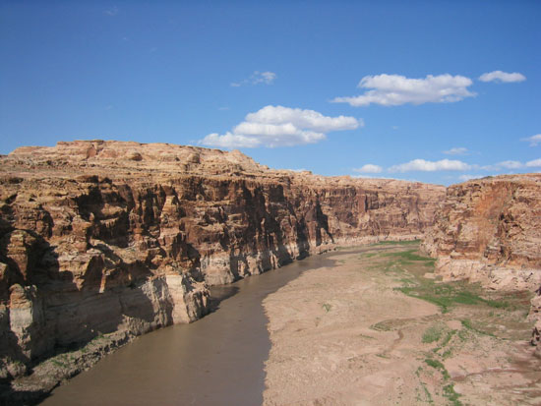
(18)
14a - Why is there no talus built up along the scarps here?

Slide 18
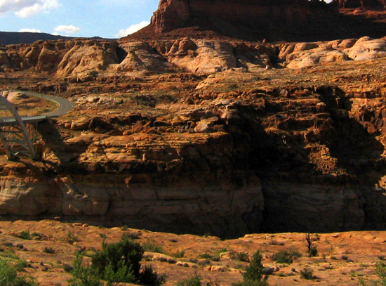
(17)
14b - Why do you think the decision was made to cross the river at this particular spot?

Slide 19
Mass Wasting (from Ch. 15)

Slide 20
mass wasting
The relatively rapid movement of bedrock, debris, regolith, and/or soil down a slope a short distance
Landform / human scale
Unweathered rock resists forces; weathered rock not as much
Gravity dominates
No transporting medium required
Requires a trigger
Produces colluvium

Slide 21
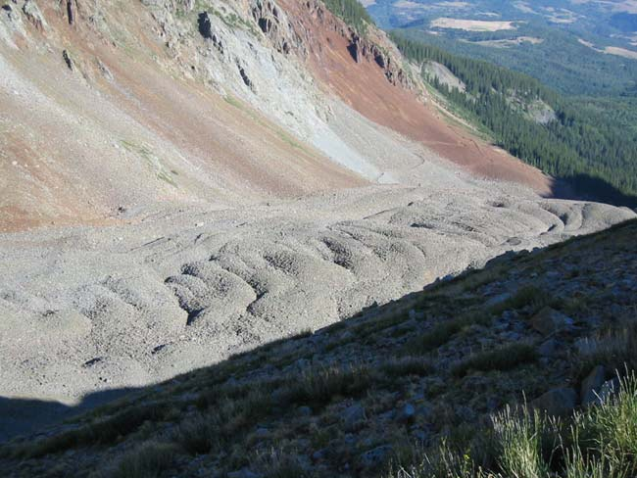
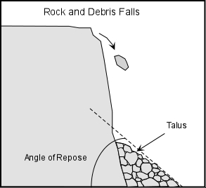
mass wasting
Angle of repose
  talus 30 to 37°
  dry sand 28 to 30°
~32 °

Slide 22
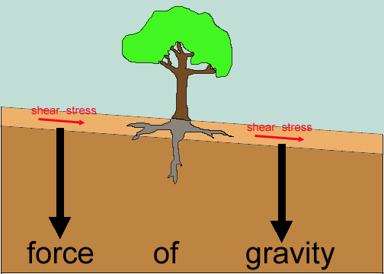
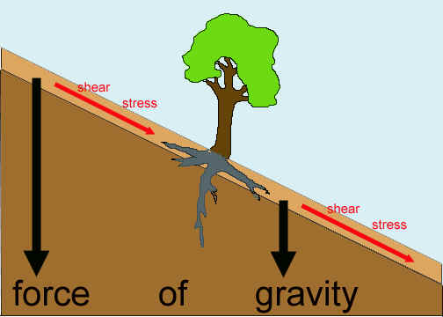
mass wasting – shear stress vs. shear strength
Shear strength
Shear strength
    When shear stress exceeds shear strength, mass wasting occurs. What about bedding planes and joints?

Slide 23
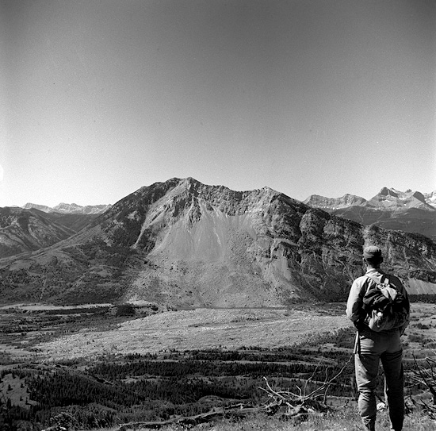
mass wasting
Year Location Name Cause Deaths
Tadzhik Russia Kahit slide 7.5 EQ 200,000
Peru Huascaran debris aval. 7.7 EQ 18,000
Peru Huascaran debris aval. ?? EQ 5,000
1969 Virginia, USA Hurricane Camille 30 in. in 8 hrs. 150
Alberta, Canada Frank slide ?? 70+
2014 Washington Oso mudslide ?? 43
http://www.suite101.com/view_image.cfm/641283

Slide 24
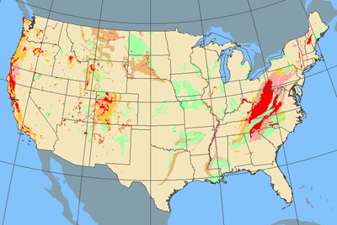
mass wasting
United States landslide incidence and susceptibility map.
National Atlas of the United States
http://nationalatlas.gov/articles/geology/a_landslide.html

Slide 25
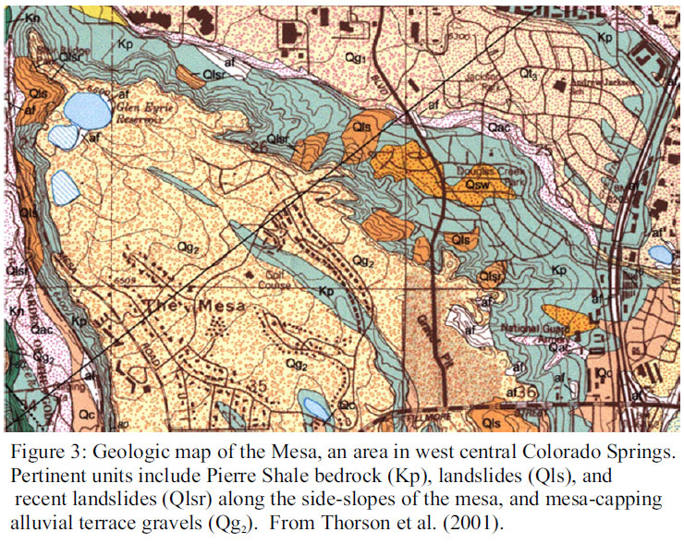
mass wasting

Slide 26
mass wasting triggers / causes
    Vibration
      earthquakes
      meteor impact
      nuclear testing
      trucks / trains
      volcanic eruptions
    Rain, heavy or light
    Watering / leaky pipes
    Oversteepening
      Cut banks in streams
      Road cuts
      Foundations
    Deforestation
    Planting

Slide 27
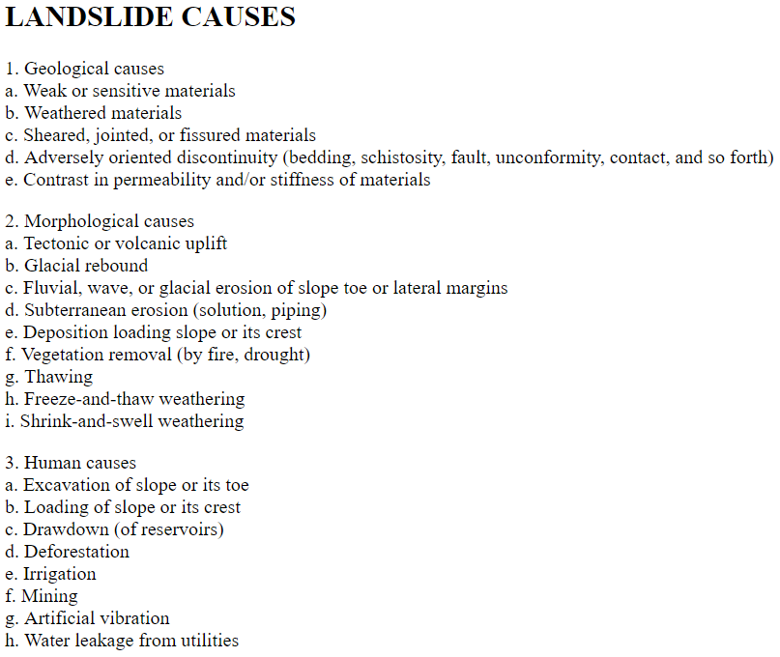
From USGS
Landslides Website

Slide 28
mass wasting – factor of safety
Shear Strength / Shear Stress
= 1, critical threshold
> 1, slope stability
< 1, slope instability

Slide 29
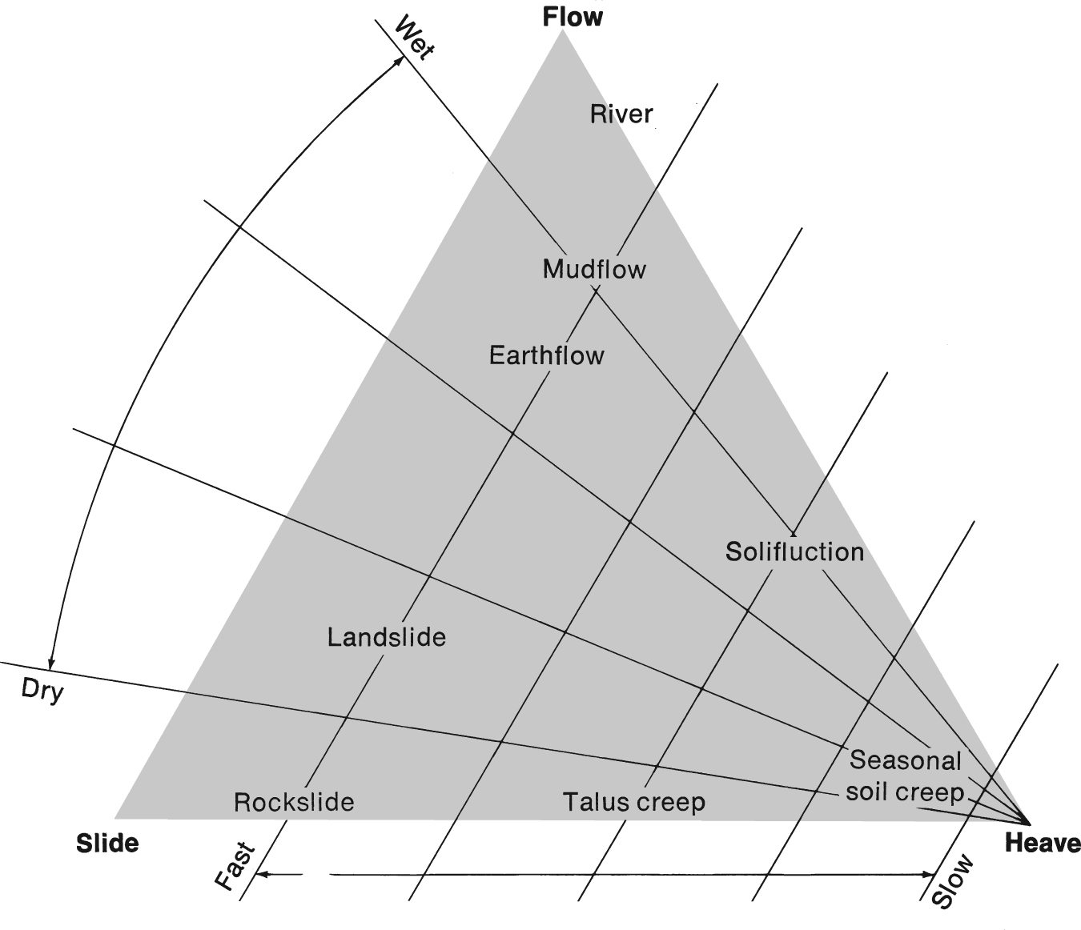
mass wasting types

Slide 30
mass wasting types
rockfall
  fastest; a rock falls and becomes talus; rocks float on air, grus, water and ‘avalanche’
slide
  fast; with/without water; regolith and sometimes bedrock too
  slow; slumping; rotational slide
flow
  slow; with water; earthflow; mudflow; debris flow
creep
  very slow; wet/dry; freeze/thaw; solifluction

Slide 31
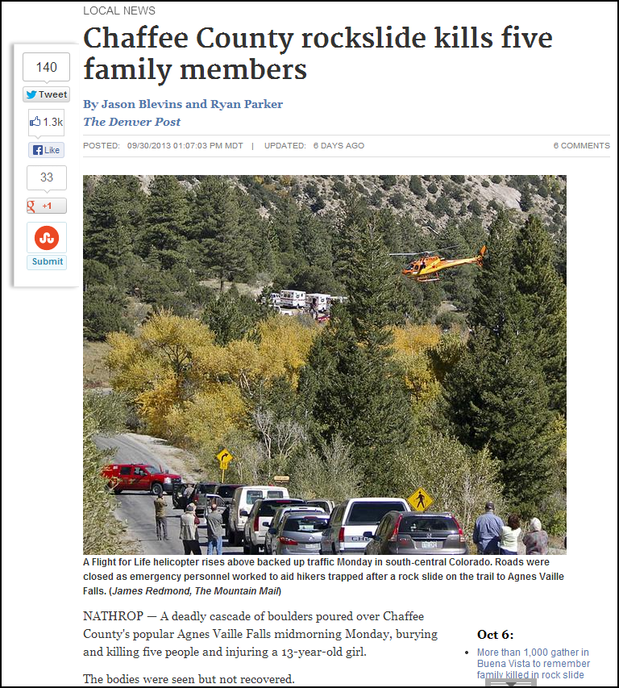
mass wasting types
rockfall
  fastest; a rock falls and becomes talus
http://www.denverpost.com/breakingnews/ci_24207249/rock-slide-reported-near-popular-hiking-trail-chaffee

Slide 32
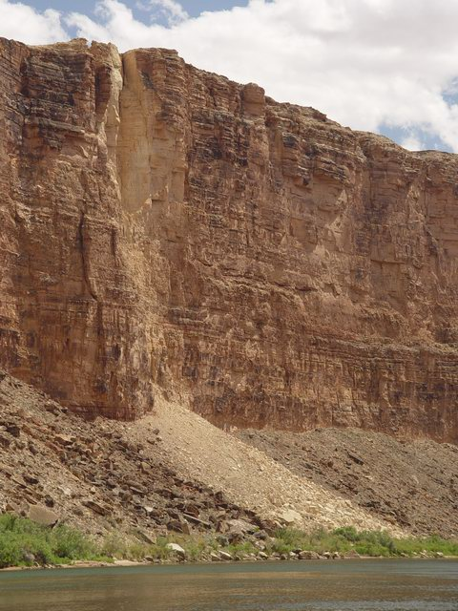
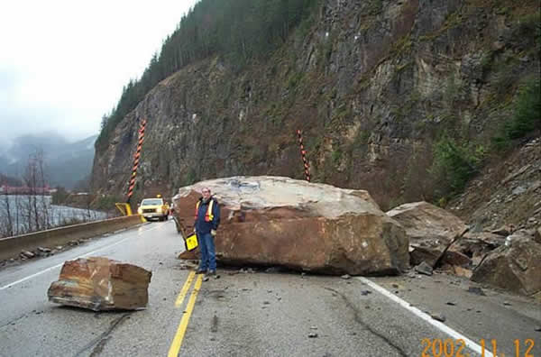
mass wasting types
rockfall
  fastest; a rock falls and becomes talus
http://atlas.nrcan.gc.ca/site/english/maps/environment/naturalhazards/landslides/
http://www.physci.mc.maricopa.edu/Geology/FieldTrips/ColoradoRiver/

Slide 33
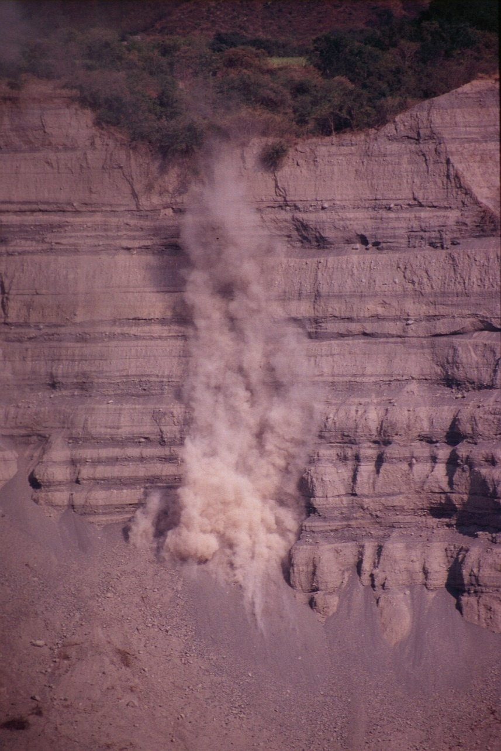
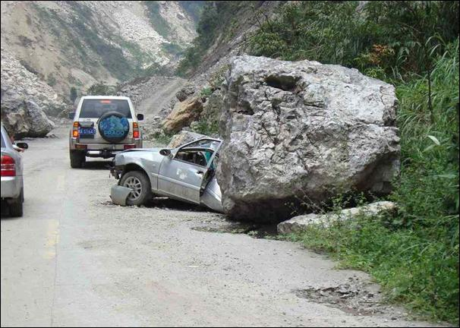
mass wasting types
rockfall
  fastest; a rock falls and becomes talus
http://www.asce.org/copri/COPRIHome.aspx
http://gees.usc.edu/GEER/

Slide 34
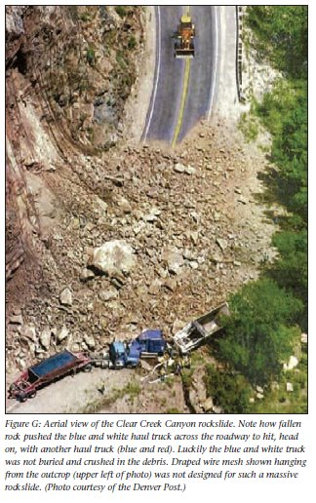
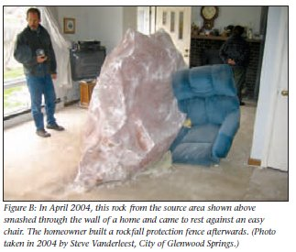
mass wasting types
rockfall
  fastest; a rock falls and becomes talus
http://daveslandslideblog.blogspot.com
http://gees.usc.edu/GEER/

Slide 35
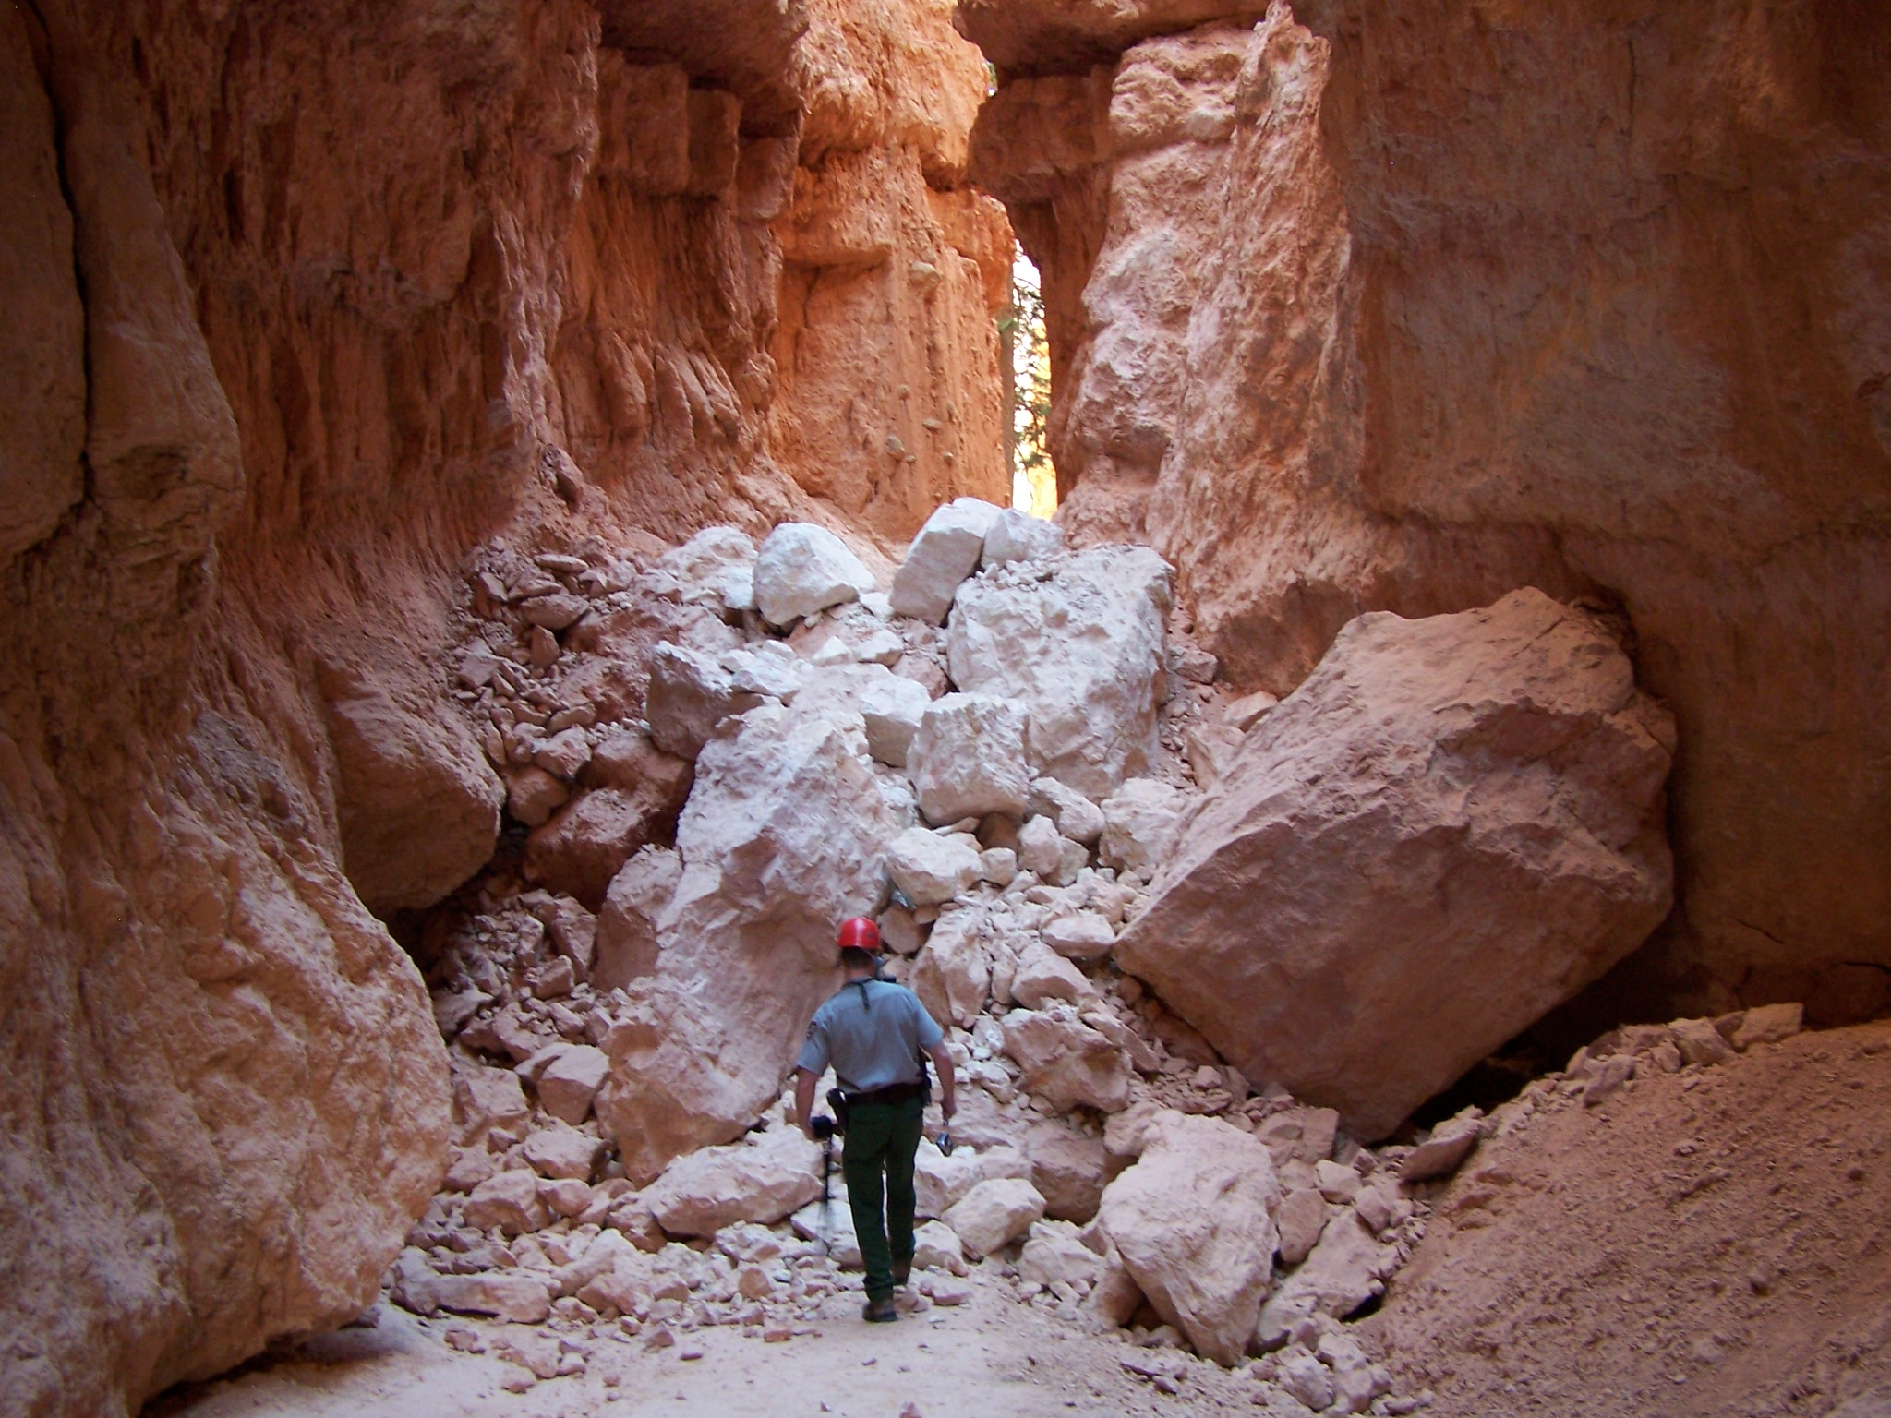
mass wasting types
rockfall
  fastest; a rock falls and becomes talus
On Tuesday, May 23, 2006 at 5:00pm on the Wall Street section of the Navajo Loop Trail there was a significant rock fall. The rock fall was caused by erosion and weathering, which have shaped Bryce Canyon into what visitors see today. The primary weathering force at Bryce Canyon is frost wedging. Here we experience over 200 freeze/thaw cycles each year.
Image from: http://www.nps.gov/brca/parknews/navajo-loop-trail-rock-fall.htm

Slide 36
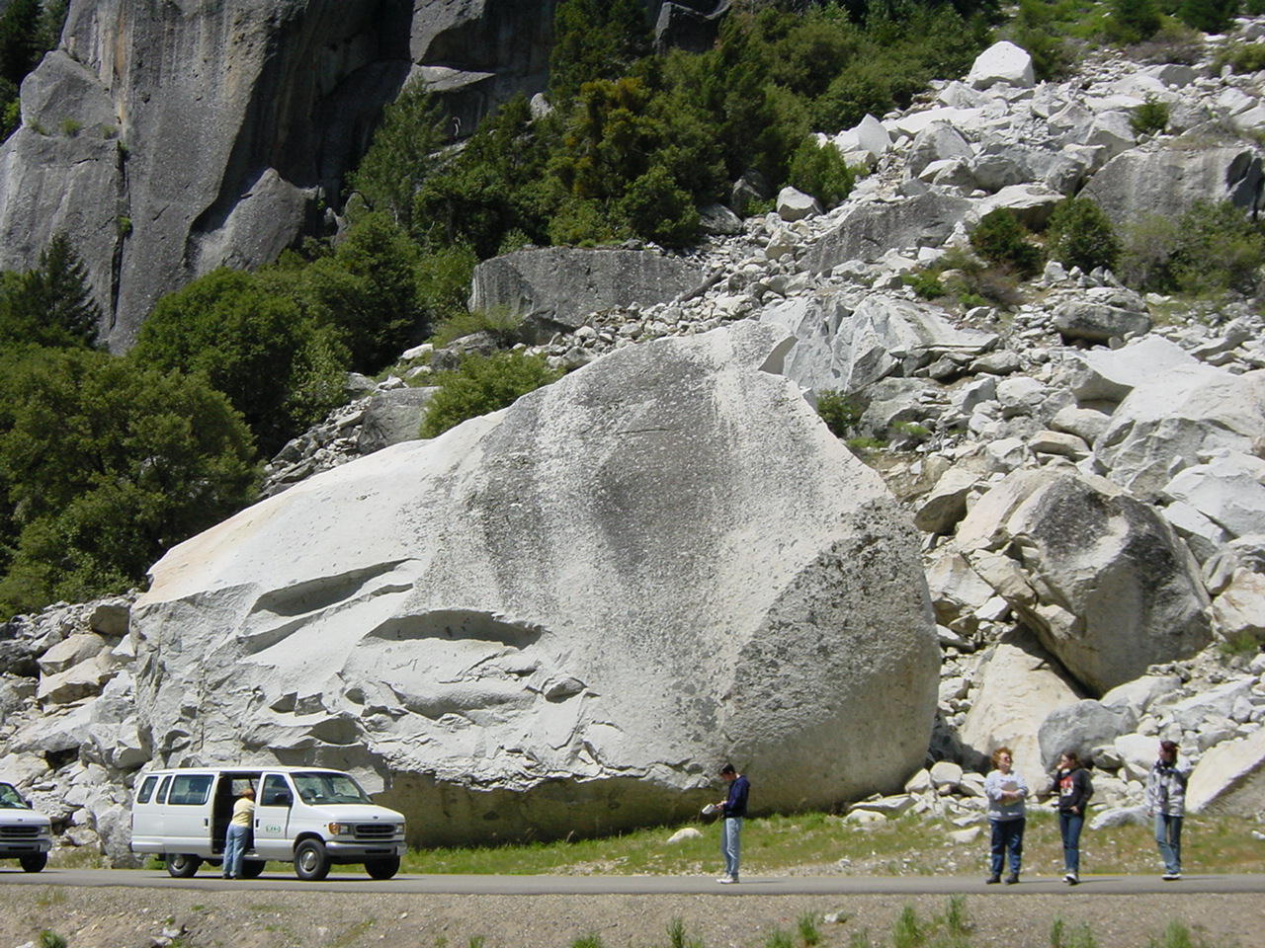
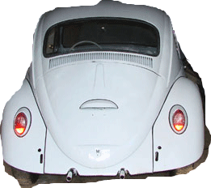
mass wasting types
rockfall
  fastest; a rock falls and becomes talus
1982 rockfall in Yosemite.
http://virtual.yosemite.cc.ca.us/ghayes/1982.htm

Slide 37
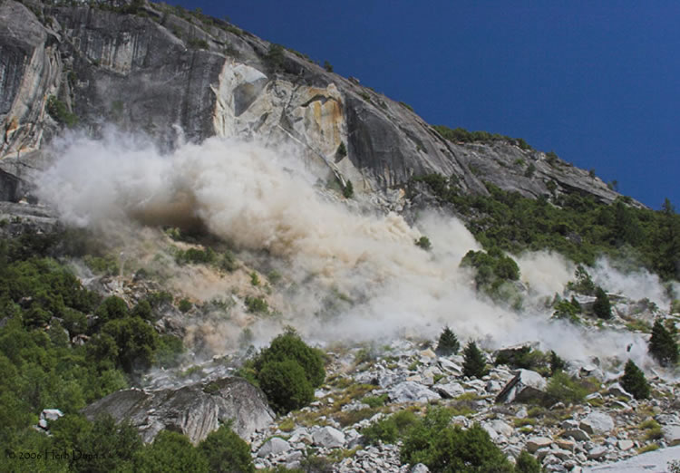
mass wasting types
rockfall
  fastest; a rock falls and becomes talus
Image from: http://geology.com/articles/yosemite-rockfall.shtml

Slide 38
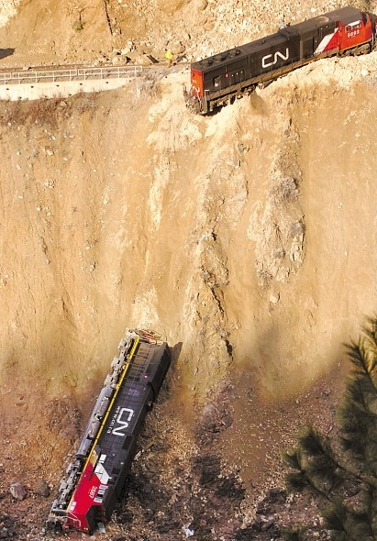
mass wasting types
rockfall
  fastest; a rock falls and becomes talus
http://landslides.usgs.gov/learning/photos/images/more_usa/various_landslides_throughout_the_united_states/cn_landslide.jpg

Slide 39
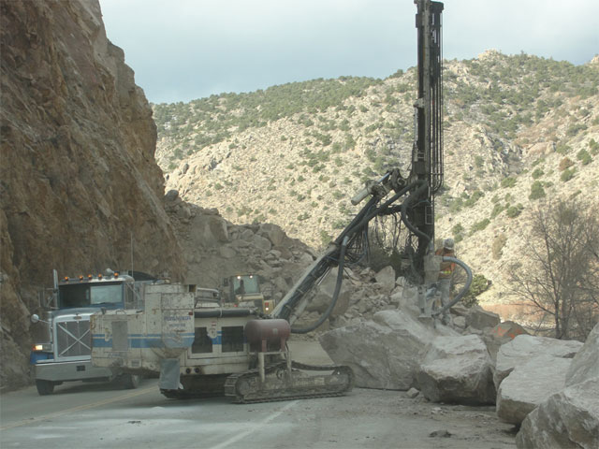
mass wasting types
rockfall
  fastest; a rock falls and becomes talus
2-15-11 - An estimated 7,000 tons of rock came down during the Monday afternoon slide, which officials said is enough to fill about 30 average-sized swimming pools. About 300 truckloads of rock will be hauled away before the road is clear.
http://gees.usc.edu/GEER/
http://hostingbold.info/TF19

Slide 40
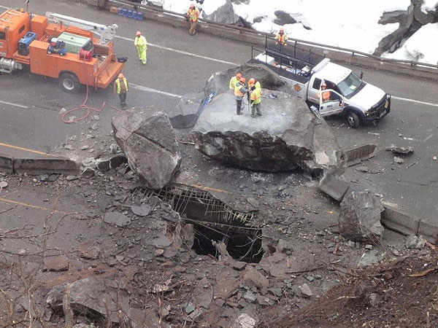
mass wasting types
rockfall
  fastest; a rock falls and becomes talus
3/8/2010
The largest hole in the roadway was 10 feet by 20 feet. About 20 boulders ranging from three to 10 feet long were scattered on the highway, with the largest weighing 66 tons, officials said.
A 1995 rock slide on I-70 in Glenwood Canyon killed three people.
A slide on Thanksgiving Day in 2004 closed the highway and required nearly $700,000 worth of repairs.
Info./image from: http://www.gazette.com/articles/springs-95280-glenwood-closes.html

Slide 41
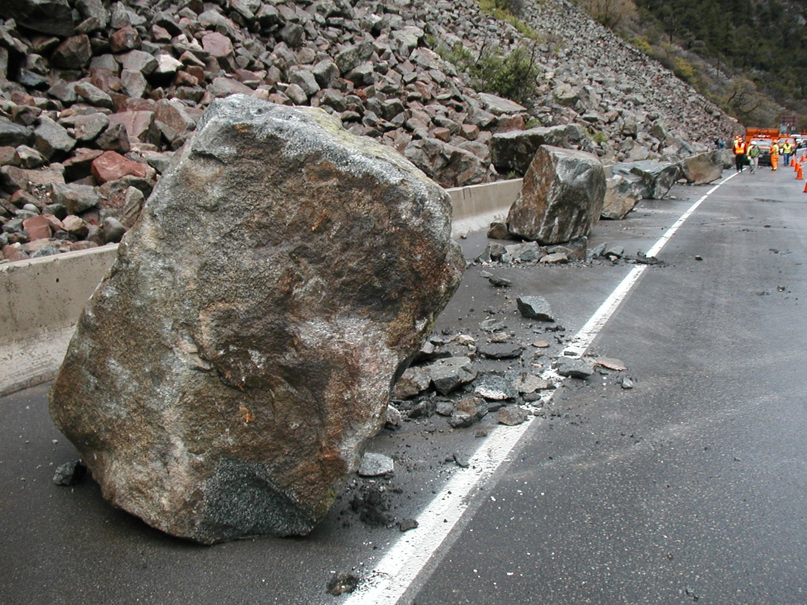
mass wasting types
rockfall
  fastest; a rock falls and becomes talus
Image from: http://landslides.usgs.gov/learning/photos/images/colorado__u.s._/glenwood_canyon__co__2003/fig1.jpg

Slide 42
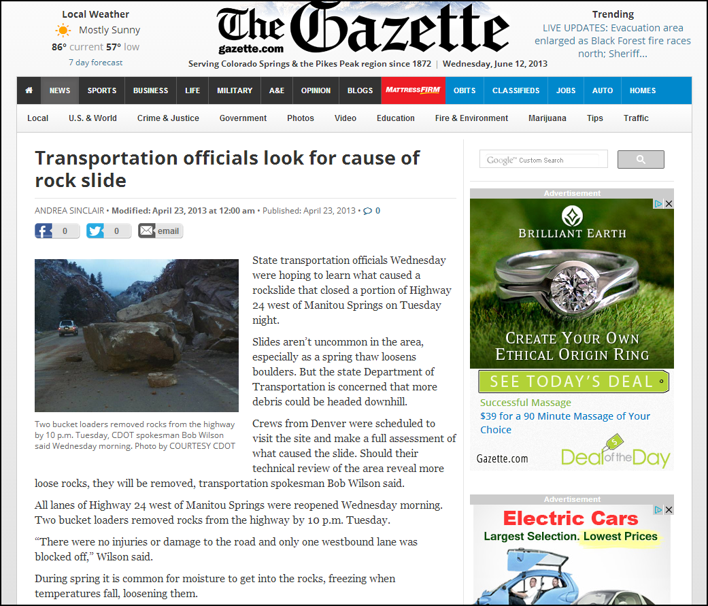
mass wasting types
fall
  fastest; a rock falls and becomes talus
http://gazette.com/transportation-officials-look-for-cause-of-rock-slide/article/153915

Slide 43
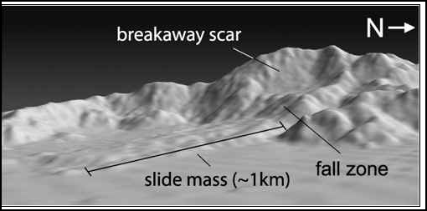
mass wasting types
slide
  fast; with/without water; regolith and sometimes bedrock too
  slow; slumping; rotational slide
Head scarp
accumulation zone
toe

Slide 44
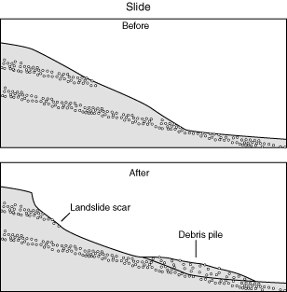

mass wasting types
slide
  fast; with/without water; regolith and sometimes bedrock too
  slow; slumping; rotational slide
fast
slide
slow
slide

Slide 45

mass wasting types
slide
  fast; with/without water; regolith and sometimes bedrock too
  slow; slumping; rotational slide
Frank Slide, Alberta, Can
1903; 76 died

Slide 46

mass wasting types
slide
  fast; with/without water; regolith and sometimes bedrock too
  slow; slumping; rotational slide
A sturzstrom!
The 17 ka Blackhawk Landslide, San Bernardino County, CA. Photo: Kerry Sieh

Slide 47

mass wasting types
slide
  fast; with/without water; regolith and sometimes bedrock too
  slow; slumping; rotational slide
A sturzstrom!
The Marcus Landslide: 500,000 years old.

Slide 48

mass wasting types
slide
  fast; with/without water; regolith and sometimes bedrock too
  slow; slumping; rotational slide
A sturzstrom!
Anza-Borrego Desert SP, CA
Photo by Bob Knapp

Slide 49

mass wasting types
slide
  fast; with/without water; regolith and sometimes bedrock too
  slow; slumping; rotational slide
A sturzstrom!
Anza-Borrego Desert SP, CA
Photo by Bob Knapp

Slide 50

mass wasting types
slide
  fast; with/without water; regolith and sometimes bedrock too
  slow; slumping; rotational slide
The Gros Ventre slide of 1925. In 3 mins., 50,000,000 cubic yards of rock slid down and 300 ft. up the other side of the valley.

Slide 51
mass wasting types
slide
  fast; with/without water; regolith and sometimes bedrock too
  slow; slumping; rotational slide
The Gros Ventre slide of 1925. In 3 mins., 50,000,000 cubic yards of rock slid down and 300 ft. up the other side of the valley.

Slide 52


mass wasting types
slide
http://hkss.cedd.gov.hk/hkss/eng/slopeinfo/images/PoShanLandslide.jpg

Slide 53

mass wasting types
slide

Slide 54

mass wasting types
slide
May 25, 2014

Slide 55

mass wasting types
slide
May 25, 2014

Slide 56

mass wasting types
slide
May 25, 2014

Slide 57

mass wasting types
slide
March 22, 2014

Slide 58

mass wasting types
slide

Slide 59

mass wasting types
slide

Slide 60

mass wasting types
slide
http://spaceref.com/news/viewsr.html?pid=40068

Slide 61

mass wasting types
slide
http://beautifulmars.tumblr.com/post/44944543941/mass-wasting-feature-in-ganges-chasma-mass

Slide 62



mass wasting types
earthflow
  slow; with water; earthflow; mudflow; debris flow

Slide 63

mass wasting types
earthflow
  slow; with water; earthflow; mudflow; debris flow
Flows are almost always associated with
excessive rainfall and oversaturation

Slide 64

mass wasting types
earthflow
  slow; with water; earthflow; mudflow; debris flow
http://almandine.geol.wwu.edu/~dave/courses/2003/spring/101/lectures/13%20Mass%20Wasting.ppt#373,26,Slide 26

Slide 65

mass wasting types
earthflow
  slow; with water; earthflow; mudflow; debris flow

Slide 66

mass wasting types
earthflow
  slow; with water; earthflow; mudflow; debris flow
4.75 km^2

Slide 67


mass wasting types
creep
  very slow; wet/dry; freeze/thaw; solifluction

Slide 68

mass wasting types
creep
  very slow; wet/dry; freeze/thaw; solifluction
Photo taken at Red Rock Canyon Open Space, Colorado Springs, CO. Sept., 2015

Slide 69

mass wasting types
creep
  very slow; wet/dry; freeze/thaw; solifluction
http://almandine.geol.wwu.edu/~dave/courses/2003/spring/101/lectures/13%20Mass%20Wasting.ppt#368,18,Creep

Slide 70

mass wasting types
creep
  very slow; wet/dry; freeze/thaw; solifluction
http://landslides.usgs.gov/learning/photos/images/more_usa/various_landslides_throughout_the_united_states/creep2.jpg

Slide 71



mass wasting types
creep
  very slow; wet/dry; freeze/thaw; solifluction
waterlogged sediment moves over an impermeable surface
http://www.fao.org

Slide 72
Your job
Risk of mass wasting hazards can be reduced with careful planning and increased understanding
Geologic / surficial geology mapping, detection of slope hazards and prediction will aid planners and engineers
Physical geographers / soil scientists play a central role

Slide 73

More info on mass wasting
The Landslide Handbook— A Guide to Understanding Landslides
https://pubs.usgs.gov/circ/1325/pdf/C1325_508.pdf

Slide 74

More info on mass wasting
https://www.usgs.gov/natural-hazards/landslide-hazards/science

Slide 75

Lab Three is in Canvas

Slide 76

mass wasting
1. Youtube
2. Youtube
3. Youtube
4. Youtube
5. Youtube
6. Youtube
7. Youtube

