Slide 1
Are you considering graduate school? Are you aware of your options, and what a graduate program involves -- financially, mentally, and emotionally?
Notes:
Tonight: About Graduate School: Sort of a panel session with our three GRAD. students.
> Have Arielle, Thad, and Ivan introduce themselves
> Introduce yourselves to Arielle, Thad, and Ivan
> Hear my story of my path to grad. school
> 16 questions for Arielle, Thad, and Ivan. (PANEL)
> Reasons to go, reasons not to go
> My list of ‘musts’ for success

Slide 2
How do you earn a Masters / PhD?
Be curious about something
Apply, get accepted
Take a few courses
Pick a topic
Pick chair and committee
Collect data > scientific method
Write a research paper
Defend

Slide 3
My path to curiosity
VA: Eagle Scout (love of WY mountains)
Mizzou: BS, Nat. Res. (+ study abroad, + geol., + Yellowstone, + USFS internship)
Boulder (+ NCAR+ USGS phys. sci. tech: climate chx., arroyos)
ASU b/c Mel Marcus (+ TA, + job, MA (Dorn), PhD (Edsall))
TX State (ABD)
UCCS (40, 40, 20)
Was PhD worth it? Yes, because i) _________ and ii) __________.

Slide 4
16 questions for our panel: Arielle, Thad, and Ivan

Slide 5
Why did you decide to go to graduate school?
How did you pick a graduate school?
The GRE
The application process
How did you pick an advisor and committee members?
Required courses: What was their purpose?
About working independently
Narrowing your research focus
About the literature review
Curiosity along the way: A good thing, right?
Data collection: What did you do?
Data analysis: What methods did you use?
Discuss (briefly) your results and conclusions
How has / will the MA help you achieve your career goals?
Are you / do you expect to be happier with an MA?
Any advice for undergrads?

Slide 6
Reasons to go
Greater earning power. This is a popular reason why people go to grad school. However, it should not be the only reason, since getting a grad degree is a very serious commitment.
Advance your career. A grad degree can open up a wider array of career opportunities.
Career change. Many people are finding their current careers unrewarding.
Enhance your education. Graduate schools provide opportunities to explore theories you may have about a topic.
Community recognition. If you explore your theories and discover something new, you will get recognition for it.
International recognition. Carry that recognition further. If your discovery is truly groundbreaking…
Research opportunities. Even if you do not get to explore your own theories, there are other opportunities to participate in funded research.

Slide 7
Reasons to go
Higher potential for future promotion. While obtaining a graduate degree does not necessarily always lead to a high-paying job right away, it can open up opportunities for future promotions.
Not being stuck behind a desk. Play golf in the afternoon on a nice day.
Because you want to. To learn, to think critically, to accept the academic challenge.
Free tuition. In some cases, grad schools might not only waive your tuition, but also give you a stipend for living expenses in return for taking on the work of a teaching assistant or research assistant.
Upgrade your education. Your knowledge of your field is outdated and you find it difficult to keep up with advancements without following up and getting an advanced degree.
Enjoy travel opportunities. Some programs, such as archaeology, require studying abroad for research purposes. For those who like to travel, this is a bonus.
Find teaching opportunities. Not everyone is suited to teaching, but for those who are, getting a PhD can lead to a tenured position at a university or college

Slide 8
Reasons not to go
Highly competitive. Graduate programs always have fewer spots than undergraduate programs. There's competition for seats, research positions, grant money, and often as a result, departmental politics.
Enables the "professional student" mindset. Some students just don't want to leave school. One of the reasons for this is said to be a fear of going out into the workforce.
Requires ability to set priorities. Successfully completing a grad degree requires a great deal of discipline and priority setting. This can be a strain on family and personal relationships, not to mention yourself.
Relationship strains. One word: inequity w/ partner...
Stressful. Emotionally exhausting. Completing a graduate degree, especially a PhD, requires emotional maturity.
Writing a thesis. Some grad programs require writing a thesis on a topic that your degree supervisor picks out for you. Writing an original thesis is not easy compared to course work, and it is often the reason grad students take a lot longer than program duration.

Slide 9
Reasons not to go
Requires support. You might need a strong support network to get through emotionally.
Takes 2–7+ years of your life.
Graduating with large debt. This state of financial affairs might force you to jump off a bridge.
No guarantee of higher salary. Getting a grad degree does not necessarily mean you'll get offered a job with a much higher salary than pre-grad degree.
Return on investment might be slow. Even with a higher salary, how quickly will that offset tuition loans and the negative cash flow due to not earning while studying?
Undesirable job locales. Teaching positions offered after graduation could be in areas you simply don't want to live in.
Too qualified. "Sorry, you're overqualified.”
If you are not totally committed, you might not pass your defense.

Slide 10
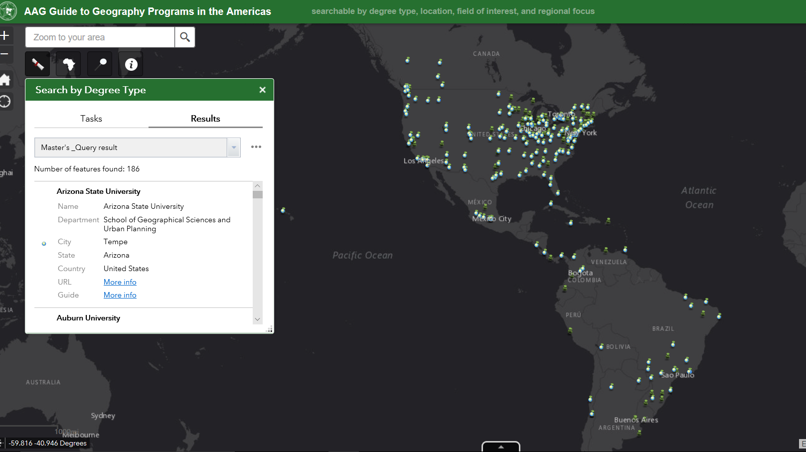

Slide 11
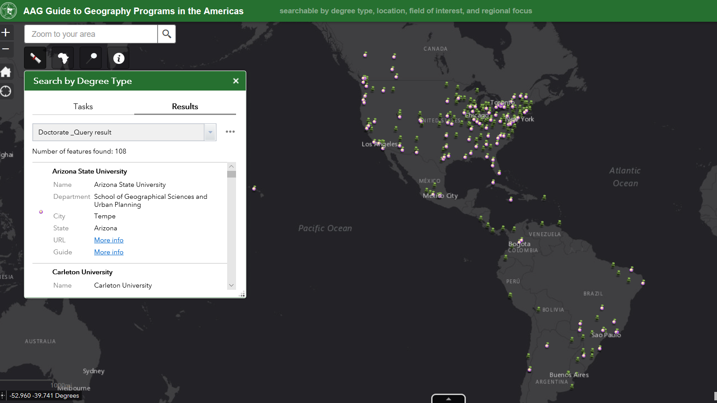

Slide 12
Brandon’s list of musts:
Have a passion about something
Be driven by curiosity and exploration
Enjoy reading
  You’ll need to acquire tremendous breadth in a topical area
Be (or become) a good writer
  You have to write a perfect, technical, publish-ready document
Internalize that you must focus your question
Be able to manage time wisely
Show up to class on time, get As and Bs
Seek funding across the board
Attend / organize Potlatches
Go to conferences, present posters / papers, try very hard to publish
Form a cohort

