Slide 1


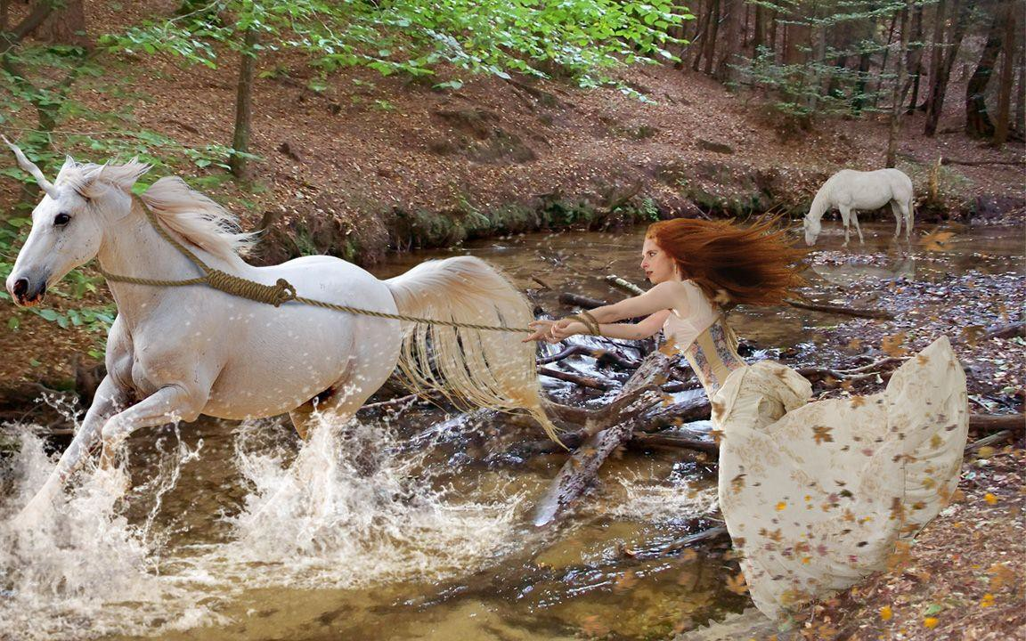

Data wrangling verbs
& the pipe operator
%>%
in the dplyr package
select() filter() summarize() group_by() mutate() arrange()

Slide 2
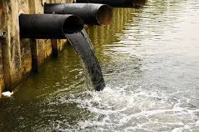






The pipe operator
Take this data frame, then…
%>%
%>%
%>%
filter the data, then
with those results…
%>%
%>%
%>%
summarize
“Pipe” a data frame into a “verb” command
“Chain” the results from one “verb” command into another
Think of it as the word “then”

Slide 3

select()
Pull out just the columns you want in a data set, based on the column names

Slide 4
select()
the data frame
Example
flights_sub<- flights %>% select(arr_delay, dep_delay)
the verb (function)
what columns (variable) to keep

Slide 5

filter()
Pull out just the rows you want in a data set, based on some criteria

Slide 6
filter()
Only keep rows of the data in which the column meets this criteria
the data
frame
Example
on_time_flights<- flights %>%
filter(arr_delay < 30)
the verb (function)
what column (variable) to use for filtering

Slide 7



filter()
&
|
Only keep rows of the data in which the column meets this criteria
the data
frame
Another example
== !=
on_time_flights <- flights %>%
filter(origin == “AK”))
the verb (function)
what column (variable) to use for filtering

Slide 8
summarize()
Take a column of data from a data frame and reduce it down to a single summary statistic

Slide 9

summarize()
what summary statistic to calculate
the data frame
Example
flights %>%
summarize(av_dist = mean(distance))
the verb (function)
what to call the
result
the column to summarize

Slide 10
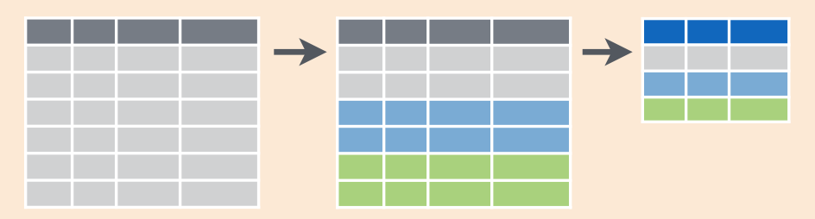
group_by()
summarize()
then
Take a column of data and reduce it down to a summary statistic, by some grouping variable

Slide 11
summarize()
what to group by
what summary statistic to calculate
the data frame
Example
flights %>%
group_by(origin) %>%
summarize(av_dist = mean(distance))
the verb (function)
the verb
(function)
what to call the
result
the column to
summarize

Slide 12

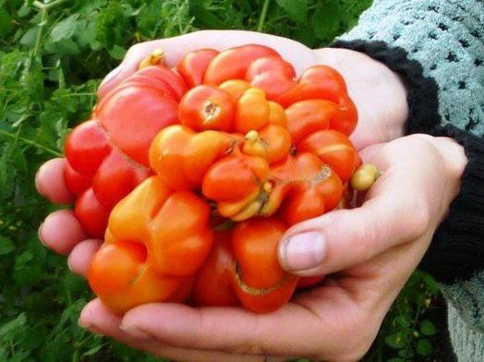
mutate()
Mutant growth on a tomato

Slide 13
mutate()
what to call the new column (new variable)
the data frame
Example
flights %>%
mutate(dist_ft = distance * 5280)
the verb (function)
what to put in the new column

