Slide 1
DATA MINING
DR. Oluwatosin Oluwadare, 2024
Department of Computer Science , University of Colorado, Colorado springs.
CS 4435/5435 and dase 4435
Data Mining,
Fall 2024
Lecture 1: Introduction
Slides Adapted from Jiawei Han et al. Data Mining: Concepts and Techniques, 3rd ed

Slide 2
Data Mining: Concepts and Techniques (3rd ed.) — Chapter 1 —
Jiawei Han, Micheline Kamber, and Jian Pei
University of Illinois at Urbana-Champaign &
Simon Fraser University
©2011 Han, Kamber & Pei. All rights reserved.
2
Notes:
2

Slide 3
Chapter 1. Introduction
Why Data Mining?
What Is Data Mining?
A Multi-Dimensional View of Data Mining
What Kind of Data Can Be Mined?
What Kinds of Patterns Can Be Mined?
What Technology Are Used?
What Kind of Applications Are Targeted?
Major Issues in Data Mining
A Brief History of Data Mining and Data Mining Society
Summary

Slide 4
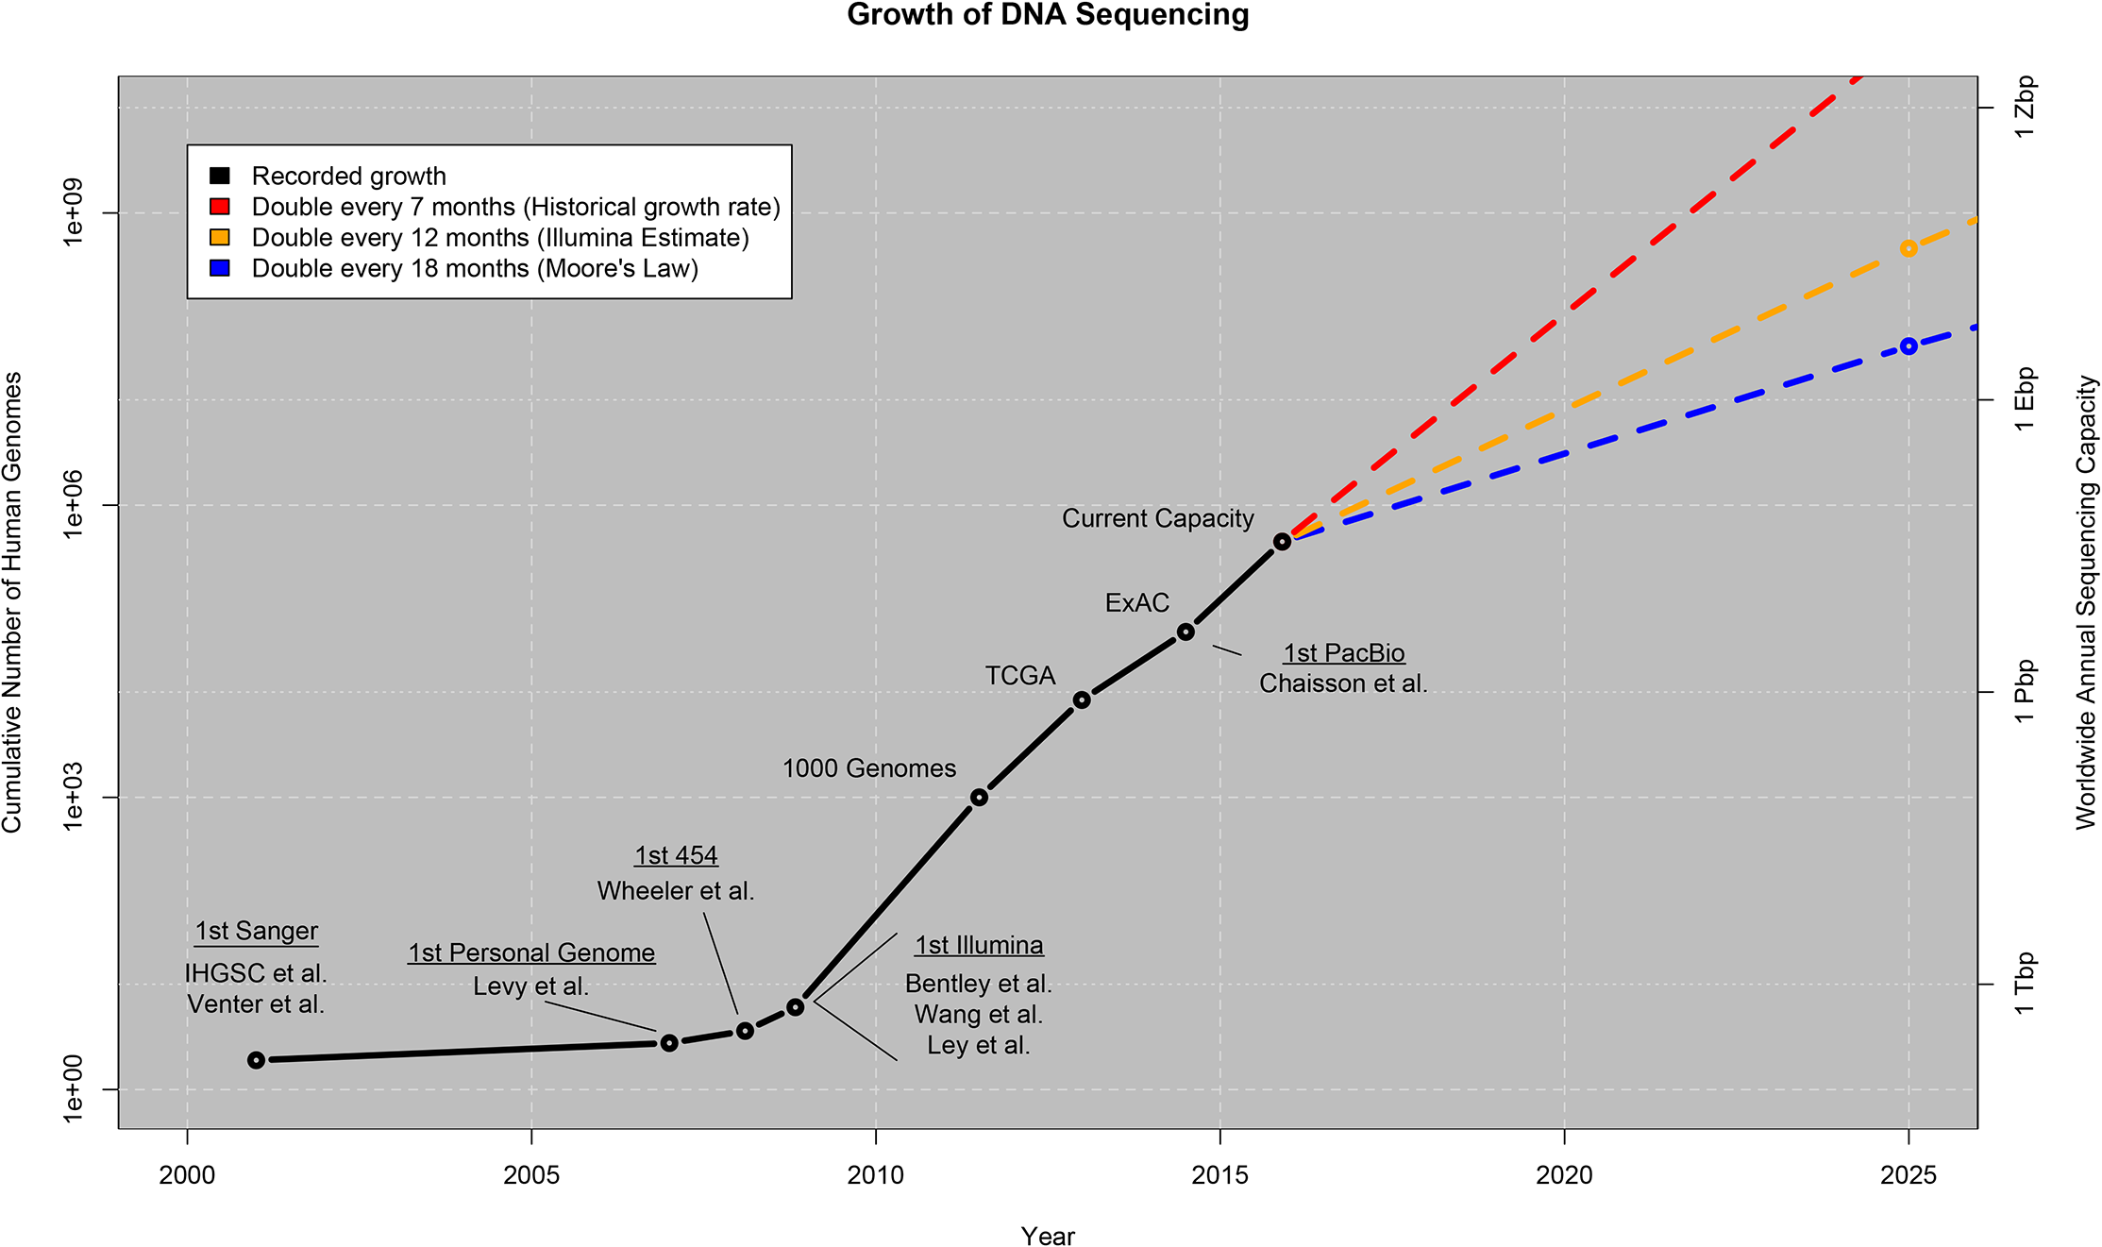
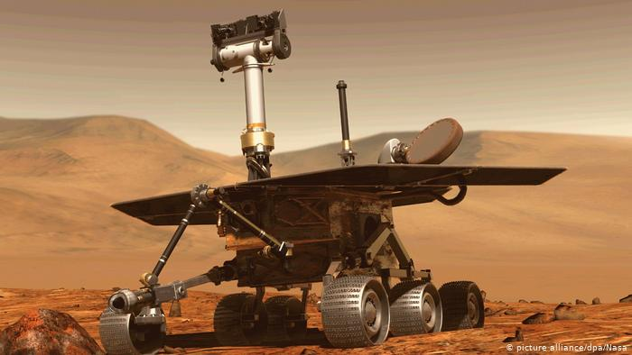
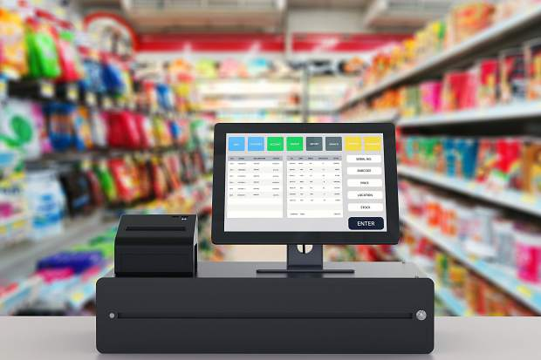
Why Mine Data?

Slide 5
Why Data Mining?
The Explosive Growth of Data: from terabytes to petabytes
Data collection and data availability
Automated data collection tools, database systems, Web, computerized society
Major sources of abundant data
Business: Web, e-commerce, transactions, stocks, …
Science: Remote sensing, bioinformatics, scientific simulation, …
Society and everyone: news, digital cameras, YouTube
We are drowning in data, but starving for knowledge!
“Necessity is the mother of invention”—Data mining—Automated analysis of massive data sets

Slide 6
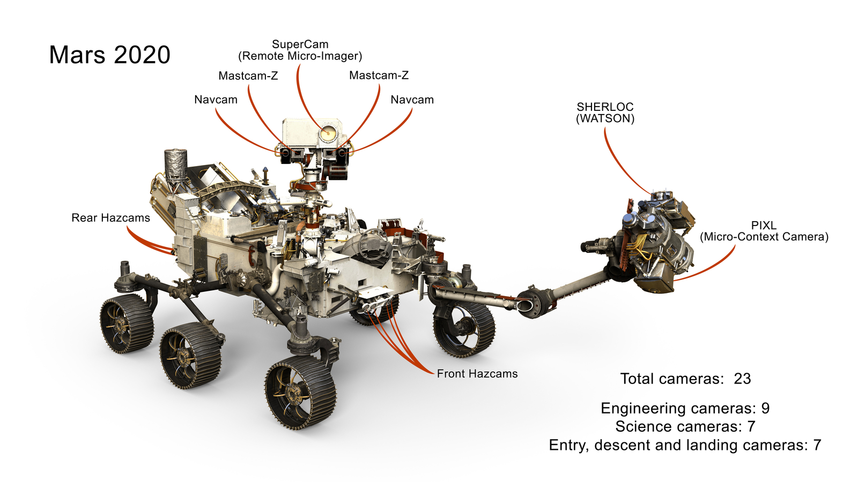

Slide 7
Perseverance: Scientific Instruments
Video
Source: https://upload.wikimedia.org/wikipedia/commons/transcoded/c/ce/PIA24426-MarsPerseveranceRover-20210216.webm/PIA24426-MarsPerseveranceRover-20210216.webm.360p.vp9.webm

Slide 8
Evolution of Sciences
Before 1600, empirical science
1600-1950s, theoretical science
Each discipline has grown a theoretical component. Theoretical models often motivate experiments and generalize our understanding.
1950s-1990s, computational science
Over the last 50 years, most disciplines have grown a third, computational branch (e.g. empirical, theoretical, and computational ecology, or physics, or linguistics.)
Computational Science traditionally meant simulation. It grew out of our inability to find closed-form solutions for complex mathematical models.
1990-now, data science
The flood of data from new scientific instruments and simulations
The ability to economically store and manage petabytes of data online
The Internet and computing Grid that makes all these archives universally accessible
Scientific info. management, acquisition, organization, query, and visualization tasks scale almost linearly with data volumes. Data mining is a major new challenge!
Jim Gray and Alex Szalay, The World Wide Telescope: An Archetype for Online Science, Comm. ACM, 45(11): 50-54, Nov. 2002

Slide 9
Evolution of Database Technology
1960s:
Data collection, database creation, IMS and network DBMS
1970s:
Relational data model, relational DBMS implementation
1980s:
RDBMS, advanced data models (extended-relational, OO, deductive, etc.)
Application-oriented DBMS (spatial, scientific, engineering, etc.)
1990s:
Data mining, data warehousing, multimedia databases, and Web databases
2000s
Stream data management and mining
Data mining and its applications
Web technology (XML, data integration) and global information systems
Notes:
Two slides should be added after this one
1. Evolution of machine learning
2. Evolution of statistics methods

Slide 10
Chapter 1. Introduction
Why Data Mining?
What Is Data Mining?
A Multi-Dimensional View of Data Mining
What Kind of Data Can Be Mined?
What Kinds of Patterns Can Be Mined?
What Technology Are Used?
What Kind of Applications Are Targeted?
Major Issues in Data Mining
A Brief History of Data Mining and Data Mining Society
Summary

Slide 11
What Is Data Mining?
Data mining (knowledge discovery from data)
Extraction of interesting (non-trivial, implicit, previously unknown and potentially useful) patterns or knowledge from huge amount of data
Data mining: a misnomer?
Alternative names
Knowledge discovery (mining) in databases (KDD), knowledge extraction, data/pattern analysis, data archeology, data dredging, information harvesting, business intelligence, etc.
Watch out: Is everything “data mining”?
Simple search and query processing
(Deductive) expert systems

Slide 12
What is (not) Data Mining?
What is not Data Mining?
Simple Querying
Done with a predetermined hypothesis.
Examples
Look up phone number in phone directory
Query a Web search engine for information about “Amazon”
What is Data Mining?
Extraction of patterns and Knowledge
Examples:
Certain Cars are more prevalent in Colorado Springs ( Tesla, Chevy)
Group together similar documents returned by search engine according to their context (e.g. Amazon rainforest, Amazon.com,)

Slide 13
Knowledge Discovery (KDD) Process
Knowledge
This is a view from typical database systems and data warehousing communities
Data mining plays an essential role in the knowledge discovery process
Pattern Evaluation
Data Mining
Task-relevant Data
Data Warehouse
Selection
Data Cleaning
Data Integration
Databases

Slide 14
Example: A Web Mining Framework
Web mining usually involves
Data cleaning
Data integration from multiple sources
Warehousing the data
Data cube construction
Data selection for data mining
Data mining
Presentation of the mining results
Patterns and knowledge to be used or stored into knowledge-base

Slide 15
Data Mining in Business Intelligence
Ex: Cancer research
Increasing potential
to support
business decisions
End User
Decision Making
Data Presentation
Business
Analyst
Visualization Techniques
Data Mining
Data
Analyst
Information Discovery
Data Exploration
Statistical Summary, Querying, and Reporting
Data Preprocessing/Integration, Data Warehouses
Data Sources
DBA
Paper, Files, Web documents, Scientific experiments, Database Systems

Slide 16
Example: Mining vs. Data Exploration
Business intelligence view
Warehouse, data cube, reporting but not much mining
Business objects vs. data mining tools
Supply chain example: tools
Data presentation
Exploration

Slide 17
Chapter 1. Introduction
Why Data Mining?
What Is Data Mining?
A Multi-Dimensional View of Data Mining
What Kind of Data Can Be Mined?
What Kinds of Patterns Can Be Mined?
What Technology Are Used?
What Kind of Applications Are Targeted?
Major Issues in Data Mining
A Brief History of Data Mining and Data Mining Society
Summary

Slide 18
Multi-Dimensional View of Data Mining
Data to be mined
Database data (extended-relational, object-oriented, heterogeneous, legacy), data warehouse, transactional data, stream, spatiotemporal, time-series, sequence, text and web, multi-media, graphs & social and information networks
Knowledge to be mined (or: Data mining functions)
Characterization, discrimination, association, classification, clustering, trend/deviation, outlier analysis, etc.
Descriptive vs. predictive data mining
Multiple/integrated functions and mining at multiple levels
Techniques utilized
Data-intensive, data warehouse (OLAP), machine learning, statistics, pattern recognition, visualization, high-performance, etc.
Applications adapted
Retail, telecommunication, banking, fraud analysis, bio-data mining, stock market analysis, text mining, Web mining, etc.

Slide 19
Big Data Applications
Brodsky, 2013

Slide 20
Chapter 1. Introduction
Why Data Mining?
What Is Data Mining?
A Multi-Dimensional View of Data Mining
What Kind of Data Can Be Mined?
What Kinds of Patterns Can Be Mined?
What Technology Are Used?
What Kind of Applications Are Targeted?
Major Issues in Data Mining
A Brief History of Data Mining and Data Mining Society
Summary

Slide 21
Data Mining: On What Kinds of Data?
Database-oriented data sets and applications
Relational database, data warehouse, transactional database
Advanced data sets and advanced applications
Data streams and sensor data
Time-series data, temporal data, sequence data (incl. bio-sequences)
Structure data, graphs, social networks and multi-linked data
Object-relational databases
Heterogeneous databases and legacy databases
Spatial data and spatiotemporal data
Multimedia database
Text databases
The World-Wide Web(Web Mining)

Slide 22
Chapter 1. Introduction
Why Data Mining?
What Is Data Mining?
A Multi-Dimensional View of Data Mining
What Kind of Data Can Be Mined?
What Kinds of Patterns Can Be Mined?
What Technology Are Used?
What Kind of Applications Are Targeted?
Major Issues in Data Mining
A Brief History of Data Mining and Data Mining Society
Summary

Slide 23
Data Mining Function: (1) Generalization
Information integration and data warehouse construction
Data cleaning, transformation, integration, and multidimensional data model
Data cube technology
Scalable methods for computing (i.e., materializing) multidimensional aggregates
OLAP (online analytical processing)
Multidimensional concept description: Characterization and discrimination
Generalize, summarize, and contrast data characteristics, e.g., dry vs. wet region
Notes:
I BELIEVE WE MAY NEED TO DO IT IN MORE IN-DEPTH INTRODUCTION, USING SOME EXAMPLES. So it will take one slide for one function, i.e., one chapter we want to cover.
Do we need to cover chapter 2: preprocessing and 3. Statistical methods?

Slide 24
Data Mining Function: (2) Association and Correlation Analysis
Frequent patterns (or frequent itemsets)
What items are frequently purchased together in your Walmart?
Association, correlation vs. causality
A typical association rule
Diaper → Beer [0.5%, 75%] (support, confidence)
Are strongly associated items also strongly correlated?
How to mine such patterns and rules efficiently in large datasets?
How to use such patterns for classification, clustering, and other applications?

Slide 25
Data Mining Function: (3) Classification
Classification: Finding a model(or function) that distinguishes data classes
How?
The given data set is divided into training and test sets, with training set used to build the model and test set used to validate it.
Given a collection of records (training set )
Each record contains a set of attributes, one of the
attributes is the class.
Find a model for class attribute as a function of the values of other attributes.
Goal: previously unseen records should be assigned a class as accurately as possible.
A test set is used to determine the accuracy of the model.

Slide 26
Classification Example
Tid | Refund | Marital Status | Taxable Income | Cheat
1 | Yes | Single | 125K | No
2 | No | Married | 100K | No
3 | No | Single | 70K | No
4 | Yes | Married | 120K | No
5 | No | Divorced | 95K | Yes
6 | No | Married | 60K | No
7 | Yes | Divorced | 220K | No
8 | No | Single | 85K | Yes
9 | No | Married | 75K | No
10 | No | Single | 90K | Yes
Refund | Marital Status | Taxable Income | Cheat
No | Single | 75K | ?
Yes | Married | 50K | ?
No | Married | 150K | ?
Yes | Divorced | 90K | ?
No | Single | 40K | ?
No | Married | 80K | ?
Test Set
10
Learn
Classifier
Training Set
Model
10

Slide 27
Data Mining Function: (3) Classification
Classification and label prediction
Construct models (functions) based on some training examples
Describe and distinguish classes or concepts for future prediction
E.g., classify countries based on (climate), or classify cars based on (gas mileage)
Predict some unknown class labels
Typical methods
Decision trees, naïve Bayesian classification, support vector machines, neural networks, rule-based classification, pattern-based classification, logistic regression, …
Typical applications: Name one?
Credit card fraud detection, direct marketing, classifying stars, diseases, web-pages, …

Slide 28
Classification: Application 1
Direct Marketing
Goal: Reduce cost of mailing by targeting a set of consumers likely to buy a new cell-phone product.
Approach:
Use the data for a similar product introduced before.
We know which customers decided to buy and which decided otherwise.
This {buy, don’t buy} decision forms the class attribute.
Collect various demographic, lifestyle, and company-interaction related information about all such customers.
Type of business, where they stay, how much they earn, etc.
Use this information as input attributes to learn a classifier model.
From [Berry & Linoff] Data Mining Techniques, 1997

Slide 29
Classification: Application 2
Fraud Detection
Goal: Predict fraudulent cases in credit card transactions.
Approach:
Use credit card transactions and the information on its account- holder as attributes.
Questions: When does a customer buy, what does he buy, how often he pays on time, etc
Track location
Did he swipe the card in New York and minutes later purchasing another good in California
Label past transactions as {fraud} or {fair} transactions. This forms the class attribute.
Learn a model for the class of the transactions.
Use this model to detect fraud by observing credit card transactions on an account.

Slide 30
Data Mining Function: (4) Cluster Analysis
Given a set of data points, each having a set of attributes, and a similarity measure among them, find clusters such that
Data points in one cluster are more similar to one another.
Data points in separate clusters are less similar to one another.
Similarity Measures:
Euclidean Distance if attributes are continuous.
Other Problem-specific Measures.

Slide 31
Illustrating Clustering
Euclidean Distance Based Clustering in 3-D space.
Intracluster distances are minimized
Intercluster distances are maximized

Slide 32
Clustering: Application 1
Market Segmentation:
Goal: subdivide a market into distinct subsets of customers where any subset may conceivably be selected as a market target to be reached with a distinct marketing mix.
Approach:
Collect different attributes of customers based on their geographical and lifestyle related information.
Find clusters of similar customers.
Measure the clustering quality by observing buying patterns of customers in same cluster vs. those from different clusters.

Slide 33
Clustering: Application 2
Document Clustering:
Goal: To find groups of documents that are similar to each other based on the important terms appearing in them.
Approach: To identify frequently occurring terms in each document. Form a similarity measure based on the frequencies of different terms. Use it to cluster.
Gain: Information Retrieval can utilize the clusters to relate a new document or search term to clustered documents.

Slide 34
Illustrating Document Clustering
Clustering Points: 3204 Articles of Los Angeles Times.
Similarity Measure: How many words are common in these documents (after some word filtering).
Category | Total Articles | Correctly Placed
Financial | 555 | 364
Foreign | 341 | 260
National | 273 | 36
Metro | 943 | 746
Sports | 738 | 573
Entertainment | 354 | 278

Slide 35
Data Mining Function: (4) Cluster Analysis
Unsupervised learning (i.e., Class label is unknown)
Group data to form new categories (i.e., clusters), e.g., cluster houses to find distribution patterns
Principle: Maximizing intra-class similarity & minimizing interclass similarity
Many methods and applications

Slide 36
Data Mining Function: (5) Outlier Analysis
Outlier analysis
Outlier: A data object that does not comply with the general behavior of the data
Noise or exception? ― One person’s garbage could be another person’s treasure
Methods: by product of clustering or regression analysis, …
An Example?:
Useful in fraud detection, rare events analysis

Slide 37
Evaluation of Knowledge
Are all mined knowledge interesting?
One can mine tremendous amount of “patterns” and knowledge
Some may fit only certain dimension space (time, location, …)
Some may not be representative, may be transient, …
Evaluation of mined knowledge → directly mine only interesting knowledge?
Descriptive vs. predictive
Coverage
Typicality vs. novelty
Accuracy
Timeliness
…

Slide 38
Chapter 1. Introduction
Why Data Mining?
What Is Data Mining?
A Multi-Dimensional View of Data Mining
What Kind of Data Can Be Mined?
What Kinds of Patterns Can Be Mined?
What Technology Are Used?
What Kind of Applications Are Targeted?
Major Issues in Data Mining
A Brief History of Data Mining and Data Mining Society
Summary

Slide 39
Data Mining: Confluence of Multiple Disciplines
Machine
Learning
Pattern
Recognition
Statistics
Applications
Data Mining
Visualization
Algorithm
Database
Technology
High-Performance
Computing

Slide 40
Why Confluence of Multiple Disciplines?
Tremendous amount of data
Algorithms must be highly scalable to handle such as tera-bytes of data
High-dimensionality of data
Micro-array may have tens of thousands of dimensions
High complexity of data
Data streams and sensor data
Time-series data, temporal data, sequence data
Structure data, graphs, social networks and multi-linked data
Heterogeneous databases and legacy databases
Spatial, spatiotemporal, multimedia, text and Web data
Software programs, scientific simulations
New and sophisticated applications
Notes:
Add a definition/description of “traditional data analysis”.

Slide 41
Chapter 1. Introduction
Why Data Mining?
What Is Data Mining?
A Multi-Dimensional View of Data Mining
What Kind of Data Can Be Mined?
What Kinds of Patterns Can Be Mined?
What Technology Are Used?
What Kind of Applications Are Targeted?
Major Issues in Data Mining
A Brief History of Data Mining and Data Mining Society
Summary

Slide 42
Applications of Data Mining
Web page analysis: from web page classification, clustering to PageRank & HITS algorithms
Collaborative analysis & recommender systems
Basket data analysis to targeted marketing
Biological and medical data analysis: classification, cluster analysis (microarray data analysis), biological sequence analysis, biological network analysis
Data mining and software engineering (e.g., IEEE Computer, Aug. 2009 issue)
From major dedicated data mining systems/tools (e.g., SAS, MS SQL-Server Analysis Manager, Oracle Data Mining Tools) to invisible data mining

Slide 43
Why Data Mining?—Potential Applications
Data analysis and decision support
Market analysis and management
Target marketing, customer relationship management (CRM), market basket analysis, cross selling, market segmentation
Risk analysis and management
Forecasting, customer retention, improved underwriting, quality control, competitive analysis
Fraud detection and detection of unusual patterns (outliers)
Other Applications
Text mining (news group, email, documents) and Web mining
Stream data mining
Bioinformatics and bio-data analysis

Slide 44
Ex. 1: Market Analysis and Management
Where does the data come from?—Credit card transactions, loyalty cards, discount coupons, customer complaint calls, plus (public) lifestyle studies
Target marketing
Find clusters of “model” customers who share the same characteristics: interest, income level, spending habits, etc.
Determine customer purchasing patterns over time
Cross-market analysis—Find associations/co-relations between product sales, & predict based on such association
Customer profiling—What types of customers buy what products (clustering or classification)
Customer requirement analysis
Identify the best products for different groups of customers
Predict what factors will attract new customers
Provision of summary information
Multidimensional summary reports
Statistical summary information (data central tendency and variation)

Slide 45
Ex. 2: Corporate Analysis & Risk Management
Finance planning and asset evaluation
cash flow analysis and prediction
contingent claim analysis to evaluate assets
cross-sectional and time series analysis (financial-ratio, trend analysis, etc.)
Resource planning
summarize and compare the resources and spending
Competition
monitor competitors and market directions
group customers into classes and a class-based pricing procedure
set pricing strategy in a highly competitive market

Slide 46
Ex. 3: Fraud Detection & Mining Unusual Patterns
Approaches: Clustering & model construction for frauds, outlier analysis
Applications: Health care, retail, credit card service, telecomm.
Auto insurance: ring of collisions
Money laundering: suspicious monetary transactions
Medical insurance
Professional patients, ring of doctors, and ring of references
Unnecessary or correlated screening tests
Telecommunications: phone-call fraud
Phone call model: destination of the call, duration, time of day or week. Analyze patterns that deviate from an expected norm
Retail industry
Analysts estimate that 38% of retail shrink is due to dishonest employees
Anti-terrorism

Slide 47
Chapter 1. Introduction
Why Data Mining?
What Is Data Mining?
A Multi-Dimensional View of Data Mining
What Kind of Data Can Be Mined?
What Kinds of Patterns Can Be Mined?
What Technology Are Used?
What Kind of Applications Are Targeted?
Major Issues in Data Mining
A Brief History of Data Mining and Data Mining Society
Summary

Slide 48
Major Issues in Data Mining
Mining methodology
Mining different kinds of knowledge from diverse data types, e.g., bio, stream, Web
Performance: efficiency, effectiveness, and scalability
Pattern evaluation: the interestingness problem
Incorporation of background knowledge
Handling noise and incomplete data
Parallel, distributed and incremental mining methods
Integration of the discovered knowledge with existing one: knowledge fusion
User interaction
Data mining query languages and ad-hoc mining
Expression and visualization of data mining results
Interactive mining of knowledge at multiple levels of abstraction

Slide 49
Major Issues in Data Mining (2)
Efficiency and Scalability
Efficiency and scalability of data mining algorithms
Parallel, distributed, stream, and incremental mining methods
Diversity of data types
Handling complex types of data
Mining dynamic, networked, and global data repositories
Data mining and society
Social impacts of data mining
Privacy-preserving data mining
Invisible data mining

Slide 50
Chapter 1. Introduction
Why Data Mining?
What Is Data Mining?
A Multi-Dimensional View of Data Mining
What Kind of Data Can Be Mined?
What Kinds of Patterns Can Be Mined?
What Technology Are Used?
What Kind of Applications Are Targeted?
Major Issues in Data Mining
A Brief History of Data Mining and Data Mining Society
Summary

Slide 51
A Brief History of Data Mining Society
1989 IJCAI Workshop on Knowledge Discovery in Databases
Knowledge Discovery in Databases (G. Piatetsky-Shapiro and W. Frawley, 1991)
1991-1994 Workshops on Knowledge Discovery in Databases
Advances in Knowledge Discovery and Data Mining (U. Fayyad, G. Piatetsky-Shapiro, P. Smyth, and R. Uthurusamy, 1996)
1995-1998 International Conferences on Knowledge Discovery in Databases and Data Mining (KDD’95-98)
Journal of Data Mining and Knowledge Discovery (1997)
ACM SIGKDD conferences since 1998 and SIGKDD Explorations
More conferences on data mining
PAKDD (1997), PKDD (1997), SIAM-Data Mining (2001), (IEEE) ICDM (2001), etc.
ACM Transactions on KDD starting in 2007

Slide 52
Conferences and Journals on Data Mining
KDD Conferences
ACM SIGKDD Int. Conf. on Knowledge Discovery in Databases and Data Mining (KDD)
SIAM Data Mining Conf. (SDM)
(IEEE) Int. Conf. on Data Mining (ICDM)
European Conf. on Machine Learning and Principles and practices of Knowledge Discovery and Data Mining (ECML-PKDD)
Pacific-Asia Conf. on Knowledge Discovery and Data Mining (PAKDD)
Int. Conf. on Web Search and Data Mining (WSDM)
Other related conferences
DB conferences: ACM SIGMOD, VLDB, ICDE, EDBT, ICDT, …
Web and IR conferences: WWW, SIGIR, WSDM
ML conferences: ICML, NIPS
PR conferences: CVPR,
Journals
Data Mining and Knowledge Discovery (DAMI or DMKD)
IEEE Trans. On Knowledge and Data Eng. (TKDE)
KDD Explorations
ACM Trans. on KDD

Slide 53
Where to Find References? DBLP, CiteSeer, Google
Data mining and KDD (SIGKDD: CDROM)
Conferences: ACM-SIGKDD, IEEE-ICDM, SIAM-DM, PKDD, PAKDD, etc.
Journal: Data Mining and Knowledge Discovery, KDD Explorations, ACM TKDD
Database systems (SIGMOD: ACM SIGMOD Anthology—CD ROM)
Conferences: ACM-SIGMOD, ACM-PODS, VLDB, IEEE-ICDE, EDBT, ICDT, DASFAA
Journals: IEEE-TKDE, ACM-TODS/TOIS, JIIS, J. ACM, VLDB J., Info. Sys., etc.
AI & Machine Learning
Conferences: Machine learning (ML), AAAI, IJCAI, COLT (Learning Theory), CVPR, NIPS, etc.
Journals: Machine Learning, Artificial Intelligence, Knowledge and Information Systems, IEEE-PAMI, etc.
Web and IR
Conferences: SIGIR, WWW, CIKM, etc.
Journals: WWW: Internet and Web Information Systems,
Statistics
Conferences: Joint Stat. Meeting, etc.
Journals: Annals of statistics, etc.
Visualization
Conference proceedings: CHI, ACM-SIGGraph, etc.
Journals: IEEE Trans. visualization and computer graphics, etc.

Slide 54
Recommended Reference Books
S. Chakrabarti. Mining the Web: Statistical Analysis of Hypertex and Semi-Structured Data. Morgan Kaufmann, 2002
R. O. Duda, P. E. Hart, and D. G. Stork, Pattern Classification, 2ed., Wiley-Interscience, 2000
T. Dasu and T. Johnson. Exploratory Data Mining and Data Cleaning. John Wiley & Sons, 2003
U. M. Fayyad, G. Piatetsky-Shapiro, P. Smyth, and R. Uthurusamy. Advances in Knowledge Discovery and Data Mining. AAAI/MIT Press, 1996
U. Fayyad, G. Grinstein, and A. Wierse, Information Visualization in Data Mining and Knowledge Discovery, Morgan Kaufmann, 2001
J. Han and M. Kamber. Data Mining: Concepts and Techniques. Morgan Kaufmann, 3rd ed., 2011
D. J. Hand, H. Mannila, and P. Smyth, Principles of Data Mining, MIT Press, 2001
T. Hastie, R. Tibshirani, and J. Friedman, The Elements of Statistical Learning: Data Mining, Inference, and Prediction, 2nd ed., Springer-Verlag, 2009
B. Liu, Web Data Mining, Springer 2006.
T. M. Mitchell, Machine Learning, McGraw Hill, 1997
G. Piatetsky-Shapiro and W. J. Frawley. Knowledge Discovery in Databases. AAAI/MIT Press, 1991
P.-N. Tan, M. Steinbach and V. Kumar, Introduction to Data Mining, Wiley, 2005
S. M. Weiss and N. Indurkhya, Predictive Data Mining, Morgan Kaufmann, 1998
I. H. Witten and E. Frank, Data Mining: Practical Machine Learning Tools and Techniques with Java Implementations, Morgan Kaufmann, 2nd ed. 2005

Slide 55
Chapter 1. Introduction
Why Data Mining?
What Is Data Mining?
A Multi-Dimensional View of Data Mining
What Kind of Data Can Be Mined?
What Kinds of Patterns Can Be Mined?
What Technology Are Used?
What Kind of Applications Are Targeted?
Major Issues in Data Mining
A Brief History of Data Mining and Data Mining Society
Summary

Slide 56
Summary
Data mining: Discovering interesting patterns and knowledge from massive amount of data
A natural evolution of database technology, in great demand, with wide applications
A KDD process includes data cleaning, data integration, data selection, transformation, data mining, pattern evaluation, and knowledge presentation
Mining can be performed in a variety of data
Data mining functionalities: characterization, discrimination, association, classification, clustering, outlier and trend analysis, etc.
Data mining technologies and applications
Major issues in data mining

