Slide 1
DATA MINING
DR. Oluwatosin Oluwadare, 2024
Department of Computer Science , University of Colorado, Colorado springs.
CS 4434/5434 and dase 4435
Data Mining,
FALL 2024
Lecture 9 –15 & 20 – 24:
Classification and Prediction

Slide 2
Data Mining:
Concepts and Techniques
(3rd ed.)
— Chapter 8 and 9—
Jiawei Han, Micheline Kamber, and Jian Pei
University of Illinois at Urbana-Champaign &
Simon Fraser University
©2011 Han, Kamber & Pei. All rights reserved.
2
Notes:
2

Slide 3
Chapter 8-9. Classification and Prediction
What is classification and regression (prediction)?
Issues regarding classification and prediction
Classification by decision tree induction and random forest
Bayesian classification
Rule-based classification
Classification by back propagation
Support Vector Machines (SVM)
Associative classification
Lazy learners (or learning from your neighbors)
Other classification methods
Prediction
Accuracy and error measures
Ensemble methods
Model selection
Summary

Slide 4
Prediction: Classification vs. Regression
Classification
  predicts categorical class labels (discrete or nominal)
  classifies data (constructs a model) based on the training set and the values (class labels) in a classifying attribute and uses it in classifying new data
Regression
  models continuous-valued functions, i.e., predicts unknown or missing values
Typical applications
  Credit approval
  Target marketing
  Medical diagnosis
  Fraud detection

Slide 5
Classification—A Two-Step Process
Model construction: describing a set of predetermined classes
  Each tuple/sample is assumed to belong to a predefined class, as determined by the class label attribute
  The set of tuples used for model construction is training set
  The model is represented as classification rules, decision trees, or mathematical formulae
Model usage: for classifying future or unknown objects
  Estimate accuracy of the model
    The known label of test sample is compared with the classified result from the model
    Accuracy rate is the percentage of test set samples that are correctly classified by the model
    Test set is independent of training set, otherwise over-fitting will occur
  If the accuracy is acceptable, use the model to classify data tuples whose class labels are not known

Slide 6
Process (1): Model Construction
Classification
Algorithms
Training
Data
Classifier
(Model)
IF rank = ‘professor’
OR years >= 5
THEN tenured = ‘yes’

Slide 7
Process (2): Using the Model in Prediction
Classifier
Testing
Data
Unseen Data
(Jeff, Professor, 4)
Tenured?

Slide 8
Supervised vs. Unsupervised Learning
Supervised learning (classification)
  Supervision: The training data (observations, measurements, etc.) are accompanied by labels indicating the class of the observations
  New data is classified based on the model built on training set
Unsupervised learning (clustering)
  The class labels of training data is unknown
  Given a set of measurements, observations, etc. with the aim of establishing the existence of classes or clusters in the data

Slide 9
Chapter 8-9. Classification and Prediction
What is classification? What is prediction?
Issues regarding classification and prediction
Classification by decision tree induction
Bayesian classification
Rule-based classification
Classification by back propagation
Support Vector Machines (SVM)
Associative classification
Lazy learners (or learning from your neighbors)
Other classification methods
Prediction
Accuracy and error measures
Ensemble methods
Model selection
Summary

Slide 10
Issues: Data Preparation
Data cleaning
  Preprocess data in order to reduce noise and handle missing values
Relevance analysis (feature selection)
  Remove the irrelevant or redundant attributes
Data transformation
  Generalize and/or normalize data

Slide 11
Issues: Evaluating Classification Methods
Accuracy
  classifier accuracy: predicting class label
  regression accuracy: guessing value of predicted attributes
Speed
  time to construct the model (training time)
  time to use the model (classification/prediction time)
Robustness: handling noise and missing values
Scalability: efficiency on large databases
Interpretability
  understanding and insight provided by the model
Other measures, e.g., goodness of rules, such as decision tree size or compactness of classification rules

Slide 12
Chapter 8-9. Classification and Prediction
What is classification? What is prediction?
Issues regarding classification and prediction
Classification by decision tree induction
Bayesian classification
Rule-based classification
Classification by back propagation
Support Vector Machines (SVM)
Associative classification
Lazy learners (or learning from your neighbors)
Other classification methods
Prediction
Accuracy and error measures
Ensemble methods
Model selection
Summary

Slide 13
Decision Tree Induction: Training Dataset
Training Examples: 9 yes/ 5 no

Slide 14
Output: A Decision Tree for “buys_computer”
age?
<=30
overcast
>40
31..40
student?
yes
credit rating?
no
yes
excellent
fair
no
yes
no
yes

Slide 15

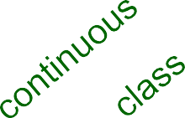
Example of a Decision Tree
Splitting Attributes
Tid | Refund | Marital Status | Taxable Income | Cheat
1 | Yes | Single | 125K | No
2 | No | Married | 100K | No
3 | No | Single | 70K | No
4 | Yes | Married | 120K | No
5 | No | Divorced | 95K | Yes
6 | No | Married | 60K | No
7 | Yes | Divorced | 220K | No
8 | No | Single | 85K | Yes
9 | No | Married | 75K | No
10 | No | Single | 90K | Yes
Refund
Yes
No
NO
MarSt
Single, Divorced
Married
TaxInc
NO
< 80K
> 80K
NO YES
Model: Decision Tree
10
Training Data
15

Slide 16

Another Example of Decision Tree
MarSt
Single, Divorced
Married
Tid | Refund | Marital Status | Taxable Income | Cheat
1 | Yes | Single | 125K | No
2 | No | Married | 100K | No
3 | No | Single | 70K | No
4 | Yes | Married | 120K | No
5 | No | Divorced | 95K | Yes
6 | No | Married | 60K | No
7 | Yes | Divorced | 220K | No
8 | No | Single | 85K | Yes
9 | No | Married | 75K | No
10 | No | Single | 90K | Yes
NO
Refund
Yes
No
NO
TaxInc
< 80K
> 80K
NO
YES
There could be more than one tree that fits the same data!
10
16

Slide 17

Decision Tree Classification Task
Tid Refund Marital Taxable
Status Income Cheat
Tree Induction algorithm
Tid
Attrib1
Attrib2
Attrib3
Class
Yes
No
No
Yes
No
No
Yes
No
No
No
10
Single
Married Single
Married Divorced Married Divorced Single Married Single
125K
100K
70K
120K
95K
60K
220K
85K
75K
90K
No
No No
No Yes No No Yes No Yes
1
Yes
Large
125K
No
2
No
Medium
100K
No
3
No
Small
70K
No
4
Yes
Medium
120K
No
Induction
5
No
Large
95K
Yes
6
No
Medium
60K
No
Learn Model
7
Yes
Large
220K
No
8
No
Small
85K
Yes
9
No
Medium
75K
No
10
No
Small
90K
Yes
Model
10
Training Set
Refund
Marital Status
Taxable Income Cheat
Apply Model
Decision
Tree
No
Single
75K ?
Tid Attr
ib1 Attrib2
Attrib3
Class
Yes
Married 50K
Married 150K Divorced 90K Single 40K
Married 80K
?
?
?
?
?
11 No
Small
55K
?
No
?
12 Yes
Medium
80K
Deduction
Yes
13 Yes
Large
110K
?
No
?
14 No
Small
95K
No
?
15 No
Large
67K
10
10
Test Set

Slide 18
Apply Model to Test Data
Test Data
Start from the root of tree.
Refund Marital Status |  |  | Taxable Income | Cheat
No | Married | 80K |  | ?
Refund
10
Yes
No
NO
MarSt
Single, Divorced
Married
TaxInc
NO
< 80K
> 80K
NO
YES

Slide 19
Apply Model to Test Data
Test Data
Refund Marital Status |  |  | Taxable Income | Cheat
No | Married | 80K |  | ?
Refund
10
Yes
No
NO
MarSt
Single, Divorced
Married
TaxInc
NO
< 80K
> 80K
NO
YES

Slide 20
Apply Model to Test Data
Test Data
Refund Marital Status |  |  | Taxable Income | Cheat
No | Married | 80K |  | ?
Refund
10
Yes
No
NO
MarSt
Single, Divorced
Married
TaxInc
NO
< 80K
> 80K
NO
YES

Slide 21
Apply Model to Test Data
Test Data
Refund Marital
Status
No Married
Taxable Income
Cheat
80K
?
Refund
10
Yes
No
NO
MarSt
Single, Divorced
Married
TaxInc
NO
< 80K
> 80K
NO
YES

Slide 22
Apply Model to Test Data
Test Data
Refund Marital Status |  |  | Taxable Income | Cheat
No | Married | 80K |  | ?
Refund
10
Yes
No
NO
MarSt
Single, Divorced
Married
TaxInc
NO
< 80K
> 80K
NO
YES

Slide 23
Apply Model to Test Data
Test Data
Refund Marital Status |  |  | Taxable Income | Cheat
No | Married | 80K |  | ?
Refund
10
Yes
No
NO
MarSt
Married
Assign Cheat to “No”
Single, Divorced
TaxInc
NO
< 80K
> 80K
NO
YES

Slide 24

Decision Tree Classification Task
Tid Refund
Marital Status
Taxable Income
Cheat
Tree Induction algorithm
Tid
Attrib1
Attrib2
Attrib3
Class
Yes
No
No
Yes
No
No
Yes
No
No
No
Single
Married Single
Married Divorced Married Divorced Single Married Single
125K
100K
70K
120K
95K
60K
220K
85K
75K
90K
No
No No
No Yes No No Yes No Yes
1
Yes
Large
125K
No
2
No
Medium
100K
No
3
No
Small
70K
No
4
Yes
Medium
120K
No
Induction
5
No
Large
95K
Yes
6
No
Medium
60K
No
Learn Model
7
Yes
Large
220K
No
8
No
Small
85K
Yes
9
No
Medium
75K
No
10
10
No
Small
90K
Yes
Model
10
Training Set
Refund
Marital Status
Taxable Income
Apply Model
Decision
Tree
Cheat
No
Single
75K
?
Tid Attr
ib1 Attrib2
Attrib3
Class
Yes
Married 50K 150K
90K
40K
80K
?
?
?
?
?
11 No
Small
55K
?
No
Married
?
12 Yes
Medium
80K
Deduction
Yes
Divorced
?
13 Yes
Large
110K
No
Single
?
14 No
Small
95K
No Married
?
15 No
Large
67K
10
10
Test Set
17

Slide 25
Algorithm for Decision Tree Induction
Basic algorithm (a greedy algorithm)
  Tree is constructed in a top-down recursive divide-and-conquer manner
  At start, all the training examples are at the root
  Attributes are categorical (if continuous-valued, they are discretized in advance)
  Examples are partitioned recursively based on selected attributes
  Test attributes are selected on the basis of a heuristic or statistical measure (e.g., information gain)
Conditions for stopping partitioning
  All (or most) samples for a given node belong to the same class
  There are no remaining attributes for further partitioning – majority voting is employed for classifying the leaf

Slide 26
Decision Tree Induction
Large search space
  Exponential number of trees, with respect to the set of
attributes.
  Finding the optimal decision tree is computationally infeasible
Efficient algorithm for accurate suboptimal decision tree
  Greedy strategy
  Grow the tree by making locally optimally decisions in
selecting the attributes

Slide 27
Decision Tree Induction
Many Algorithms:
  Hunt’s Algorithm (one of the earliest, basis of others)
  CART
  ID3, C4.5
  SLIQ,SPRINT

Slide 28
General Structure of Hunt’s Algorithm
Let D_{t} be the set of training records that reach a node t
General Procedure:
Tid | Refund | Marital Status | Taxable Income | Cheat
1 | Yes | Single | 125K | No
2 | No | Married | 100K | No
3 | No | Single | 70K | No
4 | Yes | Married | 120K | No
5 | No | Divorced | 95K | Yes
6 | No | Married | 60K | No
7 | Yes | Divorced | 220K | No
8 | No | Single | 85K | Yes
9 | No | Married | 75K | No
10 | No | Single | 90K | Yes
If D_{t} contains records that belong the same class y_{t}, then t is a leaf node labeled as y_{t}
If D_{t} is an empty set, then t is a leaf node labeled by the default class, y_{d}
If D_{t} contains records that belong to more than one class, use an attribute test to split the data into smaller subsets.
Recursively apply the procedure to each
subset.
10
D
t
?
20

Slide 29
Hunt’s Algorithm
Tid | Refund | Marital Status | Taxable Income Cheat
1 | Yes | Single | 125K | No
2 | No | Married | 100K | No
3 | No | Single | 70K | No
4 | Yes | Married | 120K | No
5 | No | Divorced | 95K | Yes
6 | No | Married | 60K | No
7 | Yes | Divorced | 220K | No
8 | No | Single | 85K | Yes
9 | No | Married | 75K | No
10 | No | Single | 90K | Yes
Refund
Don’t
No
Don’t
Cheat
Yes
Don’t
Cheat
Cheat
Refund
Yes
Refund
Yes
No
No
Don’t
Cheat
Don’t
Cheat
Marital Status
10
Marital Status
Single, Divorced
Single, Divorced
Taxable
Income
Married
Married
Cheat
Don’t
Cheat
Don’t
Cheat
< 80K
>= 80K
Don’t
Cheat
Cheat

Slide 30
Tree Induction
Greedy strategy.
  Split the records based on an attribute test that optimizes certain criterion.
Issues
  Determine how to split the records
    How to specify the attribute test condition?
    How to determine the best split?
  Determine when to stop splitting

Slide 31
Stopping Criteria for Tree Induction
Stop expanding a node when all the records belong to the same class
Stop expanding a node when all the records have same (or similar) attribute values
  What to do? majority voting

Slide 32
Decision Tree Based Classification
Advantages:
  Inexpensive to construct
  Extremely fast at classifying unknown records
  Easy to interpret for small-sized trees
  Accuracy is comparable to other classification techniques for many simple data sets

Slide 33
Example: C4.5
Simple depth-first construction.
Uses Information Gain
Sorts Continuous Attributes at each node.
Needs entire data to fit in memory.
Unsuitable for Large Datasets.
  Needs out-of-core sorting.
You can download the software from (C4.5 or C5):
https://www.rulequest.com/Personal/

Slide 34
Questions You have now?
How to choose the attribute/value to split on at each level of the tree?
When to stop splitting? When should a node be declared a leaf?
If a leaf node is impure, how should the class label be assigned?

Slide 35
Attribute Selection Measure: Information Gain (ID3/C4.5)
Select the attribute with the highest information gain
Let p_{i} be the probability that an arbitrary tuple in D belongs to class C_{i}, estimated by |C_{i, D}|/|D|
Initial entropy:
New entropy (after using A to split D into v partitions) to classify D:
Information gained by branching on attribute A
Notes:
I : the expected information needed to classify a given sample
E (entropy) : expected information based on the partitioning into subsets by A

Slide 36
Attribute Selection: Information Gain
Class P: buys_computer = “yes”
Class N: buys_computer = “no”
means “age <=30” has 5 out of 14 samples, with 2 yes’es and 3 no’s. Hence
Similarly,

Slide 37
Decision Boundary ?
Class C
Class A
Class B
X
Y

Slide 38
Decision Boundary ?
Class C
Class A
Class B
X
Y

Slide 39
Decision Boundary ?
Class C
Class A
Class B
X
Y

Slide 40
Computing Information-Gain for Continuous-Value Attributes
Let attribute A be a continuous-valued attribute
Must determine the best split point for A
  Sort the value A in increasing order
  Typically, the midpoint between each pair of adjacent values is considered as a possible split point
    (a_{i}+a_{i+1})/2 is the midpoint between the values of a_{i} and a_{i+1}
  The point yielding maximum information gain for A is selected as the split-point for A
Split:
  D1 is the set of tuples in D satisfying A ≤ split-point, and D2 is the set of tuples in D satisfying A > split-point

Slide 41
Gain Ratio for Attribute Selection (C4.5)
Information gain measure is biased towards attributes with a large number of values
C4.5 (a successor of ID3) uses gain ratio to overcome the problem (normalization to information gain)
  GainRatio(A) = Gain(A)/SplitEntropy(A)
Ex.
  gain_ratio(income) = 0.029/0.926 = 0.031
The attribute with the maximum gain ratio is selected as the splitting attribute

Slide 42
Gini index (CART, IBM IntelligentMiner)
If a data set D contains examples from n classes, gini index, gini(D) is defined as
where p_{j} is the relative frequency (proportion) of class j in D
If a data set D is split on A into two subsets D₁ and D₂, the gini index gini(D) is defined as
Reduction in Impurity:
The attribute provides the largest reduction in impurity is chosen to split the node (need to enumerate all the possible splitting points for each attribute)

Slide 43
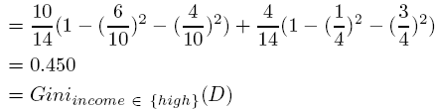
Gini index (CART, IBM IntelligentMiner)
Ex. D has 9 tuples in buys_computer = “yes” and 5 in “no”
Suppose the attribute income partitions D into 10 in D₁: {low, medium} and 4 in D₂
  but gini_{{medium,high}} is 0.30 and thus the best since it is the lowest

Slide 44
Comparing Attribute Selection Measures
The three measures, in general, return good results but
  Information gain:
    biased towards multivalued attributes
  Gain ratio:
    tends to prefer unbalanced splits in which one partition is much smaller than the others
  Gini index:
    biased to multivalued attributes
    has difficulty when # of classes is large
    tends to favor tests that result in equal-sized partitions and purity in both partitions

Slide 45
Overfitting and Tree Pruning
Overfitting: An induced tree may overfit the training data
  Too many branches, some may reflect anomalies due to noise or outliers
  Poor accuracy for unseen samples
Two approaches to avoid overfitting
  Prepruning: Halt tree construction early—do not split a node if this would result in the goodness measure falling below a threshold
    Difficult to choose an appropriate threshold
  Postpruning: Remove branches from a “fully grown” tree—get a sequence of progressively pruned trees
    Use a set of data different from the training data to decide which is the “best pruned tree”

Slide 46
Enhancements to Basic Decision Tree Induction
Allow for continuous-valued attributes
  Dynamically define new discrete-valued attributes that partition the continuous attribute value into a discrete set of intervals
Handle missing attribute values
  Assign the most common value of the attribute
  Assign probability to each of the possible values

Slide 47
Classification in Large Databases
Classification—a classical problem extensively studied by statisticians and machine learning researchers
Scalability: Classifying data sets with millions of examples and hundreds of attributes with reasonable speed
Why decision tree induction in data mining?
  relatively faster learning speed (than other classification methods)
  convertible to simple and easy to understand classification rules
  can use SQL queries for accessing databases
  comparable classification accuracy with other methods

Slide 48
Scalable Decision Tree Induction Methods
PUBLIC (VLDB’98 — Rastogi & Shim)
  Integrates tree splitting and tree pruning: stop growing the tree earlier
RainForest (VLDB’98 — Gehrke, Ramakrishnan & Ganti)
  Builds an AVC-list (attribute, value, class label)
BOAT (PODS’99 — Gehrke, Ganti, Ramakrishnan & Loh)
  Uses bootstrapping to create several small samples
Random Forest – creates a large number of
trees with a random selection of features

Slide 49
Scalability Framework for RainForest
Builds an AVC-list: AVC (Attribute, Value, Class_label)
AVC-set (of an attribute X )
  Projection of training dataset onto the attribute X and class label where counts of individual class label are aggregated

Slide 50
Rainforest: Training Set and Its AVC Sets
Training Examples
AVC-set on Age
AVC-set on income
Age | Buy_Computer
 | yes | no
<=30 | 3 | 2
31..40 | 4 | 0
>40 | 3 | 2
income | Buy_Computer
 | yes | no
high | 2 | 2
medium | 4 | 2
low | 3 | 1
AVC-set on
credit_rating
AVC-set on Student
student | Buy_Computer
 | yes | no
yes | 6 | 1
no | 3 | 4
Credit rating | Buy_Computer
 | yes | no
fair | 6 | 2
excellent | 3 | 3

Slide 51
BOAT (Bootstrapped Optimistic Algorithm for Tree Construction)
Use a statistical technique called bootstrapping to create several smaller samples (subsets), each fits in memory
Each subset is used to create a tree, resulting in several trees
These trees are examined and used to construct a new tree T’
  It turns out that T’ is very close to the tree that would be generated using the whole data set together
Adv: requires fewer scans of DB, an incremental alg.

Slide 52
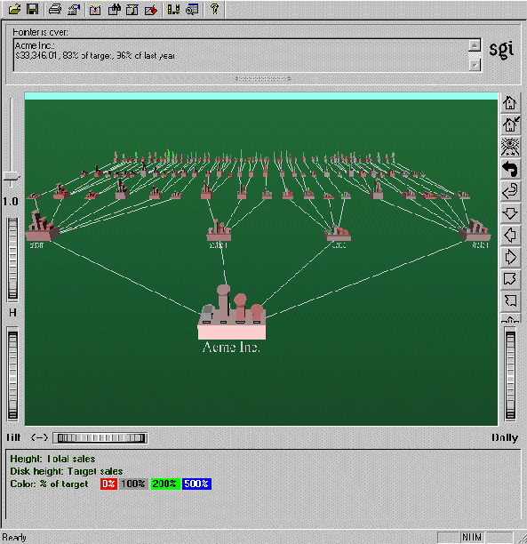
Visualization of a Decision Tree in SGI/MineSet 3.0

Slide 53
Random Forest
Randomly select a sub set of features
Create a fully grown decision tree on the n data points, with the sub feature set, sampled with replacement.
Repeat the two steps to create a large number of trees forming a random forest.
Apply each tree in the forest on test data and use majority vote of all trees as final prediction.
The random forest may work better than a tree constructed from all features.
Why does it work better? Reduce variance, bias, no feature selection, two parameters (#feature, #tree)

Slide 54
Advantages and Disadvantages
It is one of the most accurate learning algorithms available.
It runs efficiently on large databases.
It can handle thousands of input variables without variable deletion.
It gives estimates of what variables are important in the classification.
It generates an internal unbiased estimate of the generalization error as the forest building progresses.
It has an effective method for estimating missing data and maintains accuracy when a large proportion of the data are missing.
It computes proximities between pairs of cases that can be used in clustering, locating outliers, or (by scaling) give interesting views of the data.
The capabilities of the above can be extended to unlabeled data, leading to unsupervised clustering, data views and outlier detection.
It offers an experimental method for detecting variable interactions.
Disadvantages: overfitting
Wikipedia

Slide 55
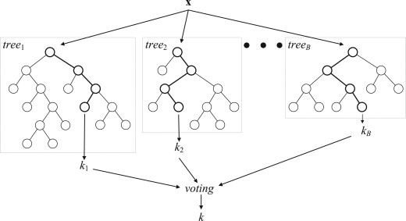
Mining Data with Random Forest
Classification
Clustering
Regression
Feature Selection
Outlier detection
Review paper: http://www.sciencedirect.com/science/article/pii/S0031320310003973

Slide 56
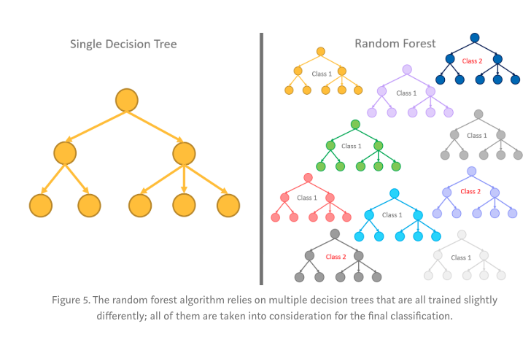
Random Forest Decision: Majority Rule

Slide 57
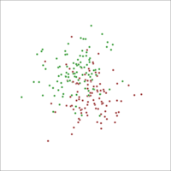
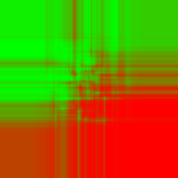

An Example
Two Gaussian point clouds
Random Forest
Logistic regression
Wikipedia

Slide 58
Model Evaluation
– Actually R and predicted as R (correct classification : true positive)
– Actually not R and predicted as not R (correct classification : true negative)
– Actually not R but predicted as R (incorrect classification : false positive)
– Actually R but predicted as not R (incorrect classification : false negative)

Slide 59
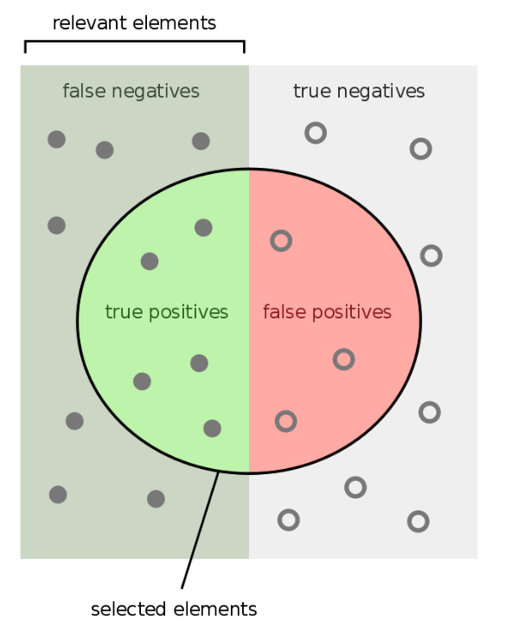
Image Explaining Sensitivity/Specificity
Wikipedia/images

Slide 60
Metrics for Evaluating Classifier Performance
True-Positive Rate(TPR) = TP / TP + FN
False-Positive Rate(FPR) = FP / FP + TN
True-Negative Rate(TNR) = TN / TN + FP
False-Negative Rate(FNR) = FN / FN + TP
NOTE:
  Sensitivity = TPR = Recall
  Specificity = TNR

Slide 61
Metrics for Evaluating Classifier Performance
Accuracy = Correct predictions / Total predictions
= (TP + TN) / (TP + TN + FP + FN)
Error Rate = Misclassified predictions/Total pred.
= (FP + FN)/ (TP + TN + FP + FN)
= 1 - Accuracy
Precision = True positive / Predicted positive
= TP / (TP + FP)
Recall = True positive / Actual positive
= TP / (TP + FN)

Slide 62
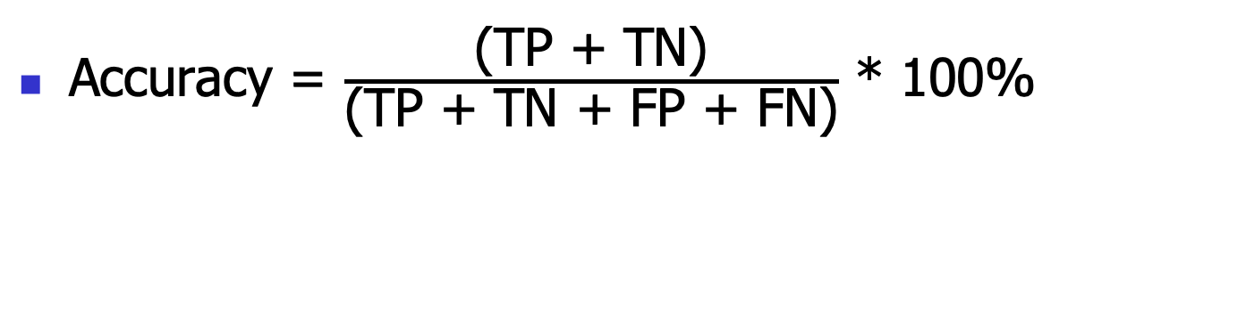
Confusion Matrix
 | C_{1(Pre)} | C_{2(pre)}
C₁ | True positive | False negative
C₂ | False positive | True negative
classes | buy_computer = yes | buy_computer = no | total | recognition(%)
buy_computer = yes | 6954 | 46 | 7000 | 99.34
buy_computer = no | 412 | 2588 | 3000 | 86.27
total | 7366 | 2634 | 10000 | 95.52

Slide 63
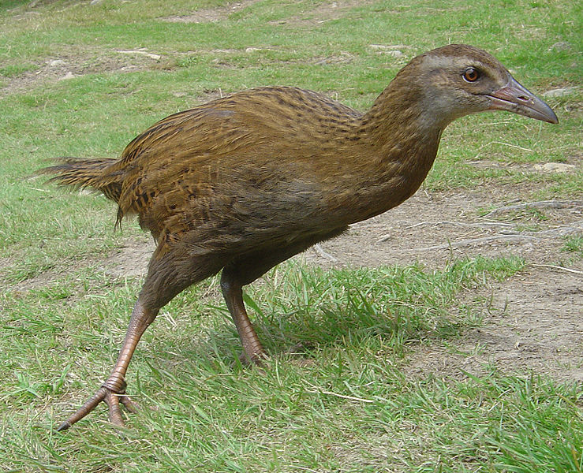
Weka Demo of A Decision Tree
http://www.cs.waikato.ac.nz/ml/weka/
Breast Cancer Data - https://archive.ics.uci.edu/ml/datasets/Breast+Cancer
Attribute Information:
1. Class: no-recurrence-events, recurrence-events
2. age: 10-19, 20-29, 30-39, 40-49, 50-59, 60-69, 70-79, 80-89, 90-99.
3. menopause: lt40, ge40, premeno.
4. tumor-size: 0-4, 5-9, 10-14, 15-19, 20-24, 25-29, 30-34, 35-39, 40-44,
45-49, 50-54, 55-59.
5. inv-nodes: 0-2, 3-5, 6-8, 9-11, 12-14, 15-17, 18-20, 21-23, 24-26,
27-29, 30-32, 33-35, 36-39.
6. node-caps: yes, no.
7. deg-malig: 1, 2, 3.
8. breast: left, right.
9. breast-quad: left-up, left-low, right-up, right-low, central.
10. irradiat: yes, no.
Class Distribution:
1. no-recurrence-events: 201 instances
2. recurrence-events: 85 instances

Slide 64
Chapter 8-9. Classification and Prediction
What is classification? What is prediction?
Issues regarding classification and prediction
Classification by decision tree induction
Bayesian classification
Rule-based classification
Classification by back propagation
Support Vector Machines (SVM)
Associative classification
Lazy learners (or learning from your neighbors)
Other classification methods
Prediction
Accuracy and error measures
Ensemble methods
Model selection
Summary

Slide 65
Bayesian Classification: Why?
A statistical classifier: performs probabilistic prediction, i.e., predicts class membership probabilities
Foundation: Based on Bayes’ Theorem.
Performance: A simple Bayesian classifier, naïve Bayesian classifier, has comparable performance with decision tree and selected neural network classifiers
Incremental: Each training example can incrementally increase/decrease the probability that a hypothesis is correct — prior knowledge can be combined with observed data
Standard: Even when Bayesian methods are computationally intractable, they can provide a standard of optimal decision making against which other methods can be measured

Slide 66
Bayesian Theorem: Basics
Let X be a data sample (“evidence”), class label is unknown
Let H be a hypothesis that X belongs to class C
Classification is to determine P(C|X), the probability that the hypothesis holds given the observed data sample X
P(C) (prior probability), the initial probability of C
  E.g., X will buy computer, regardless of age, income, …
P(X): probability that sample data is observed
P(X|C) (likelihood), the probability of observing the sample X, given that the hypothesis H holds
  E.g., Given that X will buy computer, the prob. that X is 31..40, medium income

Slide 67
Bayesian Theorem
Given training data X, posteriori probability of a hypothesis H, P(C|X), follows the Bayes theorem
Informally, this can be written as
  posteriori = prior x likelihood / evidence
Predicts X belongs to C_{i} iff the probability P(C_{i}|X) is the highest among all the P(C_{k}|X) for all the k classes
Practical difficulty: require initial knowledge of many probabilities, significant computational cost

Slide 68
Towards Naïve Bayesian Classifier
Let D be a training set of tuples and their associated class labels, and each tuple is represented by an n-D attribute vector X = (x₁, x₂, …, x_{n})
Suppose there are m classes C₁, C₂, …, C_{m}.
Classification is to derive the maximum posteriori, i.e., the maximal P(C_{i}|X)
This can be derived from Bayes’ theorem (1<= i <= m)
Since P(X) is constant for all classes, only
  needs to be maximized

Slide 69
Derivation of Naïve Bayes Classifier
A simplified assumption: attributes are conditionally independent (i.e., no dependence relation between attributes):
This greatly reduces the computation cost: Only counts the class distribution
If A_{k} is categorical, P(x_{k}|C_{i}) is the # of tuples in C_{i} having value x_{k} for A_{k} divided by |C_{i, D}| (# of tuples of C_{i} in D)
If A_{k} is continuous-valued, P(x_{k}|C_{i}) is usually computed based on Gaussian distribution with a mean μ and standard deviation σ
  and P(x_{k}|C_{i}) is

Slide 70
Naïve Bayesian Classifier: Training Dataset
Class:
C1:buys_computer = ‘yes’
C2:buys_computer = ‘no’
Data sample
X = (age <=30,
Income = medium,
Student = yes
Credit_rating = Fair)

Slide 71
Naïve Bayesian Classifier: An Example
P(C_{i}): P(buys_computer = “yes”) = 9/14 = 0.643
P(buys_computer = “no”) = 5/14= 0.357
Compute P(X|C_{i}) for each class
P(age = “<=30” | buys_computer = “yes”) = 2/9 = 0.222
P(age = “<= 30” | buys_computer = “no”) = 3/5 = 0.6
P(income = “medium” | buys_computer = “yes”) = 4/9 = 0.444
P(income = “medium” | buys_computer = “no”) = 2/5 = 0.4
P(student = “yes” | buys_computer = “yes) = 6/9 = 0.667
P(student = “yes” | buys_computer = “no”) = 1/5 = 0.2
P(credit_rating = “fair” | buys_computer = “yes”) = 6/9 = 0.667
P(credit_rating = “fair” | buys_computer = “no”) = 2/5 = 0.4
X = (age <= 30 , income = medium, student = yes, credit_rating = fair)
P(X|C_{i}) : P(X|buys_computer = “yes”) = 0.222 x 0.444 x 0.667 x 0.667 = 0.044
P(X|buys_computer = “no”) = 0.6 x 0.4 x 0.2 x 0.4 = 0.019
P(X|C_{i})*P(C_{i}) : P(X|buys_computer = “yes”) * P(buys_computer = “yes”) = 0.028
P(X|buys_computer = “no”) * P(buys_computer = “no”) = 0.007
Therefore, X belongs to class (“buys_computer = yes”)

Slide 72
Avoiding the 0-Probability Problem
Naïve Bayesian prediction requires each conditional prob. be non-zero. Otherwise, the predicted prob. will be zero
Ex. Suppose a dataset with 1000 tuples, income=low (0), income= medium (990), and income = high (10)

Slide 73
Avoiding the 0-Probability Problem
Naïve Bayesian prediction requires each conditional prob. be non-zero. Otherwise, the predicted prob. will be zero
Ex. Suppose a dataset with 1000 tuples, income=low (0), income= medium (990), and income = high (10),
Use Laplacian correction (or Laplacian estimator)
  Adding 1 to each case
    Prob(income = low) = 1/1003
    Prob(income = medium) = 991/1003
    Prob(income = high) = 11/1003
  The “corrected” prob. estimates are close to their “uncorrected” counterparts

Slide 74
Naïve Bayesian Classifier: Comments
Advantages
  Easy to implement
  Good results obtained in most of the cases
Disadvantages
  Assumption: class conditional independence, therefore loss of accuracy
  Practically, dependencies exist among variables
    E.g., salary and age.
    Symptoms: fever, cough etc., Disease: lung cancer, diabetes, etc.
    Dependencies among these cannot be modeled by Naïve Bayesian Classifier
How to deal with these dependencies?
  Bayesian Belief Networks

Slide 75
Weka Demo
Vote Classification

Slide 76
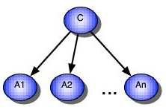
Graphical Model for Naïve Bayes Classifier
http://people.csail.mit.edu/kersting/profile/PROFILE_nb.html

Slide 77
Chapter 8-9. Classification and Prediction
What is classification? What is prediction?
Issues regarding classification and prediction
Classification by decision tree induction
Bayesian classification
Rule-based classification
Classification by back propagation
Support Vector Machines (SVM)
Associative classification
Lazy learners (or learning from your neighbors)
Other classification methods
Prediction
Accuracy and error measures
Ensemble methods
Model selection
Summary

Slide 78
Using IF-THEN Rules for Classification
Represent the knowledge in the form of IF-THEN rules
  R: IF age = youth AND student = yes THEN buys_computer = yes
  Rule antecedent/precondition vs. rule consequent
Assessment of a rule: coverage and accuracy
  n_{covers} = # of data points covered by R
  n_{correct} = # of data points correctly classified by R
  coverage(R) = n_{covers} /|D| /* D: training data set */
  accuracy(R) = n_{correct} / n_{covers}
If more than one rule is triggered, need conflict resolution
  Size ordering: assign the highest priority to the triggering rules that has the “toughest” requirement (i.e., with the most attribute test)
  Rule-based ordering (decision list): rules are organized into one long priority list, according to some measure of rule quality (accuracy) or by experts

Slide 79
Rule Extraction from a Decision Tree
age?
<=30
31..40
>40
Rules are easier to understand than large trees
One rule is created for each path from the root to a leaf
Each attribute-value pair along a path forms a conjunction: the leaf holds the class prediction
Rules are mutually exclusive and exhaustive
student?
yes
credit rating?
no
yes
excellent
fair
no
yes
no
yes
Example: Rule extraction from our buys_computer decision-tree
  IF age = young AND student = no THEN buys_computer = no
  IF age = young AND student = yes THEN buys_computer = yes
  IF age = mid-age THEN buys_computer = yes
  IF age = old AND credit_rating = excellent THEN buys_computer = yes
  IF age = young AND credit_rating = fair THEN buys_computer = no

Slide 80
Chapter 8-9. Classification and Prediction
What is classification? What is prediction?
Issues regarding classification and prediction
Classification by decision tree induction
Bayesian classification
Rule-based classification
Classification by back propagation
Support Vector Machines (SVM)
Associative classification
Lazy learners (or learning from your neighbors)
Other classification methods
Prediction
Accuracy and error measures
Ensemble methods
Model selection
Summary

Slide 81
Classification: A Mathematical Mapping
Classification:
  predicts categorical class labels
E.g., Personal homepage classification
  x_{i} = (x₁, x₂, x₃, …), y_{i} = +1 or –1
  x₁ : # of a word “homepage”
  x₂ : # of a word “welcome”
Mathematically
  x ∈ X = ℜ^{n}, y ∈ Y = {+1, –1}
  We want a function f: X → Y

Slide 82
Linear Classification
Binary Classification problem
The data above the red line belongs to class ‘x’
The data below red line belongs to class ‘o’
Examples: SVM, Perceptron
x
x
x
x
x
x
x
x
o
x
o
x
o
o
o
o
o
o
o
o
o
o
o

Slide 83
Generative VS Discriminative
Generative Classifier: develop a model to simulate the generation of data of each class (Naïve Bayes, HMM)
Discriminative Classifier: find a function to separate different groups of data
(decision tree, perceptron, neural networks, support vector machines, etc)

Slide 84
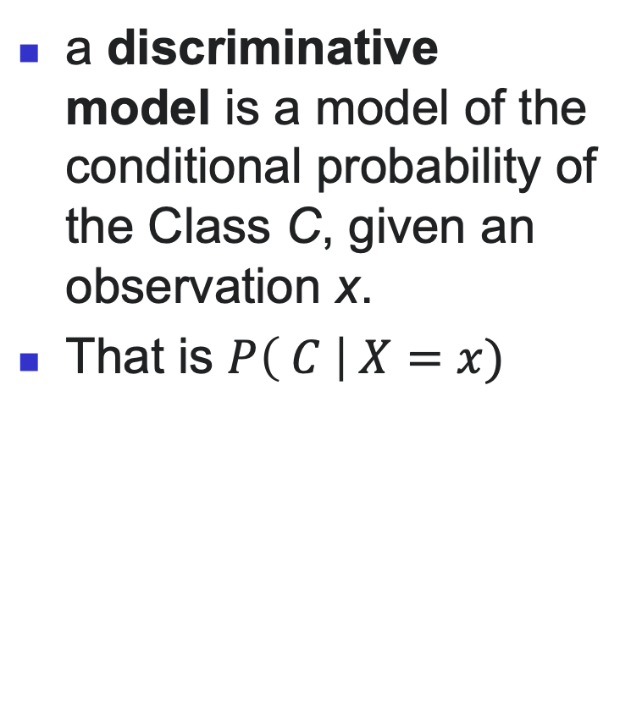
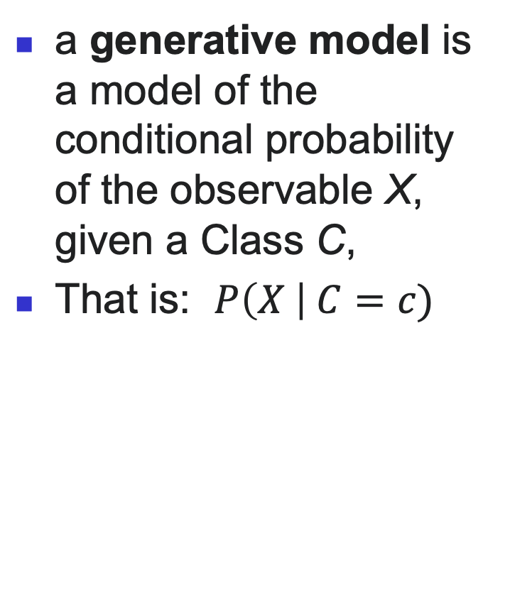
Generative VS Discriminative
a generative model is a model of the conditional probability of the observable X, given a Class C,
That is: $P\left(X \right| C=c)$
a discriminative model is a model of the conditional probability of the Class C, given an observation x.
That is $P\left( C \right| X=x)$

Slide 85
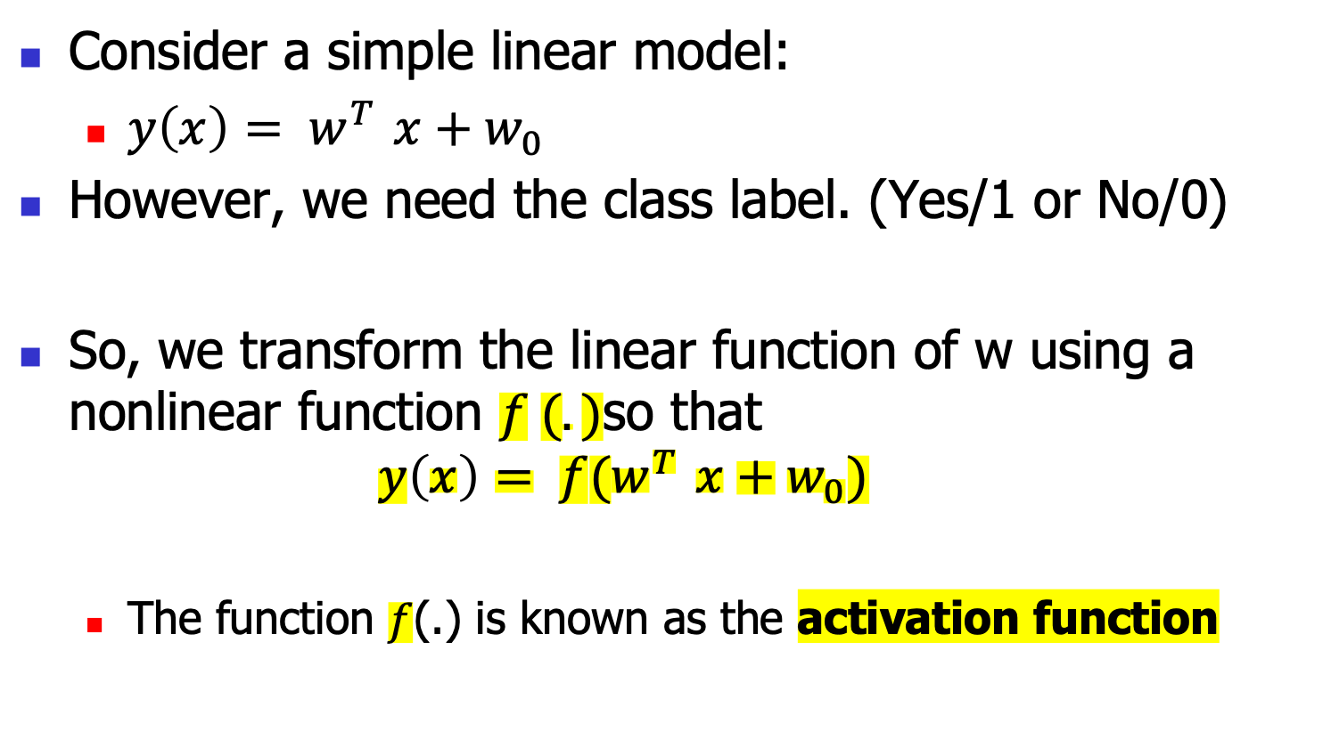
Discriminative Functions

Slide 86
Discriminative Classifiers
Advantages
  prediction accuracy is generally high
    As compared to Bayesian methods – in general
  robust, works when training examples contain errors
  fast evaluation of the learned target function
    Bayesian networks are normally slow
Criticism
  Cannot simulate data generation
  long training time
  difficult to understand the learned function (weights)
    Bayesian networks can be used easily for pattern discovery
  not easy to incorporate domain knowledge
    Easy in the form of priors on the data or distributions

Slide 87
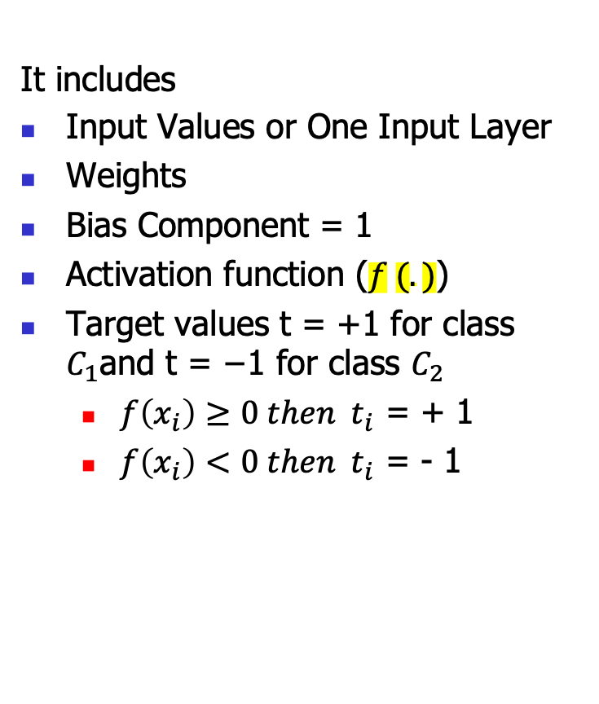
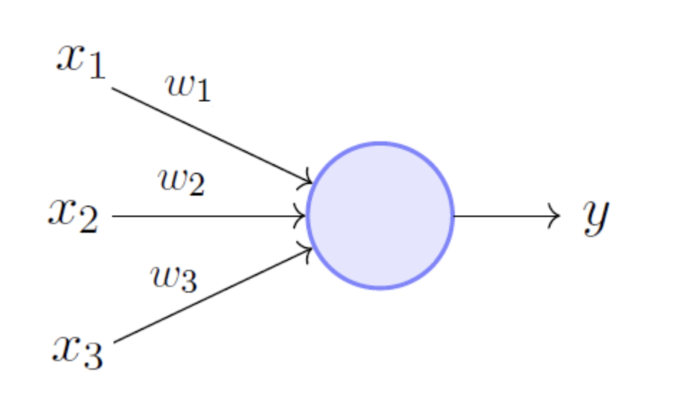
Perceptron
A linear discriminant model
Frank Rosenblatt (1962)

Slide 88
Perceptron
Vector: x, w
Scalar: x, y, w
Input: {(x₁, t₁), …}
Output: classification function f(x)
f(x_{i}) > 0 for t_{i} = +1
f(x_{i}) < 0 for t_{i} = -1
f(x) = w₁x₁+w₂x₂+b = 0
x₂
Perceptron: update W additively
x₁

Slide 89
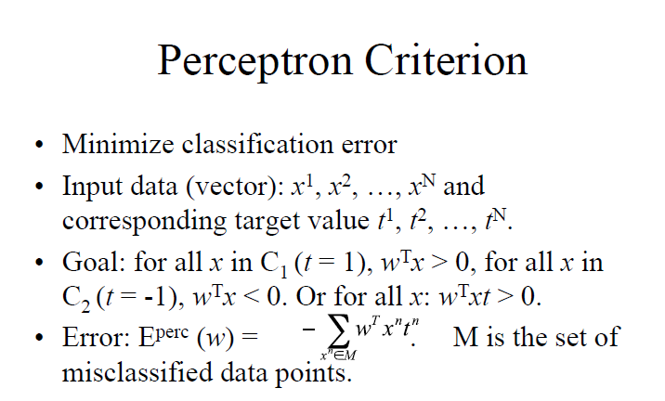

Slide 90
Minimization Illustration

Slide 91
Gradient Descent
It is an iterative optimization algorithm
It is one of the most popular algorithm used to find minimum value of a function.

Slide 92
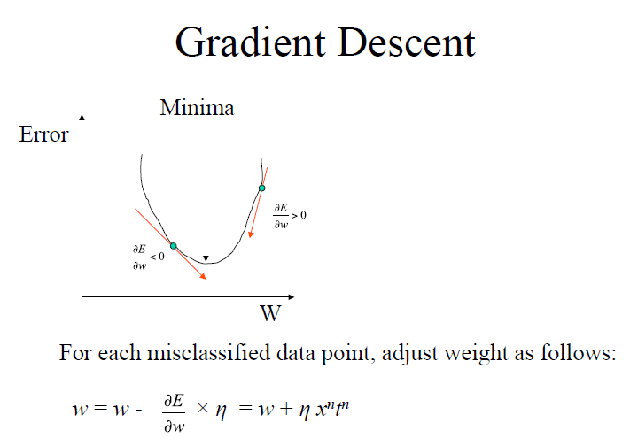

Slide 93
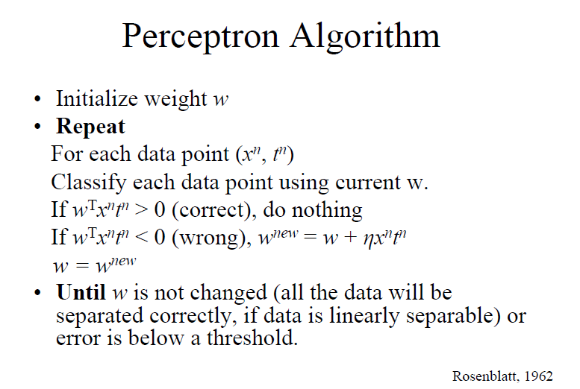

Slide 94
Perceptron Learning Movie
https://www.youtube.com/watch?v=vGwemZhPlsA

Slide 95
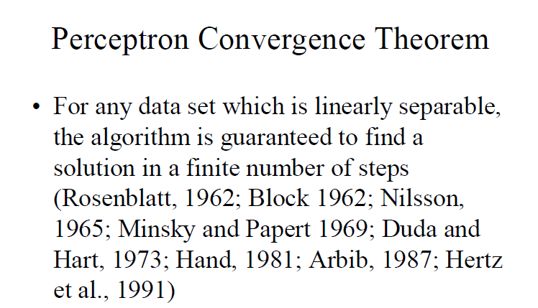

Slide 96
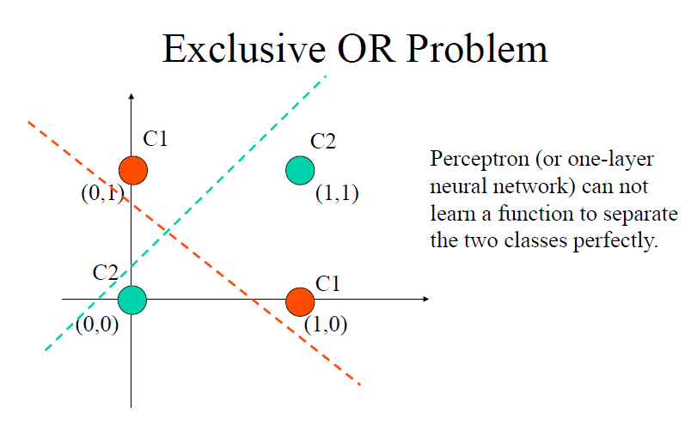

Slide 97
Extend to Neural Networks
Started by psychologists and neurobiologists to develop and test computational analogues of neurons
A neural network: A set of connected input/output units where each connection has a weight associated with it
During the learning phase, the network learns by adjusting the weights so as to be able to predict the correct class label of the input tuples
Also referred to as connectionist learning due to the connections between units

Slide 98

Brain
Images.google.com

Slide 99
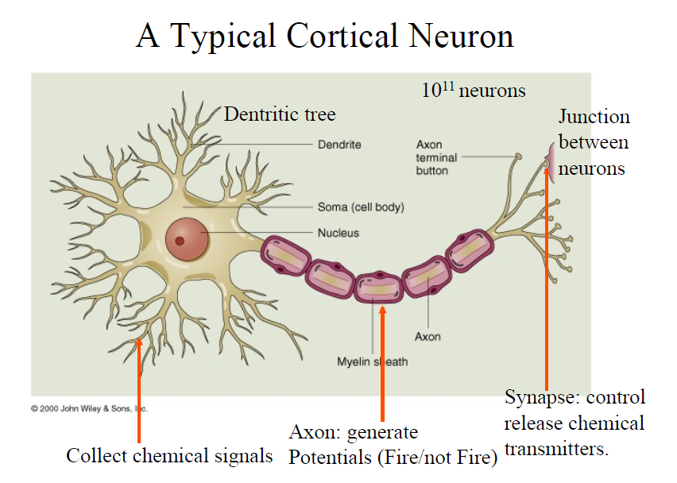

Slide 100


Slide 101
A Neuron (= a perceptron)
1
w₀
x₁
w₁
∑
f
output y
x_{n}
w_{n}
Input
vector x
weight
vector w
weighted
sum
Activation
function
The n-dimensional input vector x is mapped into variable y by means of the scalar product and a nonlinear function mapping

Slide 102
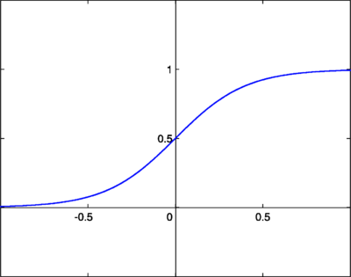
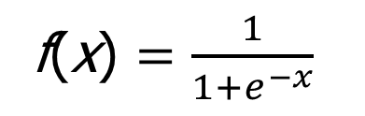
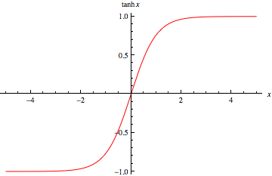
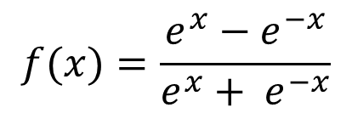
Activation / Transfer Function
Sigmoid function:
Tanh function
What is derivative of f(x)?

Slide 103
A Multi-Layer Feed-Forward Neural Network
Output vector
Output layer
Hidden layer
w_{ij}
Input layer
Input vector: X

Slide 104
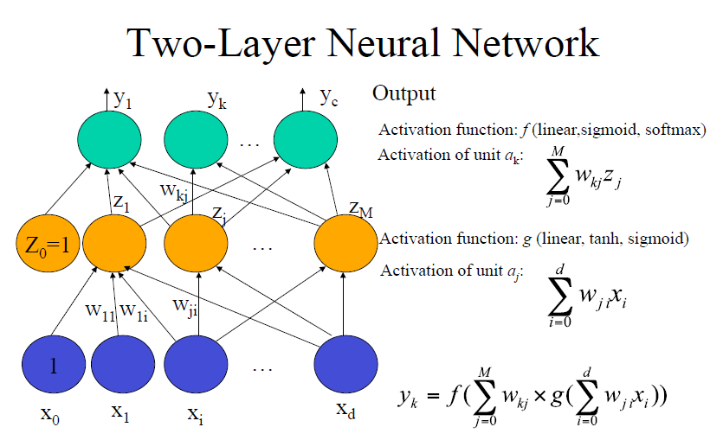

Slide 105
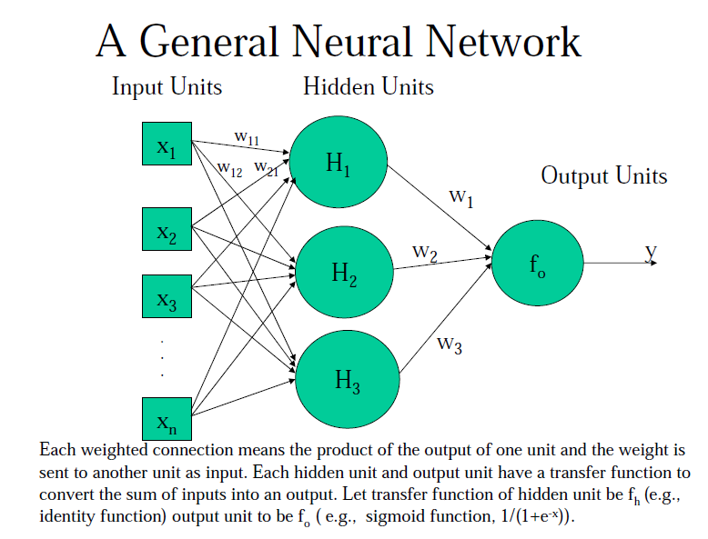

Slide 106
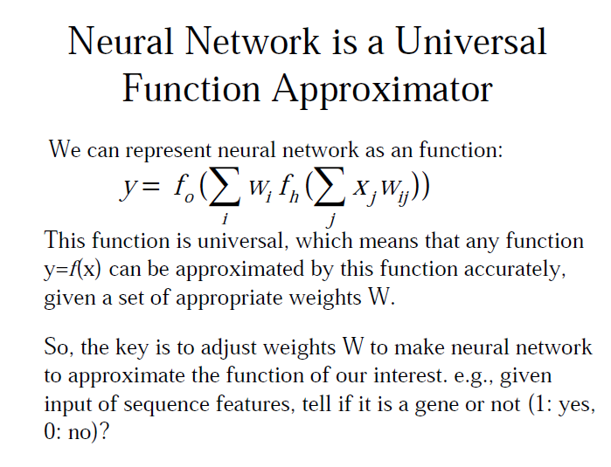

Slide 107
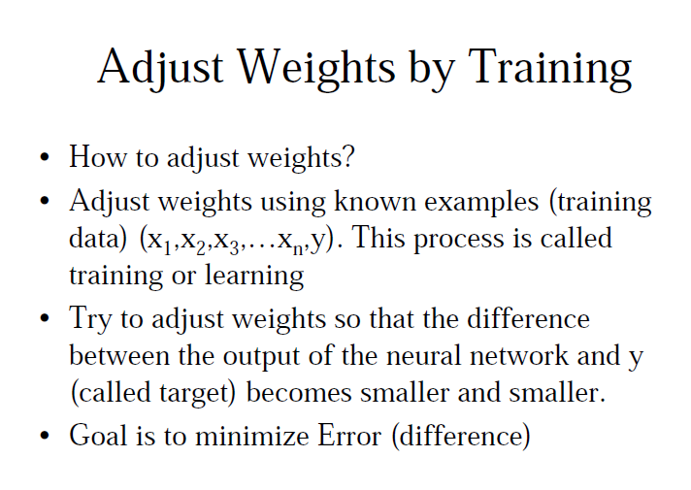

Slide 108
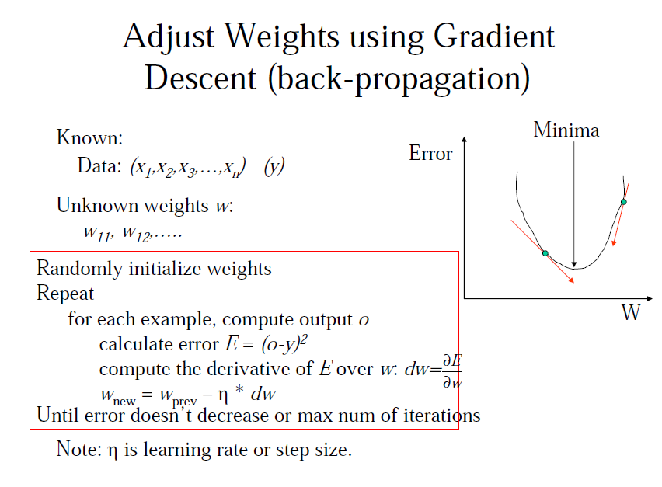

Slide 109
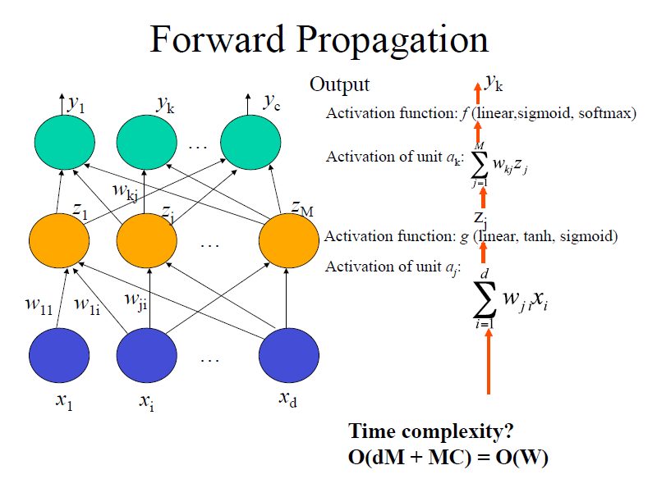

Slide 111
Matrix View of Propagation
w₁₁ | w₁₂ | w₁₃ | … | w_{1d}
W₂₁ | W₂₂ | … | …. | w_{2d}
….
W_{m1} | W_{m2} |  |  | w_{md}
*
(X₁, x₂, …, X_{d})
= (a₁, a₂, …, a_{m})
Apply
Transfer
function
w₁₁ | w₁₂ | w₁₃ | … | w_{1m}
W₂₁ | W₂₂ | … | …. | w_{2c}
….
W_{c1} | W_{m2} |  |  | w_{cm}
*
(z₁, z₂, …, z_{m})
(b₁, b₂, …, b_{c}) =
Apply transfer function
(O₁, O₂, …, O_{c})

Slide 113
Backpropagation Explained
In-Class Explanation

Slide 114
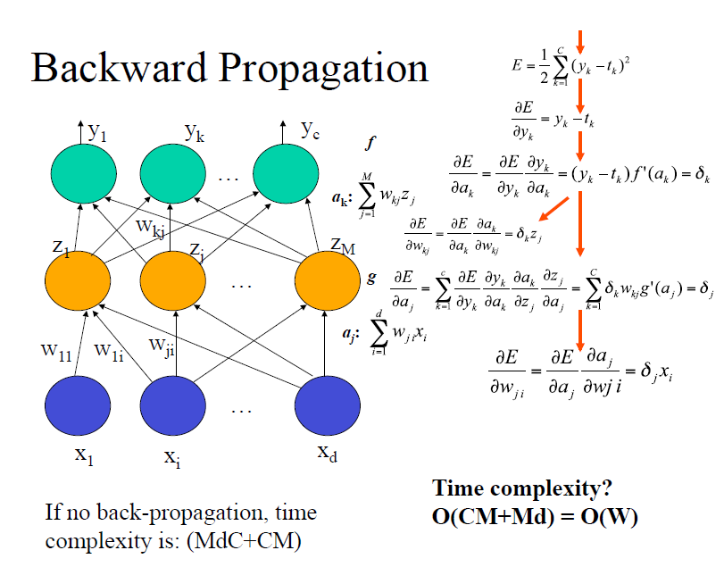
Chain Rule of Calculating Derivatives

Slide 115
Chain Rule of Calculating Derivatives

Slide 116
Backpropagation
Iteratively present a set of training tuples & compare the network's prediction with the actual known target value.
An iteration on all tuples is called an Epoch.
For each training tuple, the weights are modified to minimize the mean squared error between prediction and the actual target value
Modifications are made in the “backwards” direction backpropagation
Steps
  Initialize weights (to small random #s) and biases in the network
  Propagate the inputs forward (by applying activation function)
  Backpropagate the error (by updating weights and biases)
  Repeat propagation and back-propagation until terminating condition is reached (when error is very small, etc.)

Slide 117
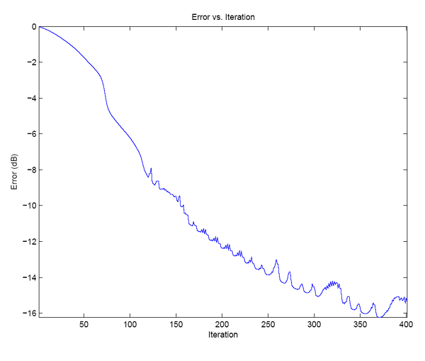
Training Error

Slide 118
Defining a Network Topology
First decide the network topology: # of units in the input layer, # of hidden layers (if > 1), # of units in each hidden layer, and # of units in the output layer
Normalizing the input values for each attribute measured in the training tuples to [0.0—1.0]
Output, if for classification and more than two classes, one output unit per class is used
Once a network has been trained and its accuracy is unacceptable, repeat the training process with a different network topology or a different set of initial weights

Slide 119
Test Phase and Prediction
Weights are known
Given an input x, neural network generates an output O
Binary classification: O > 0.5 → positive, O <= 0.5 → negative
Multi-classification: Choose the class of the output node with highest value
Regression: O is the predicted value

Slide 120
Neural Network as a Classifier
Weakness
  Long training time
  Require a number of parameters typically best determined empirically, e.g., the network topology
  Poor interpretability: Difficult to interpret the symbolic meaning behind the learned weights and of ``hidden units" in the network
Strength
  High tolerance to noisy data
  Ability to classify untrained patterns
  Well-suited for continuous-valued inputs and outputs
  Successful on a wide array of real-world data
  Algorithms are inherently parallel
  Techniques have recently been developed for the extraction of rules from trained neural networks

Slide 121
Neural Network Software
Weka (Java)
NNClass in NNRank package (C++, good performance, very fast): http://sysbio.rnet.missouri.edu/multicom_toolbox/tools.html
Matlab

Slide 122
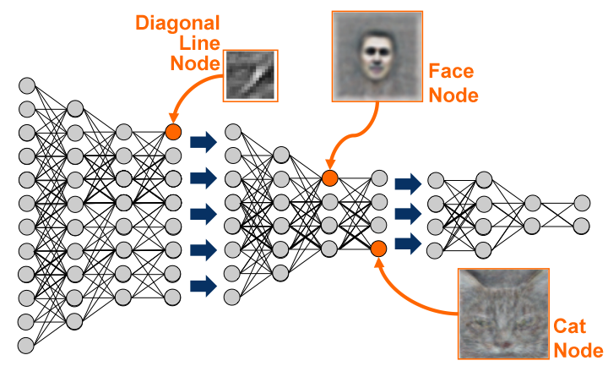
Most Recent Development – Deep Learning

Slide 123
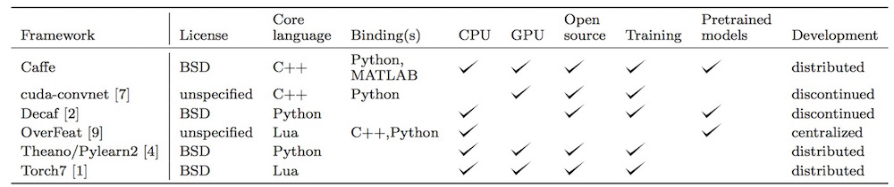
Deep Learning Tools
Pylearn2
Tensorflow
Theano
Keras
Caffe
Torch
Cuda-convnet
Deeplearning4j

Slide 124
Six Top General Data Mining Tools
RapidMiner
Weka
R-programming
Orange (python)
KNIME
NLTK

Slide 125
Chapter 8-9. Classification and Prediction
What is classification? What is prediction?
Issues regarding classification and prediction
Classification by decision tree induction
Bayesian classification
Rule-based classification
Classification by back propagation
Support Vector Machines (SVM)
Associative classification
Lazy learners (or learning from your neighbors)
Other classification methods
Prediction
Accuracy and error measures
Ensemble methods
Model selection
Summary

Slide 126
SVM—Support Vector Machines
A new classification method for both linear and nonlinear data
It uses a nonlinear mapping to transform the original training data into a higher dimension
With the new dimension, it searches for the linear optimal separating hyperplane (i.e., “decision boundary”)
With an appropriate nonlinear mapping to a sufficiently high dimension, data from two classes can always be separated by a hyperplane
SVM finds this hyperplane using support vectors (“essential” training tuples) and margins (defined by the support vectors)

Slide 127
SVM—History and Applications
Vapnik and colleagues (1992)—groundwork from Vapnik & Chervonenkis’ statistical learning theory in 1960s
Features: training can be slow but accuracy is high owing to their ability to model complex nonlinear decision boundaries (margin maximization)
Used both for classification and prediction
Applications:
  handwritten digit recognition, object recognition, speaker identification, benchmarking time-series prediction tests

Slide 128
SVM—General Philosophy
Small Margin
Large Margin
Support Vectors

Slide 129
SVM—Linearly Separable
A separating hyperplane can be written as
    W ● X + b = 0
  where W={w₁, w₂, …, w_{n}} is a weight vector and b a scalar (bias)
For 2-D it can be written as
    w₀ + w₁ x₁ + w₂ x₂ = 0
The hyperplane defining the sides of the margin:
    H₁: w₀ + w₁ x₁ + w₂ x₂ ≥ 1 for y_{i} = +1, and
    H₂: w₀ + w₁ x₁ + w₂ x₂ ≤ – 1 for y_{i} = –1
Any training tuples that fall on hyperplanes H₁ or H₂ (i.e., the
sides defining the margin) are support vectors
This becomes a constrained (convex) quadratic optimization problem: Quadratic objective function and linear constraints → Quadratic Programming (QP) → Lagrangian multipliers

Slide 130
SVM—When Data Is Linearly Separable
m
Let data D be (X₁, y₁), …, (X_{|D|}, y_{|D|}), where X_{i} is the set of training tuples associated with the class labels y_{i}
There are infinite lines (hyperplanes) separating the two classes but we want to find the best one (the one that minimizes classification error on unseen data)
SVM searches for the hyperplane with the largest margin, i.e., maximum marginal hyperplane (MMH)

Slide 131
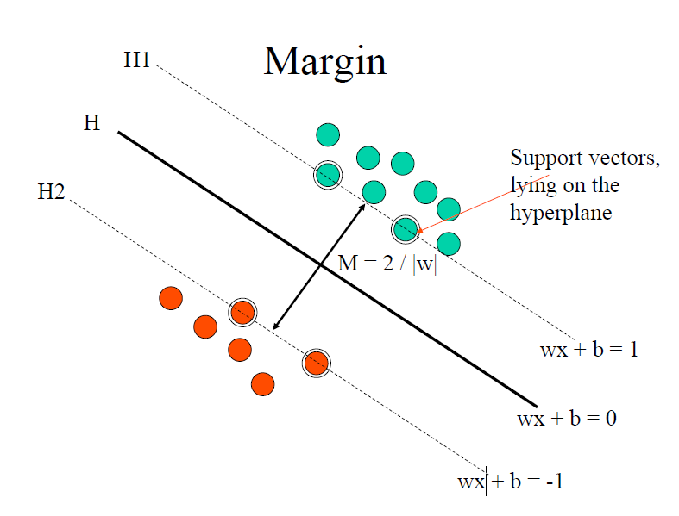

Slide 132
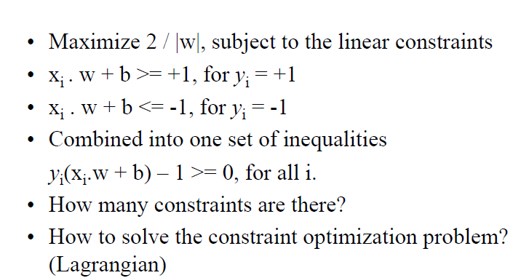
Quadratic Optimization

Slide 133
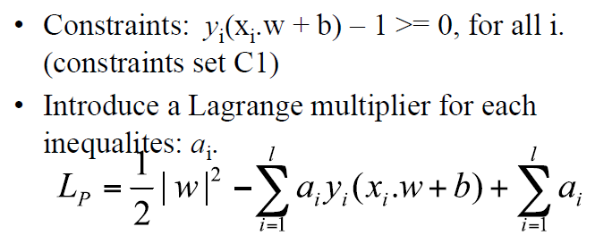
Primal Optimization

Slide 134
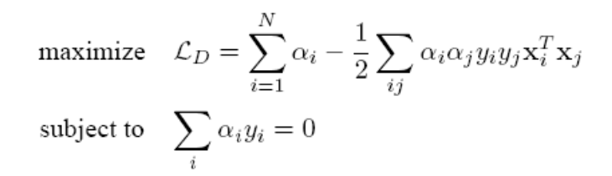
Dual Optimization

Slide 135
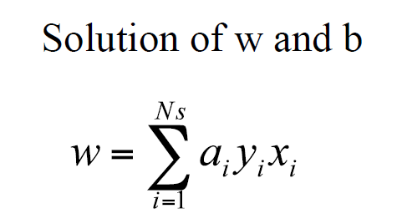

Slide 137
How to calculate b?
Take a positive (resp. negative) support vector
Given W ● X + b = 1
b = 1 - W ● X
Good practice is to use all the support vectors to caculate b and take the average

Slide 138
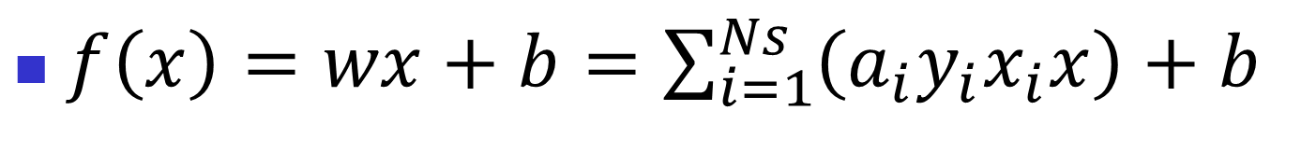
Prediction
How to interpret it?

Slide 139
Why Is SVM Effective on High Dimensional Data?
The complexity of trained classifier is characterized by the # of support vectors rather than the dimensionality of the data
The support vectors are the essential or critical training examples —they lie closest to the decision boundary (MMH)
If all other training examples are removed and the training is repeated, the same separating hyperplane would be found
The number of support vectors found can be used to compute an (upper) bound on the expected error rate of the SVM classifier, which is independent of the data dimensionality
Thus, an SVM with a small number of support vectors can have good generalization, even when the dimensionality of the data is high

Slide 140
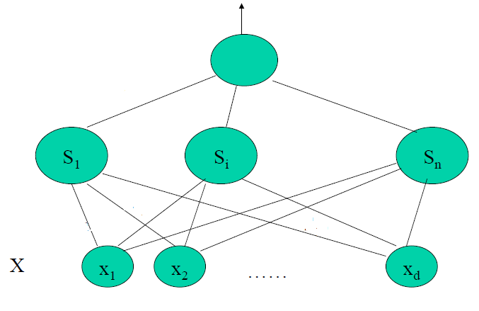
Connection between SVM and NN?

Slide 141
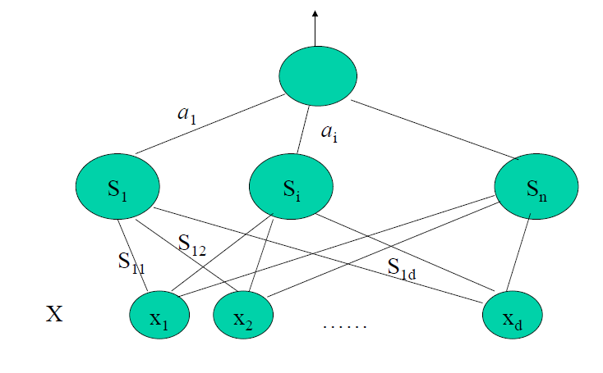
Connection Between SVM and NN

Slide 142
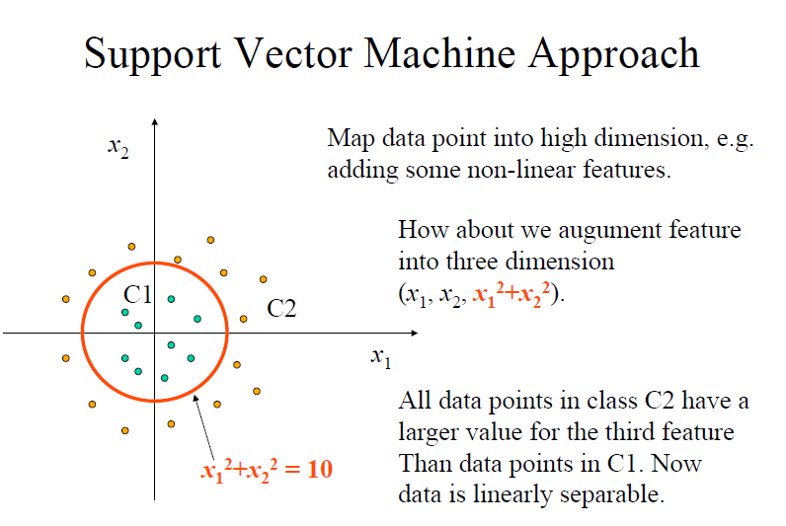

Slide 143
SVM Kernel Mapping Demo
http://www.youtube.com/watch?v=3liCbRZPrZA

Slide 144
Dual Optimization

Slide 145
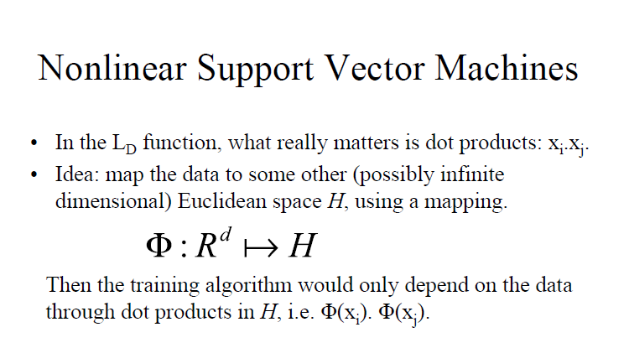

Slide 146
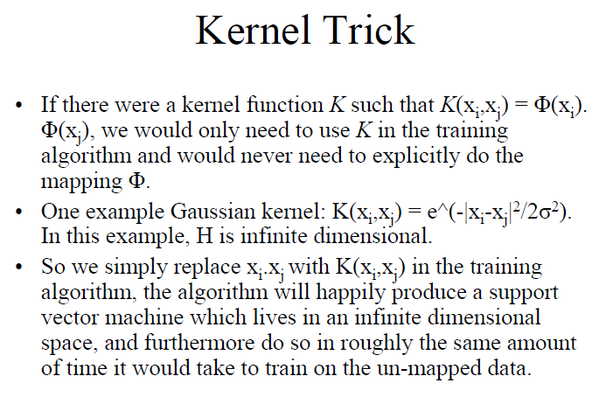

Slide 147
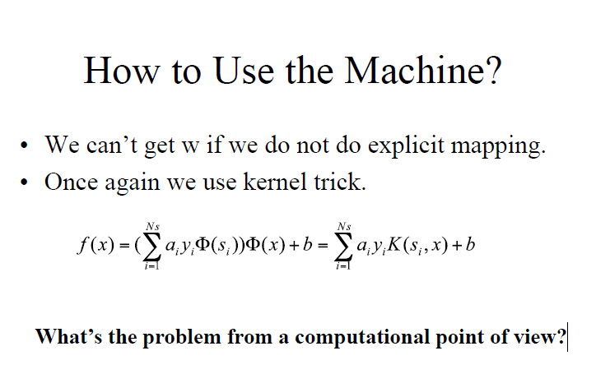

Slide 148
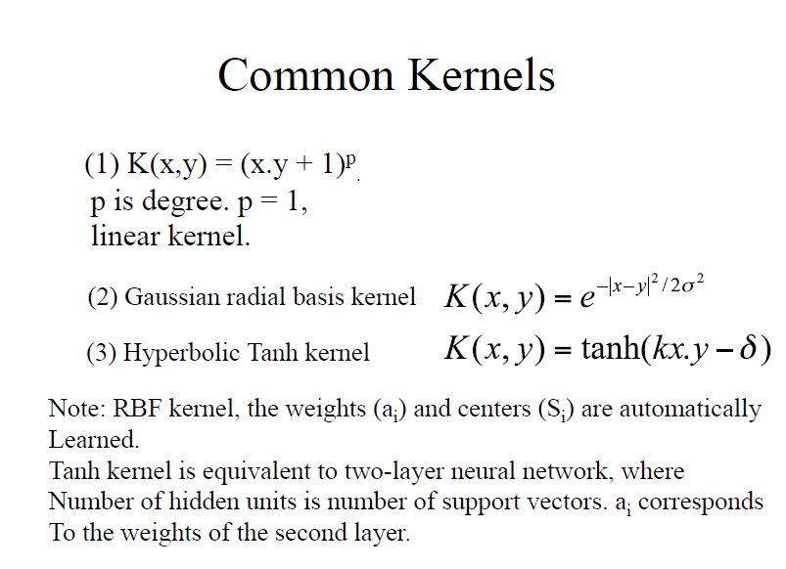

Slide 149
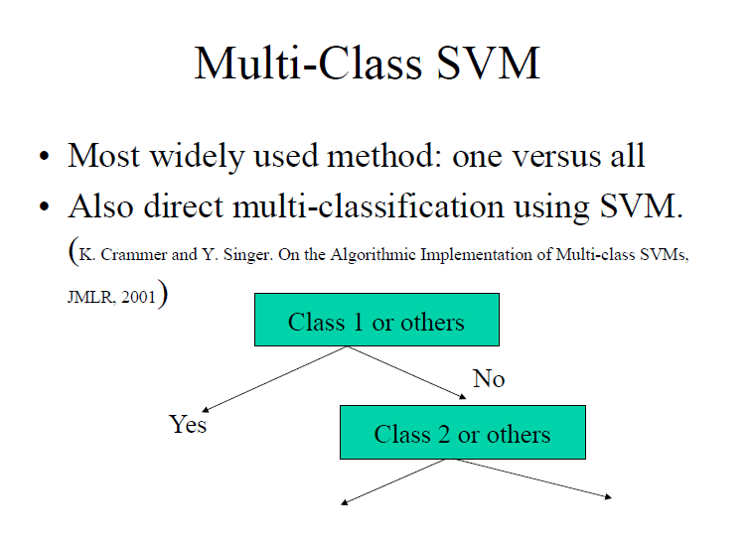

Slide 150


Slide 151


Slide 152
SVM vs. Neural Network
SVM
  Hot in late 1990s and early 2000
  Deterministic algorithm
  Nice Generalization properties
  Hard to learn – learned in batch mode using quadratic programming techniques
  Using kernels can learn very complex functions
Neural Network
  Relatively old, but hot again
  Nondeterministic algorithm
  Generalizes well
  Can easily be learned in incremental fashion
  To learn complex functions—use multilayer perceptron (not that trivial)
  Local minima

Slide 153
SVM Tools
SVM-light: http://svmlight.joachims.org/
LIBSVM: http://www.csie.ntu.edu.tw/~cjlin/libsvm/
Gist: http://bioinformatics.ubc.ca/gist/
Weka

Slide 154
SVM Related Links
SVM Website
  http://www.kernel-machines.org/
Representative implementations
  LIBSVM: an efficient implementation of SVM, multi-class classifications, nu-SVM, one-class SVM, including also various interfaces with java, python, etc.
  SVM-light: simpler but performance is not better than LIBSVM, support only binary classification and only C language
  SVM-torch: another recent implementation also written in C.

Slide 155
SVM Demo (Weka)

Slide 156
SVM—Introduction Literature
“Statistical Learning Theory” by Vapnik: extremely hard to understand, containing many errors too.
C. J. C. Burges. A Tutorial on Support Vector Machines for Pattern Recognition. Knowledge Discovery and Data Mining, 2(2), 1998.
The book “An Introduction to Support Vector Machines” by N. Cristianini and J. Shawe-Taylor
The neural network book by Haykins
  Contains one nice chapter of SVM introduction

Slide 157
Chapter 8-9. Classification and Prediction
What is classification? What is prediction?
Issues regarding classification and prediction
Classification by decision tree induction
Bayesian classification
Rule-based classification
Classification by back propagation
Support Vector Machines (SVM)
Associative classification
Lazy learners (or learning from your neighbors)
Other classification methods
Prediction
Accuracy and error measures
Ensemble methods
Model selection
Summary

Slide 158
Associative Classification
Associative classification
  Association rules are generated and analyzed for use in classification
  Search for strong associations between frequent patterns (conjunctions of attribute-value pairs) and class labels
  Classification: Based on evaluating a set of rules in the form of
      P₁ ^ p₂ … ^ p_{l} → “A_{class} = C” (conf, sup)
Why effective?
  It explores highly confident associations among multiple attributes and may overcome some constraints introduced by decision-tree induction, which considers only one attribute at a time
  In many studies, associative classification has been found to be more accurate than some traditional classification methods, such as C4.5

Slide 159
Typical Associative Classification Methods
CBA (Classification By Association: Liu, Hsu & Ma, KDD’98)
  Mine association possible rules in the form of
    Cond-set (a set of attribute-value pairs) → class label
  Build classifier: Organize rules according to decreasing precedence based on confidence and then support
CMAR (Classification based on Multiple Association Rules: Li, Han, Pei, ICDM’01)
  Classification: Statistical analysis on multiple rules

Slide 160
A Closer Look at CMAR
CMAR (Classification based on Multiple Association Rules: Li, Han, Pei, ICDM’01)
Efficiency: Uses an enhanced FP-tree that maintains the distribution of class labels among tuples satisfying each frequent itemset
Rule pruning whenever a rule is inserted into the tree
  Given two rules, R₁ and R₂, if the antecedent of R₁ is more general than that of R₂ and conf(R₁) ≥ conf(R₂), then R₂ is pruned
  Prunes rules for which the rule antecedent and class are not positively correlated, based on a χ² test of statistical significance
Classification based on generated/pruned rules
  If only one rule satisfies tuple X, assign the class label of the rule
  If a rule set S satisfies X, CMAR
    divides S into groups according to class labels
    uses a weighted χ² measure to find the strongest group of rules, based on the statistical correlation of rules within a group
    assigns X the class label of the strongest group

Slide 161


Associative Classification May Achieve High Accuracy and Efficiency (Cong et al. SIGMOD05)

Slide 162
Chapter 8-9. Classification and Prediction
What is classification? What is prediction?
Issues regarding classification and prediction
Classification by decision tree induction
Bayesian classification
Rule-based classification
Classification by back propagation
Support Vector Machines (SVM)
Associative classification
Lazy learners (or learning from your neighbors)
Other classification methods
Prediction
Accuracy and error measures
Ensemble methods
Model selection
Summary

Slide 163
Lazy vs. Eager Learning
Lazy vs. eager learning
  Lazy learning (e.g., instance-based learning): Simply stores training data (or only minor processing) and waits until it is given a test tuple
  Eager learning (the above discussed methods): Given a set of training set, constructs a classification model before receiving new (e.g., test) data to classify
Lazy: less time in training but more time in predicting
Accuracy
  Lazy method effectively uses a richer hypothesis space since it uses many local linear functions to form its implicit global approximation to the target function
  Eager: must commit to a single hypothesis that covers the entire instance space

Slide 164
Lazy Learner: Instance-Based Methods
Instance-based learning:
  Store training examples and delay the processing (“lazy evaluation”) until a new instance must be classified
Typical approaches
  k-nearest neighbor approach
    Instances represented as points in a Euclidean space.
  Locally weighted regression
    Constructs local approximation

Slide 165
The k-Nearest Neighbor Algorithm
All instances correspond to points in the n-D space
The nearest neighbor are defined in terms of Euclidean distance, dist(X₁, X₂)
Target function could be discrete- or real- valued
For discrete-valued, k-NN returns the most common value among the k training examples nearest to x_{q}
Vonoroi diagram: the decision surface induced by 1-NN for a typical set of training examples
_
.
_
_
.
+
_
.
+
.
.
_
x_{q}
+
_
.
+

Slide 166
Discussion on the k-NN Algorithm
k-NN for real-valued prediction for a given unknown tuple
  Returns the mean values of the k nearest neighbors
Distance-weighted nearest neighbor algorithm
  Weight the contribution of each of the k neighbors according to their distance to the query x_{q}
    Give greater weight to closer neighbors
Robust to noisy data by averaging k-nearest neighbors
Curse of dimensionality: distance between neighbors could be dominated by irrelevant attributes
  To overcome it, elimination of the least relevant attributes

Slide 167
Chapter 6. Classification and Prediction
What is classification? What is prediction?
Issues regarding classification and prediction
Classification by decision tree induction
Bayesian classification
Rule-based classification
Classification by back propagation
Support Vector Machines (SVM)
Associative classification
Lazy learners (or learning from your neighbors)
Other classification methods
Prediction
Accuracy and error measures
Ensemble methods
Model selection
Summary

Slide 168
Chapter 6. Classification and Prediction
What is classification? What is prediction?
Issues regarding classification and prediction
Classification by decision tree induction
Bayesian classification
Rule-based classification
Classification by back propagation
Support Vector Machines (SVM)
Associative classification
Lazy learners (or learning from your neighbors)
Other classification methods
Regression
Accuracy and error measures
Ensemble methods
Model selection
Summary

Slide 169
What Is Regression?
(Numerical) prediction / regression is similar to classification
  construct a model
  use model to predict continuous or ordered value for a given input
Regression is different from classification
  Classification refers to predict categorical class label
  Regression models continuous-valued functions
Major method for prediction of real value: regression
  model the relationship between one or more independent or predictor variables and a dependent or response variable
Regression analysis
  Linear and multiple regression
  Non-linear regression (neural networks, support vector machines, KNN)
  Other regression methods: generalized linear model, Poisson regression, log-linear models, regression trees

Slide 170
Linear Regression
Linear regression: involves a response variable y and a single predictor variable x
    y = w₀ + w₁ x
  where w₀ (y-intercept) and w₁ (slope) are regression coefficients
Method of least squares: estimates the best-fitting straight line
Multiple linear regression: involves more than one predictor variable
  Training data is of the form (X₁, y₁), (X₂, y₂),…, (X_{|D|}, y_{|D|})
  Solvable by extension of least square method or using R, SAS, S-Plus

Slide 171


Slide 172


Slide 173
Nonlinear Regression
Some nonlinear models can be modeled by a polynomial function
A polynomial regression model can be transformed into linear regression model. For example,
    y = w₀ + w₁ x + w₂ x² + w₃ x³
  convertible to linear with new variables: x₂ = x², x₃= x³
    y = w₀ + w₁ x + w₂ x₂ + w₃ x₃

Slide 174
Other Regression-Based Models
Generalized linear model:
  Foundation on which linear regression can be applied to modeling categorical response variables
  Logistic regression: models the prob. of some event occurring as a linear function of a set of predictor variables
Regression trees and model trees
  Trees to predict continuous values rather than class labels

Slide 175


Slide 176
Logistic Regression
X1 | X2 | … | Die / Live
0.01 | 0.004 |  | 1
0.001 | 0.02 |  | 0
…
…
0.003 | 0.005 |  | 1
Binomial distribution:
For one dose level x_{i}, y_{i} = P(die|x_{i}), likelihood = y_{i}^{ti}(1-y_{i})^{(1-ti)}
Maximize likelihood is equivalent to minimize negative log-likelihood:
-t_{i}log(y_{i}) – (1 - t_{i})log(1 – y_{i})

Slide 177

Logistic Regression As One Layer Neural Network – Gradient Descent

Slide 178


Slide 179
Regression Trees and Model Trees
Regression tree: proposed in CART system (Breiman et al. 1984)
  CART: Classification And Regression Trees
  Each leaf stores a continuous-valued prediction
  It is the average value of the predicted attribute for the training tuples that reach the leaf
Model tree: proposed by Quinlan (1992)
  Each leaf holds a regression model—a multivariate linear equation for the predicted attribute
  A more general case than regression tree
Regression and model trees tend to be more accurate than linear regression when the data are not represented well by a simple linear model

Slide 180

How to Partition Data
Minimize Square Errors
www.stat.cmu.edu/~cshalizi/350-2006/lecture-10.pdf

Slide 181
Algorithm
Start with a single node containing all points. Calculate m_{c} and S.
2. If all the points in the node have the same value for all the independent variables, stop. Otherwise, search over the splits of all variables for the one which will reduce S as much as possible. If the largest decrease in S would be less than some threshold , or one of the resulting nodes would contain less than q points, stop. Otherwise, take that split, creating two new nodes.
3. In each new node, go back to step 1.
www.stat.cmu.edu/~cshalizi/350-2006/lecture-10.pdf

Slide 182

Regression tree for prices of 1993 model cars. All values are standardized in [-1, 1]

Slide 183

www.stat.cmu.edu/~cshalizi/350-2006/lecture-10.pdf

Slide 184
Chapter 8-9. Classification and Prediction
What is classification? What is prediction?
Issues regarding classification and prediction
Classification by decision tree induction
Bayesian classification
Rule-based classification
Classification by back propagation
Support Vector Machines (SVM)
Associative classification
Lazy learners (or learning from your neighbors)
Other classification methods
Prediction
Accuracy and error measures
Ensemble methods
Model selection
Summary

Slide 185
Classifier Accuracy Measures
 | C_{1(Pre)} | C_{2(pre)}
C₁ | True positive | False negative
C₂ | False positive | True negative
classes | buy_computer = yes | buy_computer = no | total | recognition(%)
buy_computer = yes | 6954 | 46 | 7000 | 99.34
buy_computer = no | 412 | 2588 | 3000 | 86.27
total | 7366 | 2634 | 10000 | 95.52
Accuracy of a classifier M, acc(M): percentage of test set tuples that are correctly classified by the model M
  Error rate (misclassification rate) of M = 1 – acc(M)
  Given m classes, CM_{i,j}, an entry in a confusion matrix, indicates # of tuples in class i that are labeled by the classifier as class j
Alternative accuracy measures (e.g., for cancer diagnosis)
  sensitivity = t-pos/pos /* true positive recognition rate */
  specificity = t-neg/neg /* true negative recognition rate */
  precision = t-pos/(t-pos + f-pos)
  accuracy = sensitivity * pos/(pos + neg) + specificity * neg/(pos + neg)
  This model can also be used for cost-benefit analysis

Slide 186
Predictor Error Measures
Measure predictor accuracy: measure how far off the predicted value is from the actual known value
Loss function: measures the error betw. y_{i} and the predicted value y_{i}’
  Absolute error: | y_{i} – y_{i}’|
  Squared error: (y_{i} – y_{i}’)²
Test error (generalization error): the average loss over the test set
  Mean absolute error: Mean squared error:
  Relative absolute error: Relative squared error:
  The mean squared-error exaggerates the presence of outliers
  Popularly use (square) root mean-square error, similarly, root relative squared error

Slide 187
Evaluating the Accuracy of a Classifier or Predictor (I)
Holdout method
  Given data is randomly partitioned into two independent sets
    Training set (e.g., 2/3) for model construction
    Test set (e.g., 1/3) for accuracy estimation
  Random sampling: a variation of holdout
    Repeat holdout k times, accuracy = avg. of the accuracies obtained
Cross-validation (k-fold, where k = 10 is most popular)
  Randomly partition the data into k mutually exclusive subsets, each approximately equal size
  At i-th iteration, use D_{i} as test set and others as training set
  Leave`-one-out: k folds where k = # of tuples, for small sized data
  Stratified cross-validation: folds are stratified so that class dist. in each fold is approx. the same as that in the initial data

Slide 188
Evaluating the Accuracy of a Classifier or Predictor (II)
Bootstrap
  Works well with small data sets
  Samples the given training tuples uniformly with replacement
    i.e., each time a tuple is selected, it is equally likely to be selected again and re-added to the training set
Several boostrap methods, and a common one is .632 boostrap
  Suppose we are given a data set of d tuples. The data set is sampled d times, with replacement, resulting in a training set of d samples. The data tuples that did not make it into the training set end up forming the test set. About 63.2% of the original data will end up in the bootstrap, and the remaining 36.8% will form the test set (since (1 – 1/d)^{d} ≈ e⁻¹ = 0.368)
  Repeat the sampling procedue k times, overall accuracy of the model:

Slide 189
Chapter 8-9. Classification and Prediction
What is classification? What is prediction?
Issues regarding classification and prediction
Classification by decision tree induction
Bayesian classification
Rule-based classification
Classification by back propagation
Support Vector Machines (SVM)
Associative classification
Lazy learners (or learning from your neighbors)
Other classification methods
Prediction
Accuracy and error measures
Ensemble methods
Model selection
Summary

Slide 190

Ensemble Methods: Increasing the Accuracy
Ensemble methods
  Use a combination of models to increase accuracy
  Combine a series of k learned models, M₁, M₂, …, M_{k}, with the aim of creating an improved model M*
Popular ensemble methods
  Bagging: averaging the prediction over a collection of classifiers (e.g. Random Forest)
  Boosting: weighted vote with a collection of classifiers
  Ensemble: combining a set of heterogeneous classifiers

Slide 191
Bagging: Boostrap Aggregation
Analogy: Diagnosis based on multiple doctors’ majority vote
Training
  Given a set D of d tuples, at each iteration i, a training set D_{i} of d tuples is sampled with replacement from D (i.e., boostrap)
  A classifier model M_{i} is learned for each training set D_{i}
Classification: classify an unknown sample X
  Each classifier M_{i} returns its class prediction
  The bagged classifier M* counts the votes and assigns the class with the most votes to X
Prediction: can be applied to the prediction of continuous values by taking the average value of each prediction for a given test tuple
Accuracy
  Often significant better than a single classifier derived from D
  For noise data: not considerably worse, more robust
  Proved improved accuracy in prediction

Slide 192
Boosting
Analogy: Consult several doctors, based on a combination of weighted diagnoses—weight assigned based on the previous diagnosis accuracy
How boosting works?
  Weights are assigned to each training tuple
  A series of k classifiers is iteratively learned
  After a classifier M_{i} is learned, the weights are updated to allow the subsequent classifier, M_{i+1}, to pay more attention to the training tuples that were misclassified by M_{i}
  The final M* combines the votes of each individual classifier, where the weight of each classifier's vote is a function of its accuracy
The boosting algorithm can be extended for the prediction of continuous values
Comparing with bagging: boosting tends to achieve greater accuracy, but it also risks overfitting the model to misclassified data

Slide 193
Adaboost (Freund and Schapire, 1997)
Given a set of d class-labeled tuples, (X₁, y₁), …, (X_{d}, y_{d})
Initially, all the weights of tuples are set the same (1/d)
Generate k classifiers in k rounds. At round i,
  Tuples from D are sampled (with replacement) to form a training set D_{i} of the same size
  Each tuple’s chance of being selected is based on its weight
  A classification model M_{i} is derived from D_{i}
  Its error rate is calculated using D_{i} as a test set
  If a tuple is misclassified, its weight is increased, o.w. it is decreased
Error rate: err(X_{j}) is the misclassification error of tuple X_{j}. Classifier M_{i} error rate is the sum of the weights of the misclassified tuples:
The weight of classifier M_{i}’s vote is

Slide 194
Chapter 9. Classification and Prediction
What is classification? What is prediction?
Issues regarding classification and prediction
Classification by decision tree induction
Bayesian classification
Rule-based classification
Classification by back propagation
Support Vector Machines (SVM)
Associative classification
Lazy learners (or learning from your neighbors)
Other classification methods
Prediction
Accuracy and error measures
Ensemble methods
Model selection
Summary

Slide 195
Model Selection: ROC Curves
ROC (Receiver Operating Characteristics) curves: for visual comparison of classification models
Originated from signal detection theory
Shows the trade-off between the true positive rate and the false positive rate
The area under the ROC curve is a measure of the accuracy of the model
The closer to the diagonal line (i.e., the closer the area is to 0.5), the less accurate is the model
Vertical axis represents the true positive rate
Horizontal axis rep. the false positive rate
The plot also shows a diagonal line
A model with perfect accuracy will have an area of 1.0

Slide 196


AUC-ROC Curve in Machine Learning

Slide 197


AUC-ROC Curve in Machine Learning

Slide 198
Chapter 8-9. Classification and Prediction
What is classification? What is prediction?
Issues regarding classification and prediction
Classification by decision tree induction
Bayesian classification
Rule-based classification
Classification by back propagation
Support Vector Machines (SVM)
Associative classification
Lazy learners (or learning from your neighbors)
Other classification methods
Prediction
Accuracy and error measures
Ensemble methods
Model selection
Summary

Slide 199
Summary (I)
Classification and regression are two forms of data analysis that can be used to extract models describing important data classes or to predict future data trends.
Effective and scalable methods have been developed for decision trees induction, Naive Bayesian classification, Bayesian belief network, rule-based classifier, Backpropagation, Support Vector Machine (SVM), associative classification, nearest neighbor classifiers.
Linear, nonlinear, and generalized linear models of regression can be used for prediction. Many nonlinear problems can be converted to linear problems by performing transformations on the predictor variables. Regression trees are also used for prediction.

Slide 200
Summary (II)
Stratified k-fold cross-validation is a recommended method for accuracy estimation. Bagging and boosting can be used to increase overall accuracy by learning and combining a series of individual models.
Significance tests and ROC curves are useful for model selection
There have been numerous comparisons of the different classification and prediction methods, and the matter remains a research topic
No single method has been found to be superior over all others for all data sets
Issues such as accuracy, training time, robustness, interpretability, and scalability must be considered and can involve trade-offs, further complicating the quest for an overall superior method

Slide 201
References (1)
C. Apte and S. Weiss. Data mining with decision trees and decision rules. Future Generation Computer Systems, 13, 1997.
C. M. Bishop, Neural Networks for Pattern Recognition. Oxford University Press, 1995.
L. Breiman, J. Friedman, R. Olshen, and C. Stone. Classification and Regression Trees. Wadsworth International Group, 1984.
C. J. C. Burges. A Tutorial on Support Vector Machines for Pattern Recognition. Data Mining and Knowledge Discovery, 2(2): 121-168, 1998.
P. K. Chan and S. J. Stolfo. Learning arbiter and combiner trees from partitioned data for scaling machine learning. KDD'95.
W. Cohen. Fast effective rule induction. ICML'95.
G. Cong, K.-L. Tan, A. K. H. Tung, and X. Xu. Mining top-k covering rule groups for gene expression data. SIGMOD'05.
A. J. Dobson. An Introduction to Generalized Linear Models. Chapman and Hall, 1990.
G. Dong and J. Li. Efficient mining of emerging patterns: Discovering trends and differences. KDD'99.

Slide 202
References (2)
R. O. Duda, P. E. Hart, and D. G. Stork. Pattern Classification, 2ed. John Wiley and Sons, 2001
U. M. Fayyad. Branching on attribute values in decision tree generation. AAAI’94.
Y. Freund and R. E. Schapire. A decision-theoretic generalization of on-line learning and an application to boosting. J. Computer and System Sciences, 1997.
J. Gehrke, R. Ramakrishnan, and V. Ganti. Rainforest: A framework for fast decision tree construction of large datasets. VLDB’98.
J. Gehrke, V. Gant, R. Ramakrishnan, and W.-Y. Loh, BOAT -- Optimistic Decision Tree Construction. SIGMOD'99.
T. Hastie, R. Tibshirani, and J. Friedman. The Elements of Statistical Learning: Data Mining, Inference, and Prediction. Springer-Verlag, 2001.
D. Heckerman, D. Geiger, and D. M. Chickering. Learning Bayesian networks: The combination of knowledge and statistical data. Machine Learning, 1995.
M. Kamber, L. Winstone, W. Gong, S. Cheng, and J. Han. Generalization and decision tree induction: Efficient classification in data mining. RIDE'97.
B. Liu, W. Hsu, and Y. Ma. Integrating Classification and Association Rule. KDD'98.
W. Li, J. Han, and J. Pei, CMAR: Accurate and Efficient Classification Based on Multiple Class-Association Rules, ICDM'01.

Slide 203
References (3)
T.-S. Lim, W.-Y. Loh, and Y.-S. Shih. A comparison of prediction accuracy, complexity, and training time of thirty-three old and new classification algorithms. Machine Learning, 2000.
J. Magidson. The Chaid approach to segmentation modeling: Chi-squared automatic interaction detection. In R. P. Bagozzi, editor, Advanced Methods of Marketing Research, Blackwell Business, 1994.
M. Mehta, R. Agrawal, and J. Rissanen. SLIQ : A fast scalable classifier for data mining. EDBT'96.
T. M. Mitchell. Machine Learning. McGraw Hill, 1997.
S. K. Murthy, Automatic Construction of Decision Trees from Data: A Multi-Disciplinary Survey, Data Mining and Knowledge Discovery 2(4): 345-389, 1998
J. R. Quinlan. Induction of decision trees. Machine Learning, 1:81-106, 1986.
J. R. Quinlan and R. M. Cameron-Jones. FOIL: A midterm report. ECML’93.
J. R. Quinlan. C4.5: Programs for Machine Learning. Morgan Kaufmann, 1993.
J. R. Quinlan. Bagging, boosting, and c4.5. AAAI'96.

Slide 204
References (4)
R. Rastogi and K. Shim. Public: A decision tree classifier that integrates building and pruning. VLDB’98.
J. Shafer, R. Agrawal, and M. Mehta. SPRINT : A scalable parallel classifier for data mining. VLDB’96.
J. W. Shavlik and T. G. Dietterich. Readings in Machine Learning. Morgan Kaufmann, 1990.
P. Tan, M. Steinbach, and V. Kumar. Introduction to Data Mining. Addison Wesley, 2005.
S. M. Weiss and C. A. Kulikowski. Computer Systems that Learn: Classification and Prediction Methods from Statistics, Neural Nets, Machine Learning, and Expert Systems. Morgan Kaufman, 1991.
S. M. Weiss and N. Indurkhya. Predictive Data Mining. Morgan Kaufmann, 1997.
I. H. Witten and E. Frank. Data Mining: Practical Machine Learning Tools and Techniques, 2ed. Morgan Kaufmann, 2005.
X. Yin and J. Han. CPAR: Classification based on predictive association rules. SDM'03
H. Yu, J. Yang, and J. Han. Classifying large data sets using SVM with hierarchical clusters. KDD'03.

